Slide 1

Neurodivergent design thinking, to create inclusive recruitment
September 2025
Ollie Sweetman and David Hopkins

Slide 2
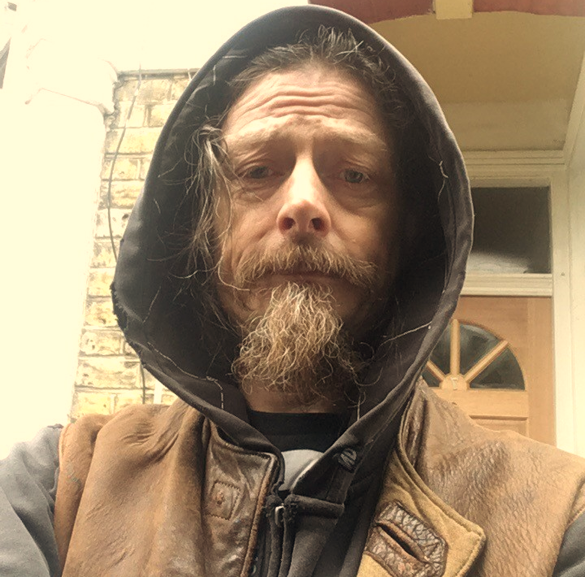
Agenda
Who we are – intros
What’s neurodiversity? Facts and figures
Why we did this
What we’ve done
Problem statement
How we got stuck
Where’s the tool now?
What we need from you
Questions
Notes:
Sooo hello, SD in gov, Edinberg 2025……and thanks for coming along to the talk,, its going to be a runthroug quickly 45 min of what we, as a volentry group of CS did,
why we did it and what we learned, we are going to take this advantage of this opportunity at the end of this brief chat to see if peeps are able to help us

Slide 3
Who we are
Notes:
, but lets first start with intros

Slide 4
Ollie Sweetman
A service designer in HMRC Policy Lab. Ollie is neurodivergent and has an extensive background in visual communication and infographic design.

Slide 5
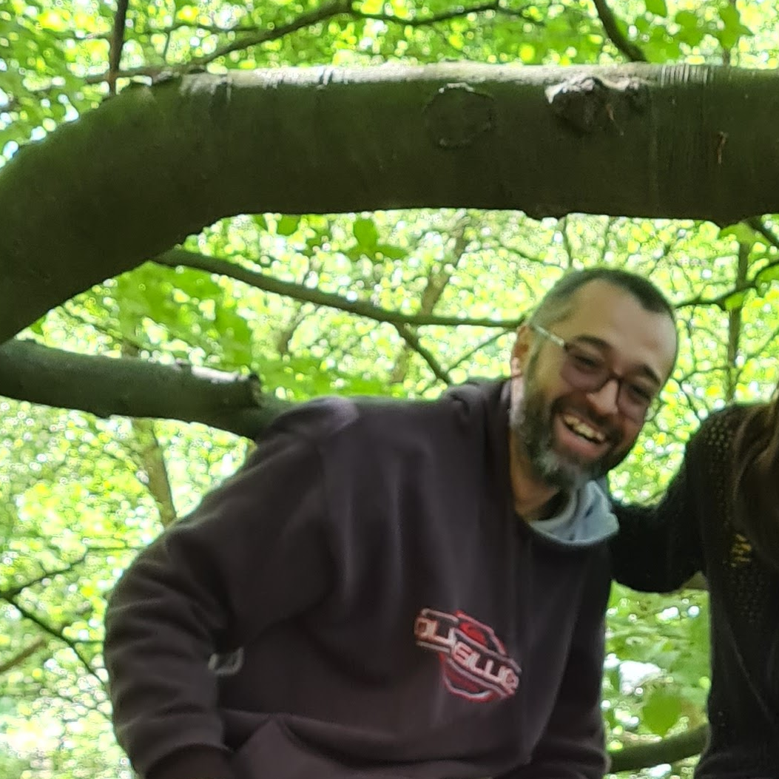
David Hopkins
A performance analyst in DWP Digital. David is proud to be autistic, a civil servant, a union rep and father figure in a neurospicy family.
He’s got depth and breadth of experience in communications, digital engagement, and data and analytics.

Slide 6









Who we’re made up of
Notes:
3 of us started out in HMRC David clare and mysely and we grew….to this .these are the groups helping on projects currently
So initially it was tory dunne (who will be around thes buildings somewhere today) ,who introduced me to clare, who is the main center pin of all the team, the go to person if you like, who introduced us all to the civil services dyslexic dysbraxic network, CSDDN which supported us to go away and think up of what we could do to improve the life of ND in the CS we started out in a 2 gov departments, but as peeps moved to different department , and we kept in touch and we grew and brought more ND talent to the group

Slide 7
Neurodiversity
Notes:
Ok we are guessing if you are here you hav an interest in ND ity, and just to be sure we will take a quick trip down definitions and facts…im going to hand over to dave

Slide 8
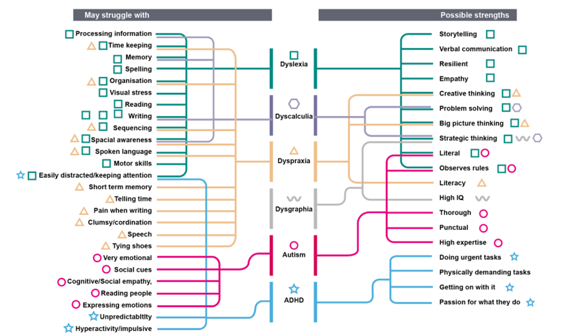
What’s neurodiversity?
Notes:
So….Neurodivergent is a term that describes people whose brains develop or work differently. This means the person has different strengths and struggles from people whose brains develop or work more typically.
When considered in a working context, it's an area of diversity and inclusion that refers to alternative thinking or behavioural styles, such as dyslexia, autism, ADHD and dyspraxia.

Slide 9
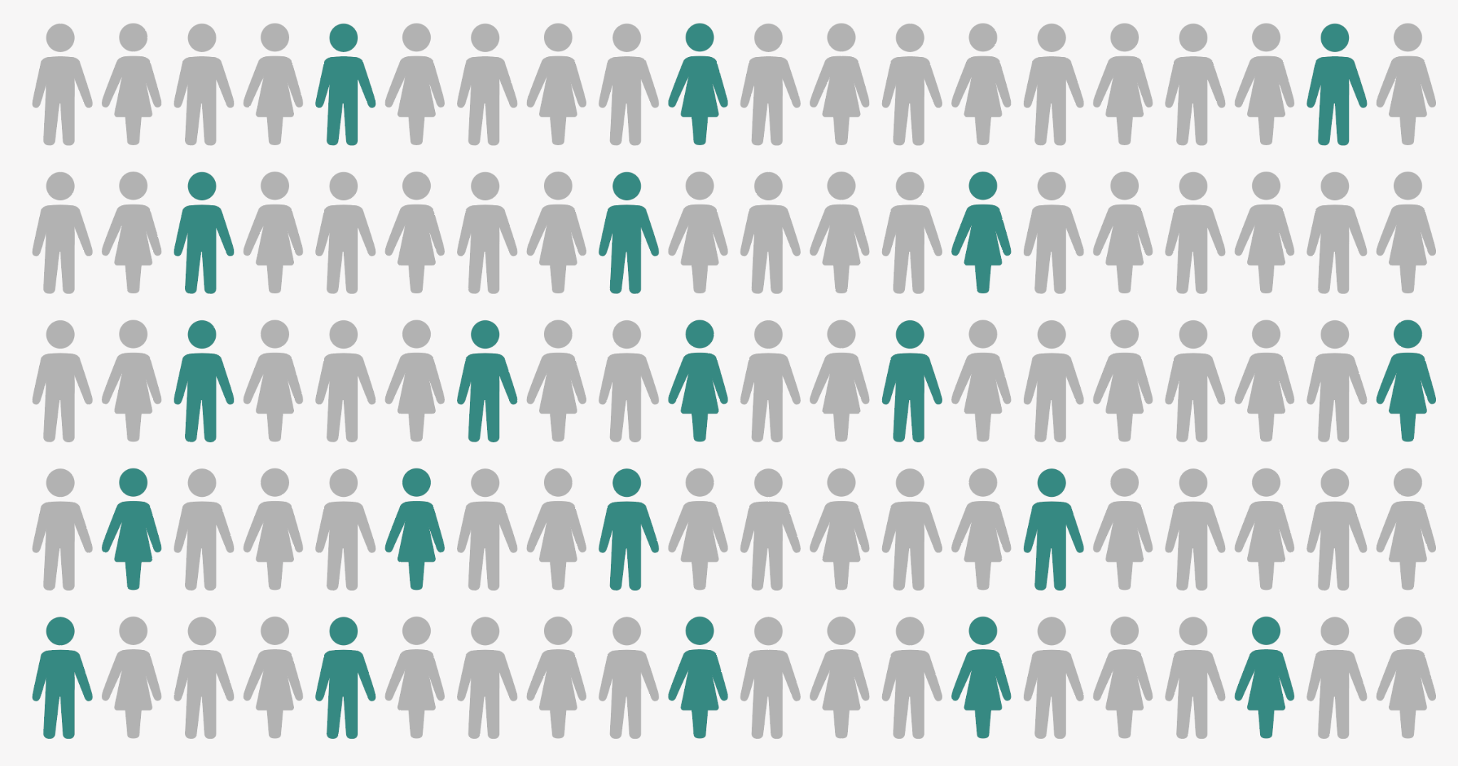
How many people are neurodivergent?
Current estimates suggest
20% of people are knowingly or unknowingly neurodivergent
Source: Doyle N (2020). Neurodiversity at work: a biopsychosocial model and the impact on working adults. British Medical Bulletin.135(1), pp. 108-125
Notes:
Neurodivergence is a non-visible disability and many neurodistinct people do not consider themselves disabled. This is relevant, as when applying for jobs people often don’t feel like they should use the Disability Confident Scheme, which allows them to apply for support they are entitled to.
Theoretically, over 110k civil servants and 1.23M public sector workers
550k CS total 6.15 PS

Slide 10
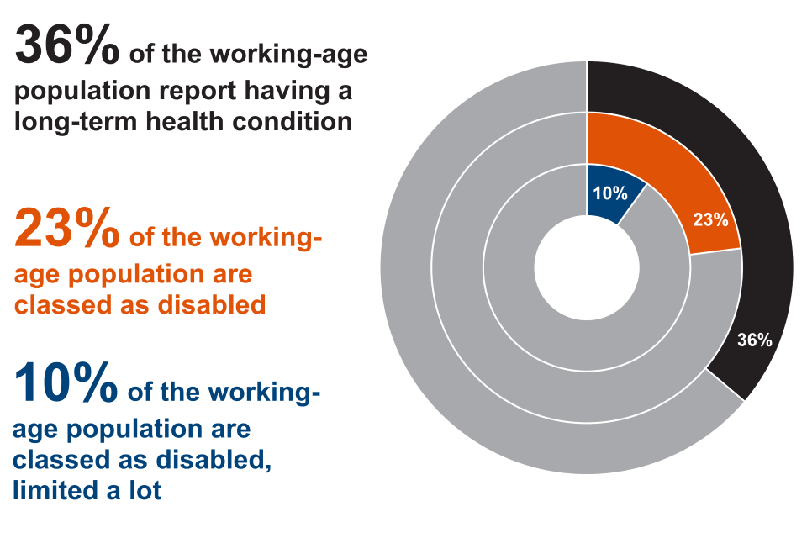
Nearly one in four of the working-age population are classed as disabled
Notes:
Source: Annual Population Survey: The employment of disabled people 2024 - GOV.UK
Lowest likelihood of employment for autistic people and those with ‘severe or specific learning difficulties’

Slide 11
Civil service diversity data continued
Most senior to least senior
Notes:
More than 1 in 4 civil servants do not declare (21%) or opt out of (5%) declaring whether they are disabled.
Representation is one issue,
in fact due to how government is relatively protective compared with other types of industry,
especially as it’s highly unionised.
So the true numbers of ND people might well exceed 1 in 4,
particularly in areas where ND strengths are valued most
Such as IT, analytical and problem-solving.
But inclusion is,… essential, and especially in management and leadership –
it’s essential to recognise and retain talent, and..
promote, invest in and retain good people
BECAUSE…

Slide 12
Why we know it’s important
It’s the right thing to do:
Ethically
Legally
Economically…
Notes:
Morally – social model
Public Sector Equality Duty – we must set the gold standard
Financial – following slide EY research

Slide 13
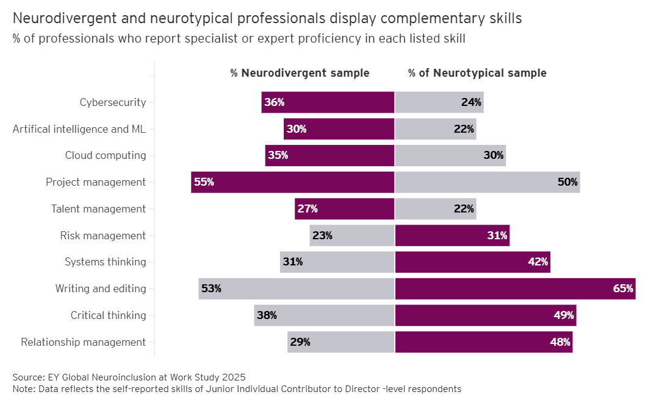
New research from EY
Acting on neuroinclusion accelerates business success | EY - Global
Notes:
ND professionals report high rates of expert or specialist proficiency in the 10 fastest-growing skills – when feeling included at work.
Chart showing some of those high demand skills and how neurodivergent and neurotypical professionals complement each other in strengths

Slide 14
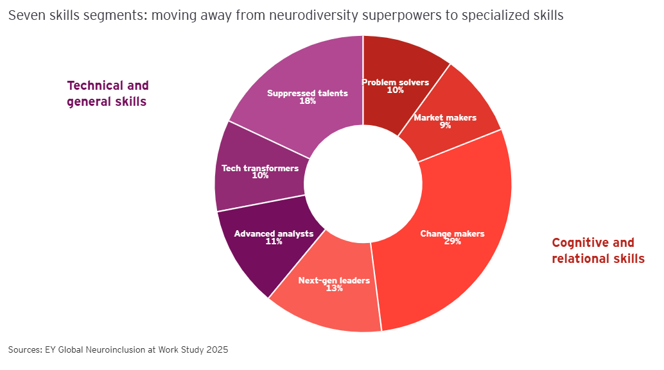
New research from EY continued
Acting on neuroinclusion accelerates business success | EY - Global
Notes:
Moving beyond labels to reimagine the potential of neurodivergent professionals
Massive global brands are putting out there that they are active looking for neurodivergent “different thinkers”
Benefits Microsoft, JPMorgan Chase, EY, BT, Google, SAP, BT, Ford, Deloitte and GCHQ found by making neurodiversity integral to their inclusion policies include: building stronger teams, diverse thinking increases creativity and innovation within teams.

Slide 15
Why are we doing this?

Slide 16
UK Civil Service keen
employ neurodivergent people
harness inherent strengths
Notes:
The UK Civil Service has and is keen to employ neurodivergent people to take full advantage of the inherent neurodivergent strengths.
BUT …Right now, there are no robust tools to help colleagues, managers or vacancy holders understand what this means.
We also understand that many neurodiverse individuals do not tick the DCS box when applying for .gov.uk roles, as they feel they will experience discrimination

Slide 17
Challenge: change
Identify steps >
better informed >
Substantial systemic change
Notes:
If we do not invest in inclusion,
we all miss out on the potential returns,
we need to identify steps,
which may be relatively small,
but lead to better informed substantial,
systemic change.

Slide 18
Consequences
Impact of in-action:
miss out on talent
less productive
lower morale
Risk of large-scale action
from legal non-compliance.
Notes:
Read above
if not addressed CS wide there could be repercussions, in line with the Equalities Act 2010. which ill explain the link between ND and it later (have we remover this?)

Slide 19
What have we done?
Notes:
So with this knowledge what did we do, and howe did we do it

Slide 20
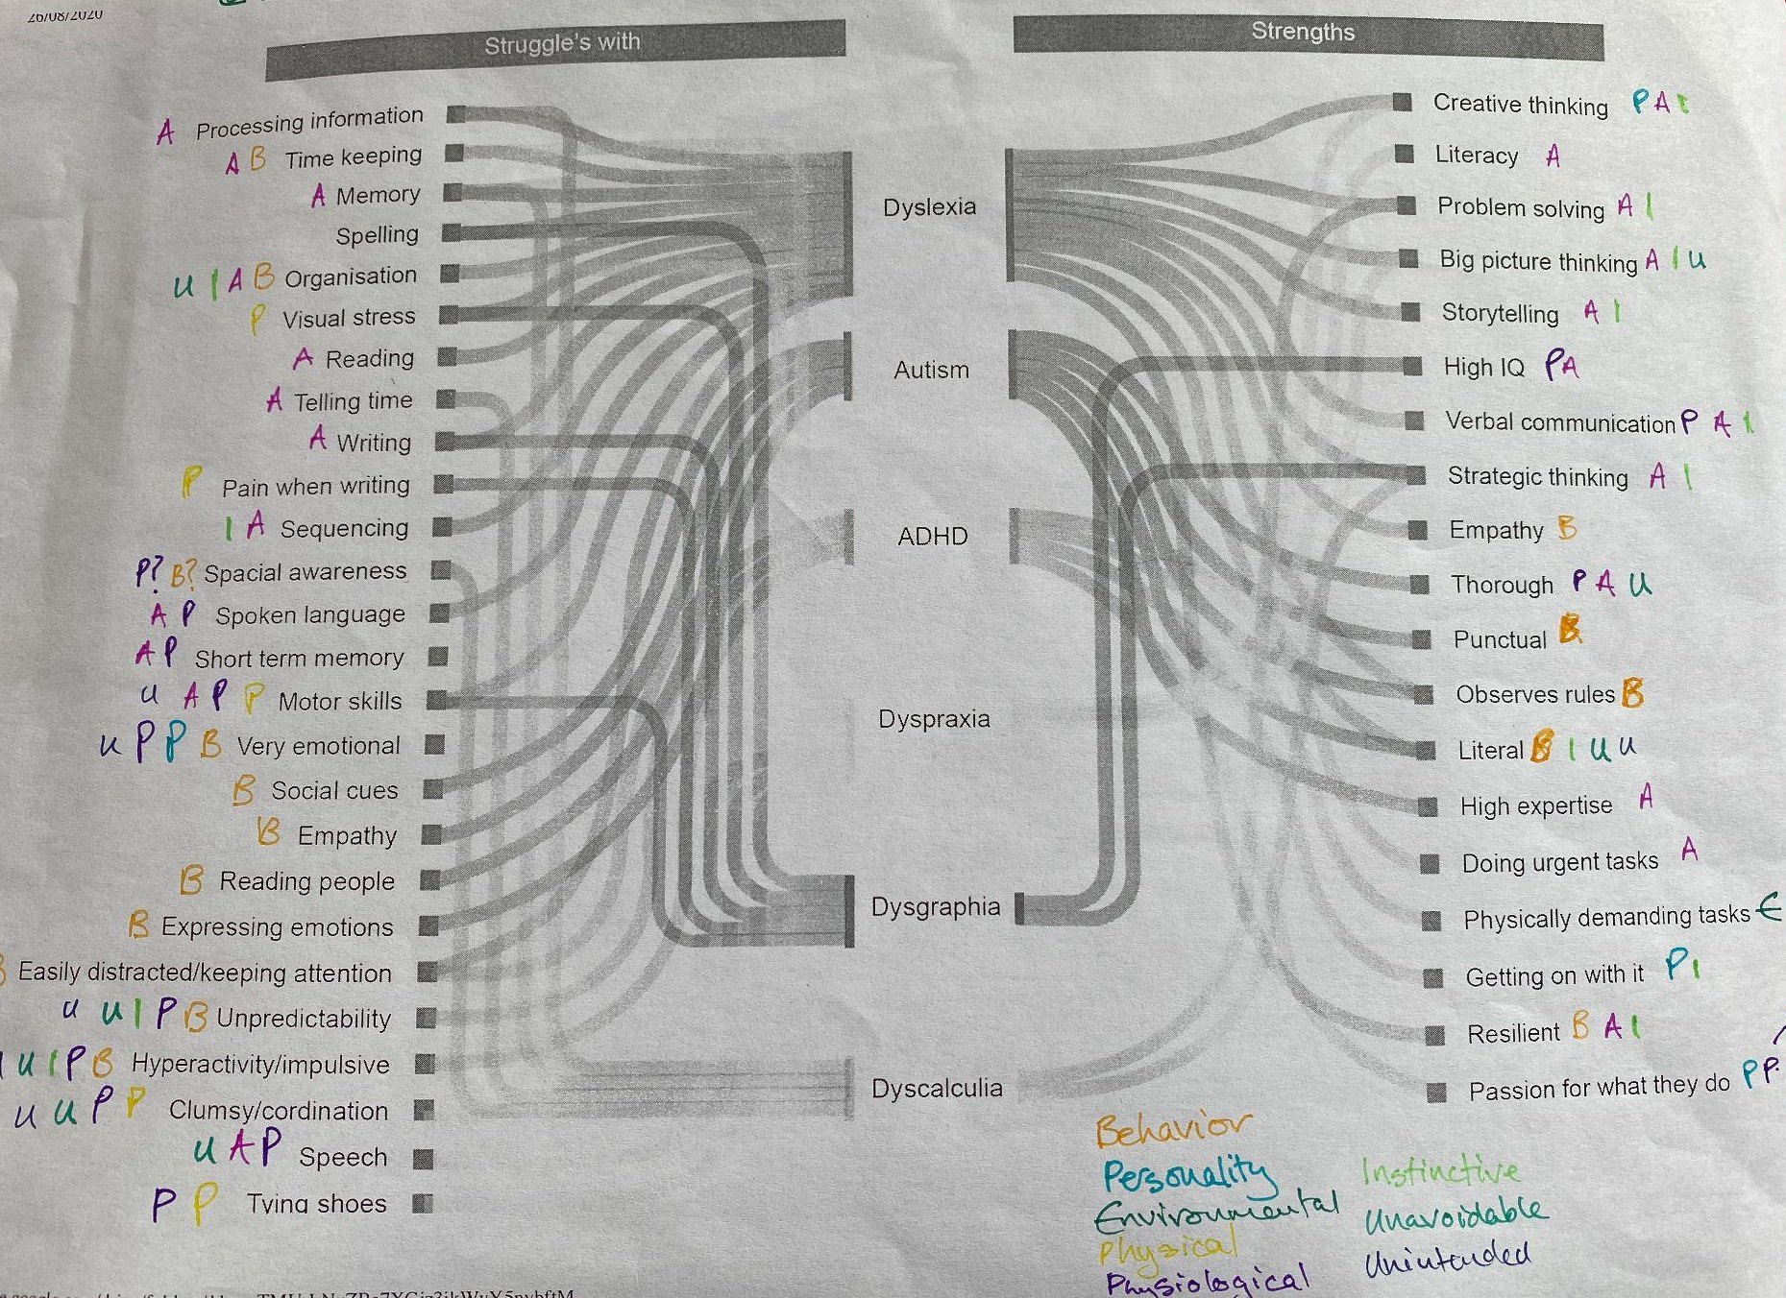
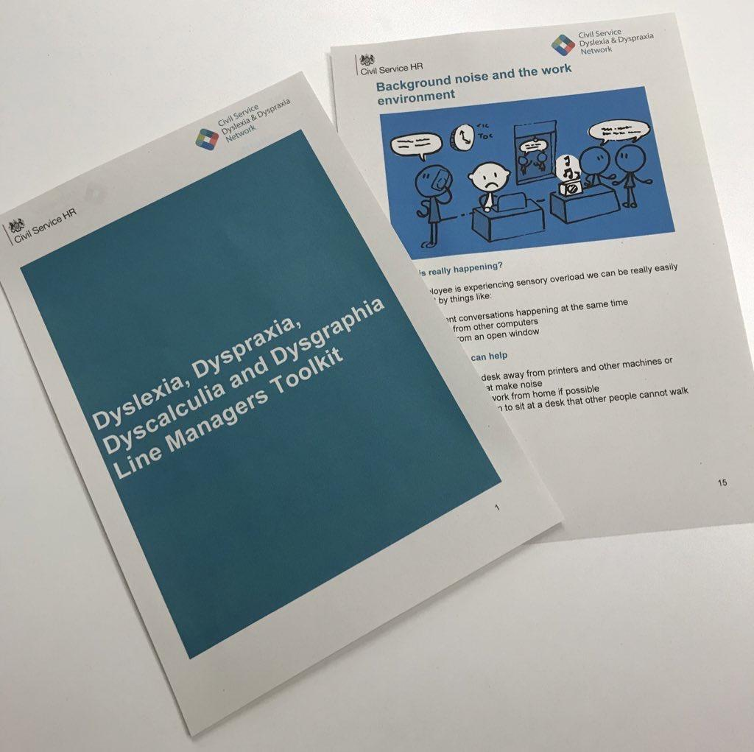
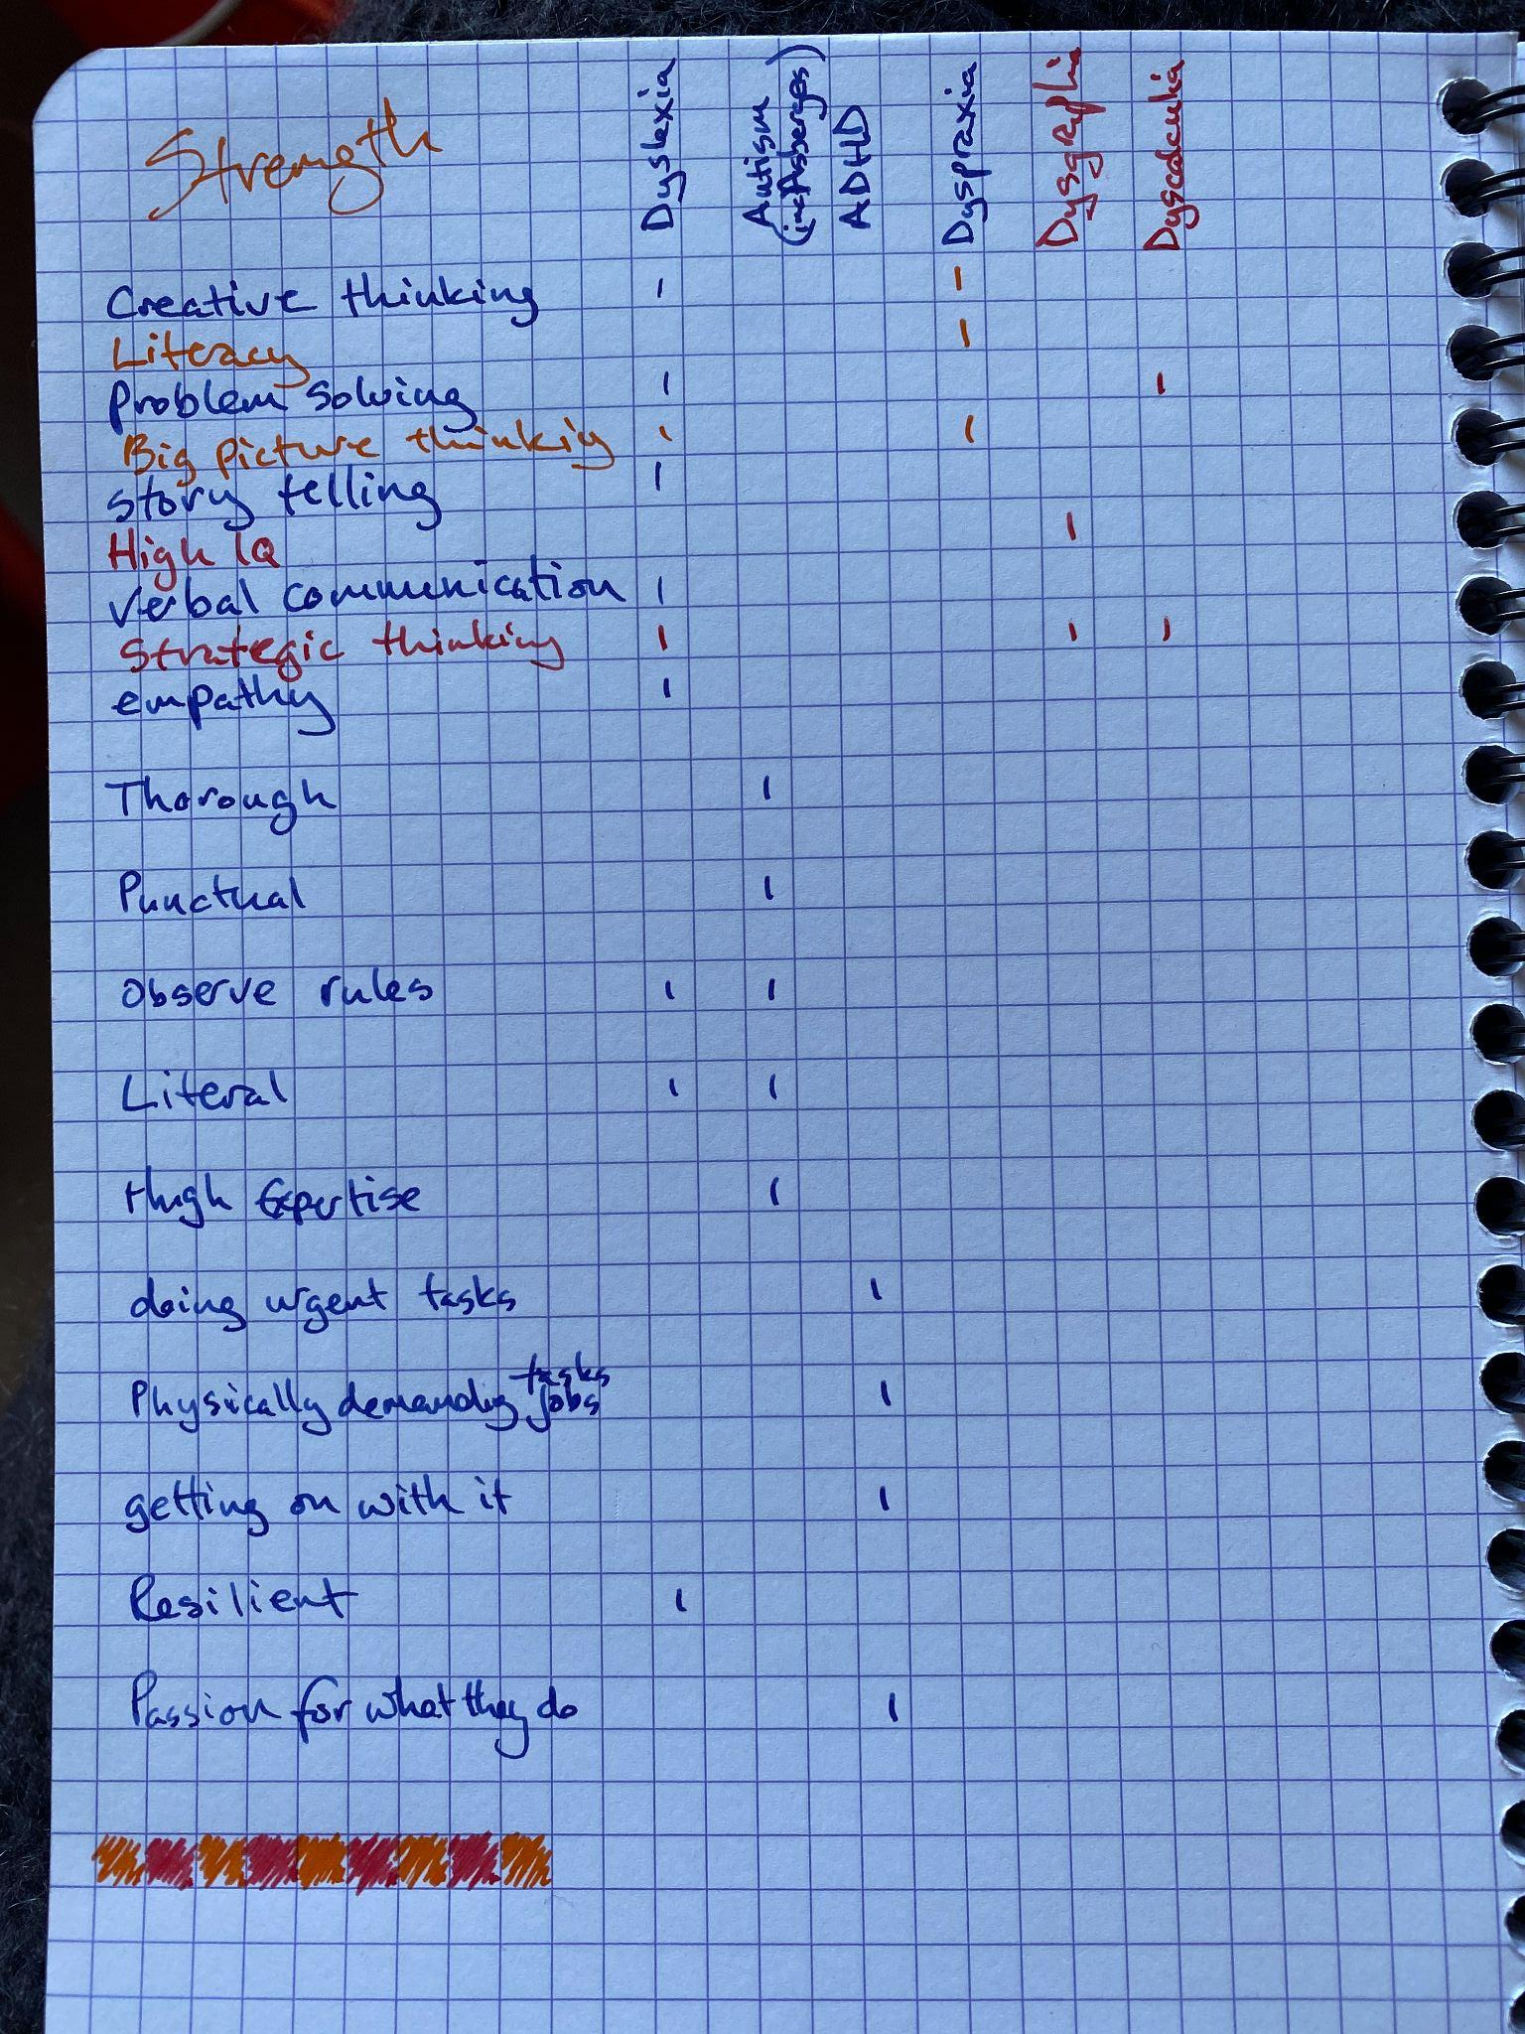
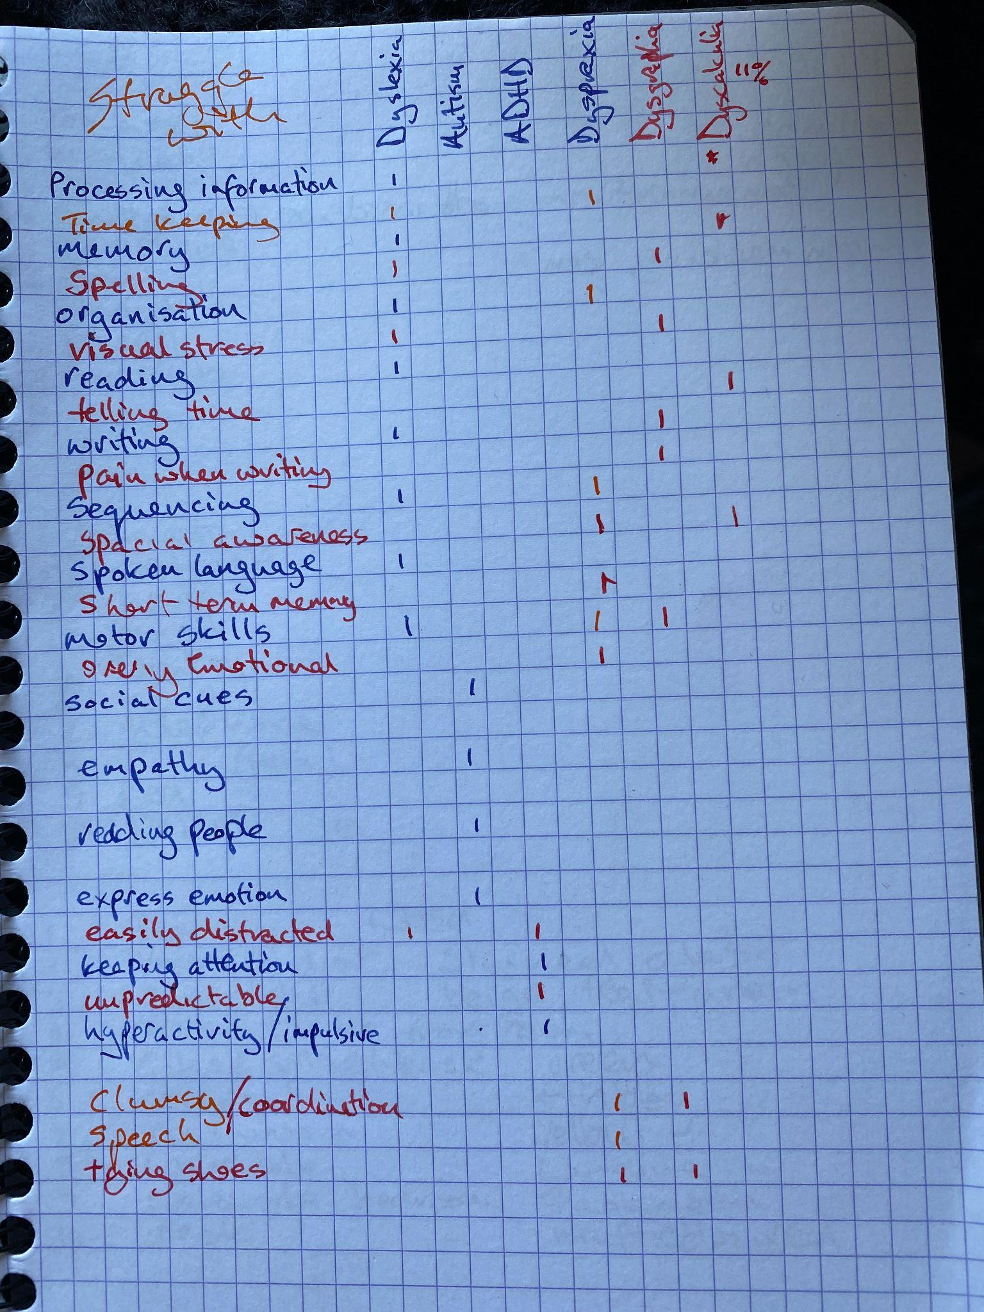
Ideation
Dec 2019
Aug 2020
Sep 2020
Dec 2020
Launch of the CSDDN 4 D’s Line Manager Toolkit
Strengths and challenges tally charts
Strengths and challenges visual
Strengths and challenges interactive page
Notes:
Our first project together was the line manager tool kit which won a CS award in 2019
it was a linemanagers toolkit, for managers of ND peeps
(we have some printed copied here if peeps want it or its digitaly available as a PDF) and how workplace adjustments can help,
The acknowledgement encouraged us to keep on looking at the areas where we can help and have lived experience, and we have been keeping ourselves busy since. The image on the left is the toolkit and after that was our next project this was a brilliant idea from clare . What you see here in the middle is the initial schetches of astruggles with and excels at tool.
Then we created a visualisation for getting buy in only. Which looks like this

Slide 21
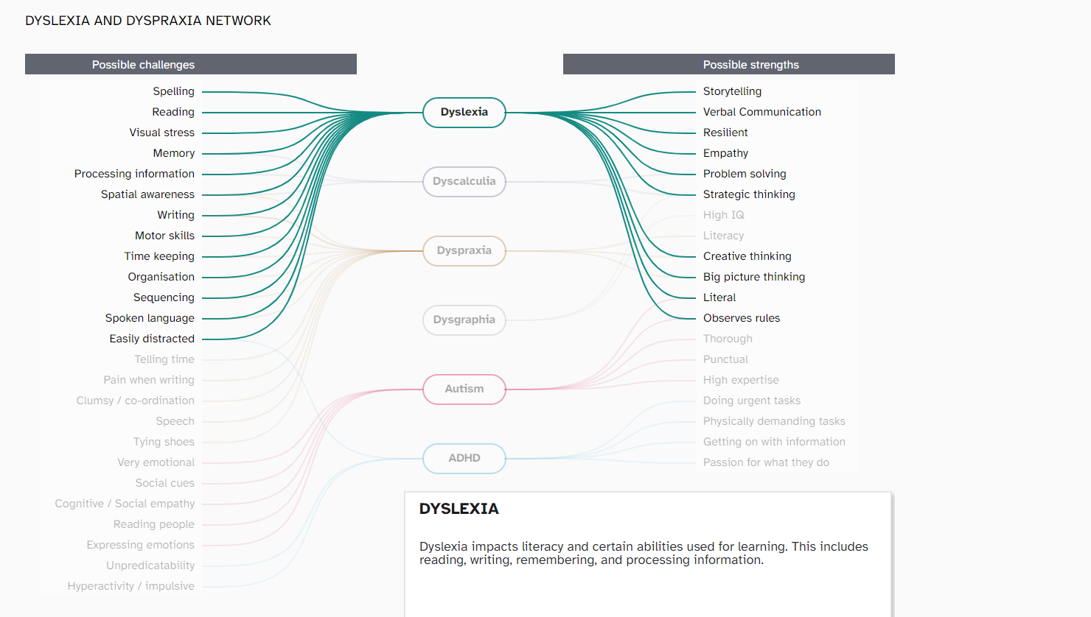
Prototype: as was… and the next project
Notes:
The idea was to look at strengths and struggles with, around ND, and to help discourage the negative stigmas, around neurodiversity,
…any one here ever herd a joke about dyslexia? ADDH? A stutter?. But the idea was to promote the strgents on ND
it’s a great idea, the prototype, whats seen here is a clickable interactive microsite, where clicking on a challenge or strength shows what condition or conditions plural - it may relate to and visa versa you can click on a condition and it shows the strgenths and struggles
but it also this isn’t ment to be a diagnostic tool , or any thing really, more it was just a prototype to show an idea and how powerful this could be.and we are well aware this approach is not accessible .especiall for visually impaired, But we will come back to this………

Slide 22
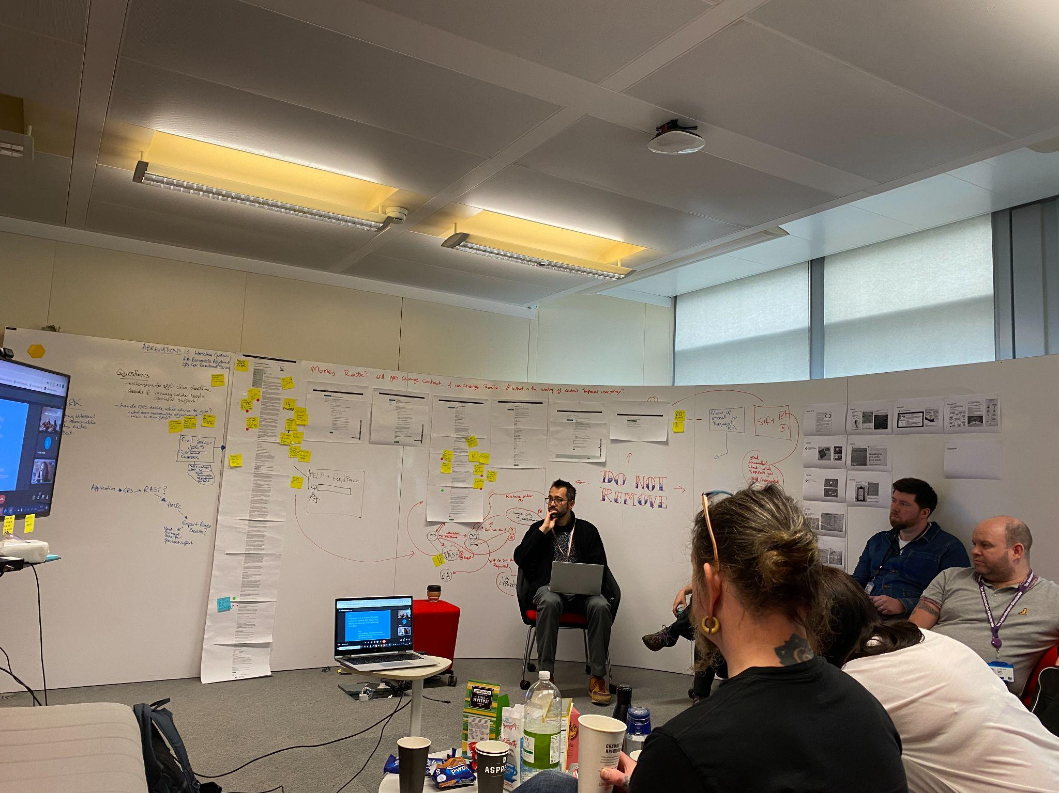
Research
In January 2022 we surveyed and ran a workshop to find out people’s ideas, thoughts and feelings on what the CS is like now and how it could be improved for neurodivergent people.
Notes:
read slide
We had not shown the tool to many people yet, out side the group (small at this time) but had this idea of a solution that my help the ND community,
we did some UR around problems in the ND/CS community the basic idea of which was,. how might we use this idea and make it into something more useful …
we ran some UR and did interviews with CS neurodivergents and the CSDDN.
This initiative, ….and this is a side note, tangents we are good at, but we do come back to eventually ,
and that is to say the group who, spearheaded this, and the other bits we are working on are dedicated neurodivergent volunteers, using their allowed time to make the \cs a better place to work, . I think in the civil service it might range from 2 to 5 days depending on department
So back to the workshop we defo did go in with an idea of a solution so , from a SD pov could have been better but.. With we then uncovered a commonality with the civil servants we interviewed

Slide 23
Research 2
We had not considered how we could best use our talents to make a difference for the neurodivergent community, meaning we initially didn't appreciate that the first obstacle is securing an interview for a governmental position.
Notes:
Read slide
Our participants told us some terrible stories how interviews went wrong and that there was a pressing need for improvements to recruitment to ensure that neurodivergent applicants are assessed fairly and equitably, in fact it’s a fairly regular scary, topic, amongst ND peeps in our group
But Applying design thinking to the recruitment processes and it allowed us to somewhat refine our understanding of the actual problem we should be trying to improve.
Even as lived experience experts, from varied disciplines, this project’s research revealed that our initial plans had totally neglected to consider the end-to-end application journey.

Slide 24
Research 3
Q: How would you make the current application process better?
“Let’s think about the process from the disabled person applying instead of making it easier for those who are advertising the role or advertising jobs.”
Dyslexic research participant

Slide 25
Quote 1
Q: How would you make the current application process better?
“There's a formula for completing applications, but the method, language etc doesn't come naturally to me. I take things very literally, so for example in the interview questions, I tend to give short, concise answers, and get marked down.”
Research participant with ADHD + Dyslexic
Notes:
A quote from a participant who is ADDH and dyslexic
This goes back to a neurotypical expected response to questions, to judge how well you can do what you are possibly very good at

Slide 26
Research 4
Notes:
90%+ of respondents feel anxious, confused or overwhelmed completing written parts of applications, for CS jobs

Slide 27
Pre-workshop survey: asking for adjustments to support job applications
Disability Confident Scheme
Reasonable adjustments
Notes:
There are 2 ways to ask for adjustments
As the names might suggest you are applying for an adjustment cos you have a disability or you want a RESIONABLE adjustment.
ND peeps can use either

Slide 28
Research 5
Notes:
95% of respondents know about reasonable adjustments offered for interviews.
This 95% is based on internal ND staff network, so those already in a CS position,

Slide 29
Research 6
Notes:
Of that 95 % who know about resionable adjustmen Only 40% apply for reasonable adjustments
on another tangent Even among the neurodivergent community, there is a lack of knowledge of (and fear of requesting) reasonable adjustments with many only learning from ND groups, or friends

Slide 30
Research 7
Notes:
55% know neurodivergent people know they can apply through the Disability Confident Scheme.
So over half

Slide 31
Research 8
Notes:
Of the 55%. Who know about DCS
Only 28% always use it.
In part The reason its at so low is ND Peeps fear discrimination when applying via DCS similarly with reasonable adjustment

Slide 32
Research 9
Notes:
75% of respondents
need support to
complete applications
Ok so we found this from our research,
we don’t have the base line but we assume this is a lot higher

Slide 33
The obligatory user journey map
Notes:
And for all the sd ers here…

Slide 34
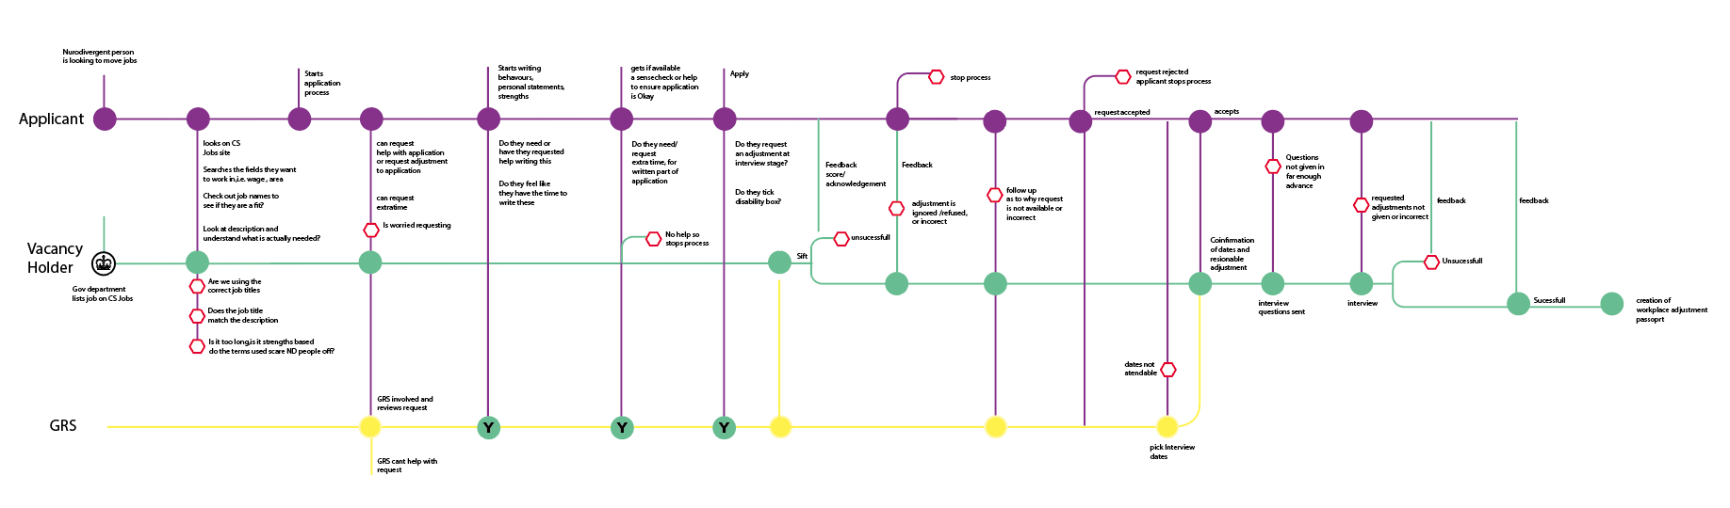
Current journey, and where issues are
In the UK there is no other project like this that we or our associated groups and GOV department know of at present
Key
Possible drop-off points due to lack of support on the applicant’s journey
Loads of drop off points
Notes:
We looked at applying to interview stage user journeys to see where the fall off points for nurodivers applications could be,
and how we can address them
so those red hexigons are possible drop off points , for ND peeps in this journey

Slide 35
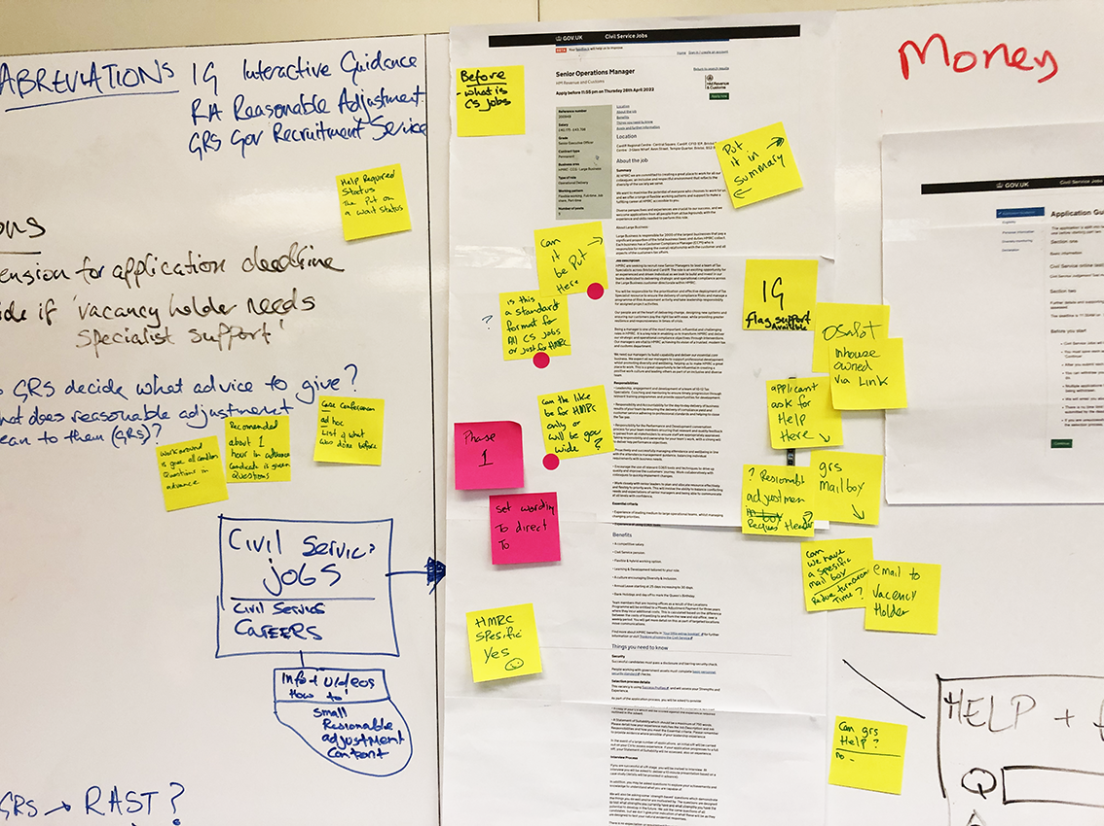
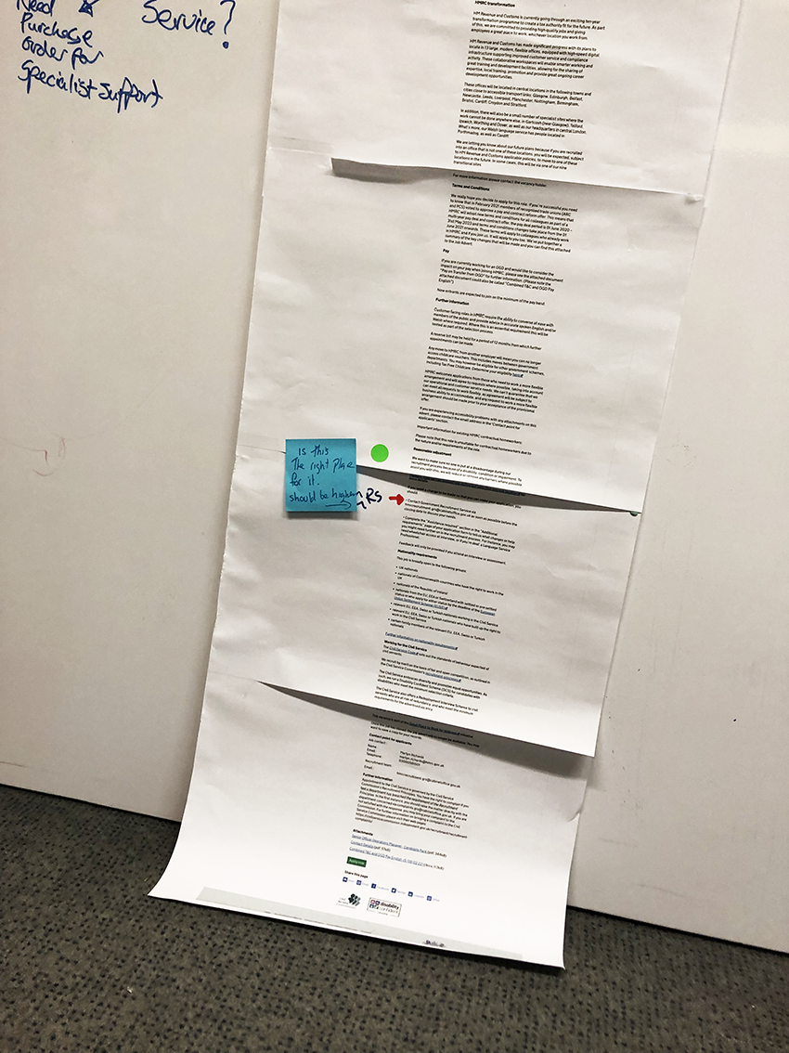
Where offer of support appears
We propose greatly increasing its prominence by moving it higher to here
This shows where currently the first reference is to reasonable adjustment.
NOTE: this is 8xA3 pages of 11 point text)
Notes:
Unfortunate point we should not have to make from the map which popped up in our first workshop, was this .. Thre image shows what a job description looks like when printed. (this was at the time we started the project..
We’re suggesting the link to help getting resionable adjustments should be significantly higher, and maybe more prominent.
The link on this advert leads to alibary of lengthy pdfs about Resionable adjustments, kind of like trinity library …if anyones been there

Slide 36
What our research has shown us so far
Vacancy holders were surveyed, asked if they knew applicants could request reasonable adjustments. If they did, did they provide the requested adjustment? Did the adjustment help?

Slide 37
What our research has shown us so far continued
Responses varied.
Vacancy holders need more info and guidance on reasonable adjustments and the Disability Confident Scheme.
Vacancy holders seemed willing to help, they just need to know how.

Slide 38
Problem statement

Slide 39
Problem statement 2
There is a lack of understanding, and tools to help vacancy holders and interview panels assess applicants who are neurodivergent, in a fair and equitable manner.

Slide 40
Problem statement 3
AND…
Even among the ND community, there is a lack of knowledge of what reasonable adjustments can be requested, there is also a reluctance to ask for them.
Notes:
Reasonable adjustments align with accessibility needs, which can make any part of work life, including the interviews accessible.

Slide 41
What we made

Slide 42
What we made 2
We’ve prototyped a simple GOV.UK tool that matches people’s support needs with reasonable adjustments they’re entitled to,
Similarly, it will inform vacancy holders of their responsibility to make sure requests are made and implemented at the right time.

Slide 43
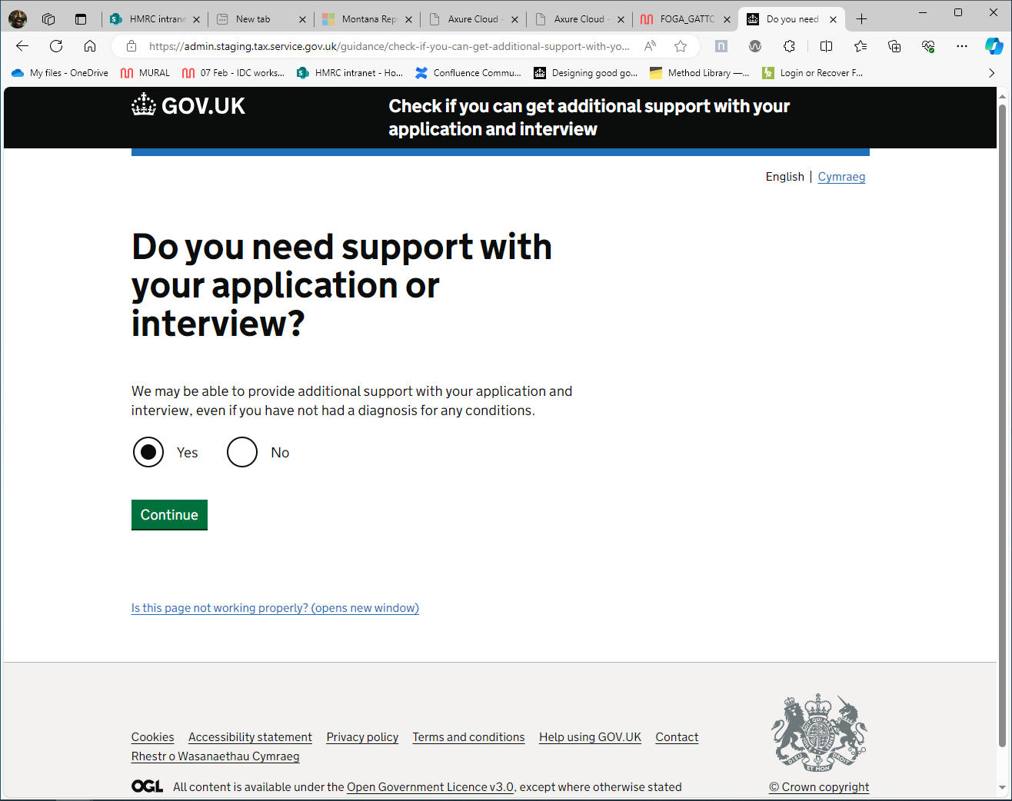
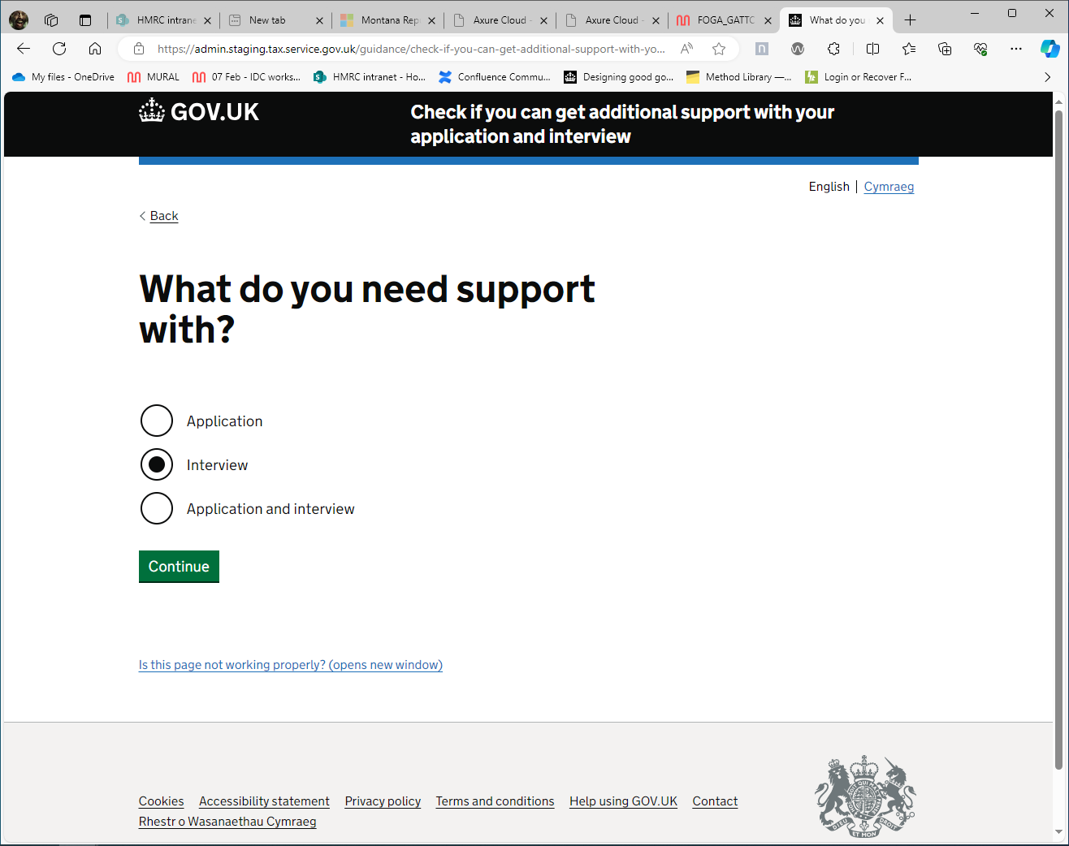
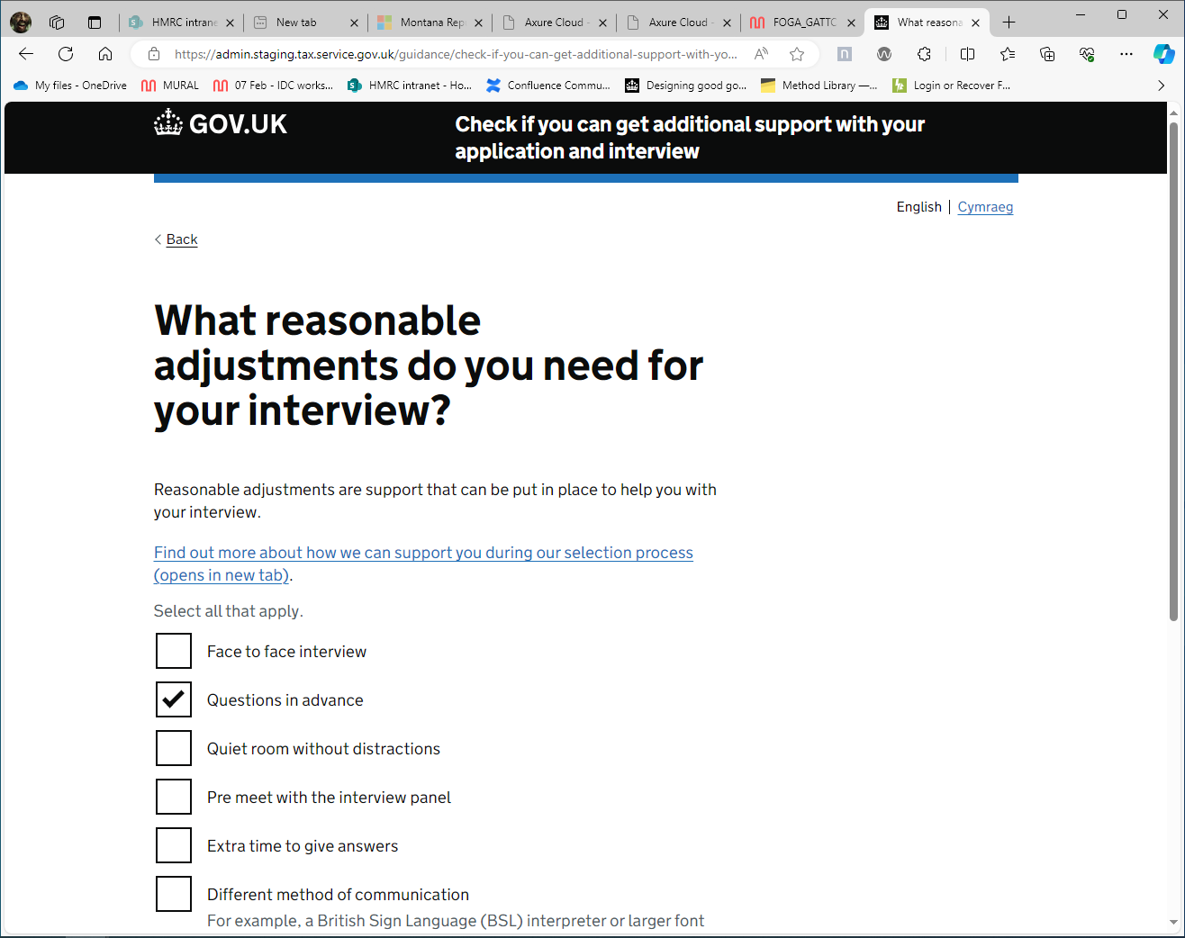
Screenshots of the tool
Notes:
This was Internally developed software the journey starts with with the candidate seeing a link where the big green arrow was on a few sildes ago … explain process

Slide 44
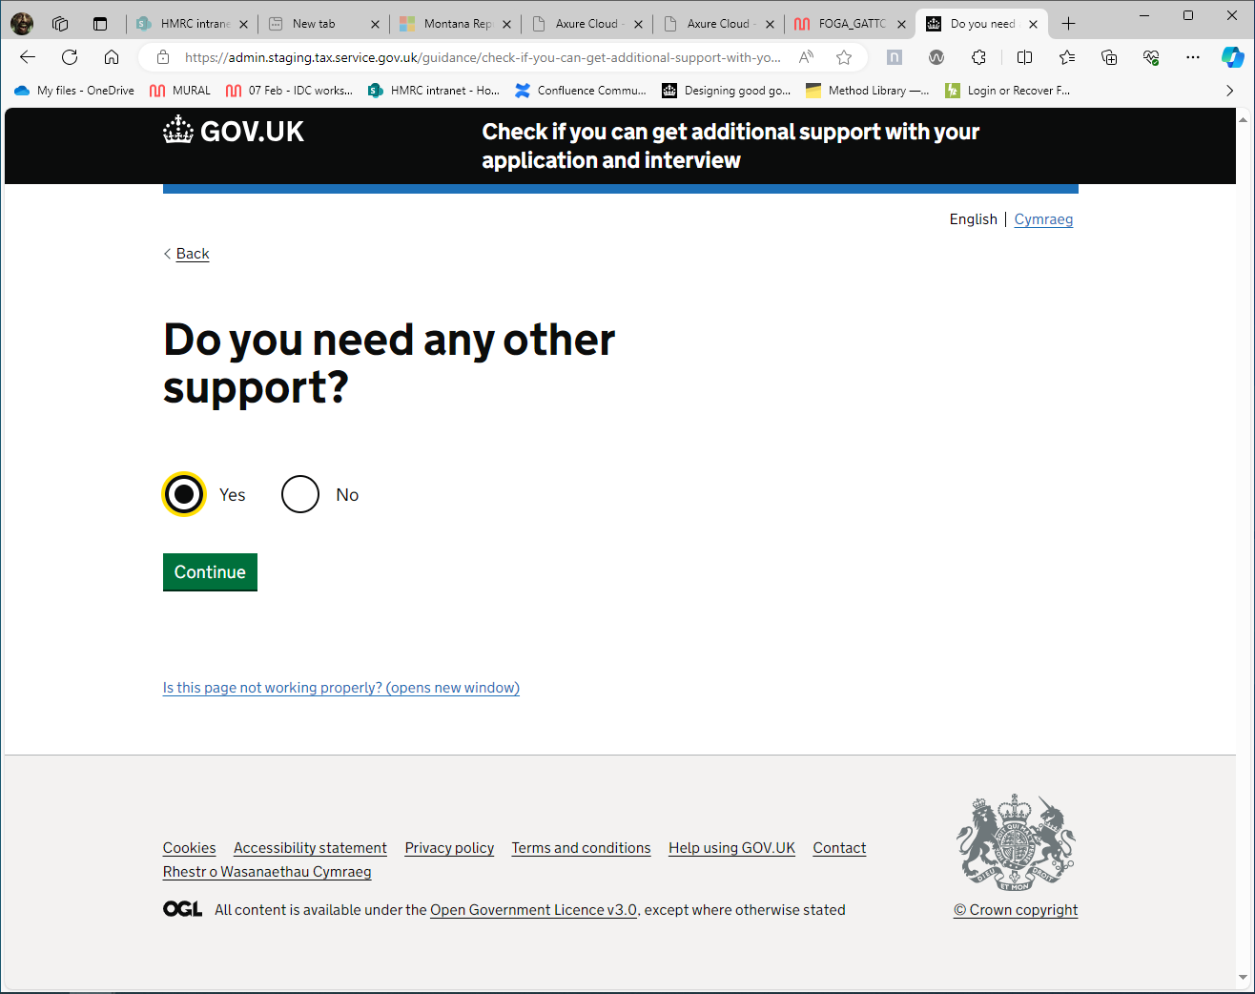
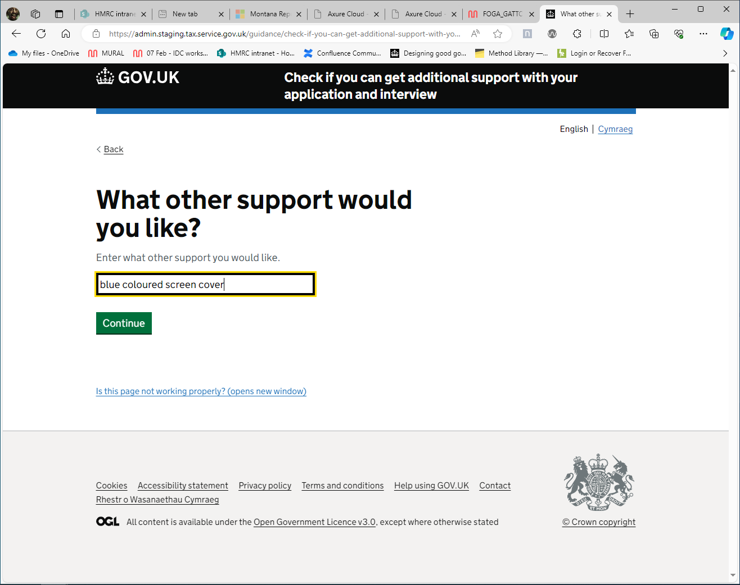
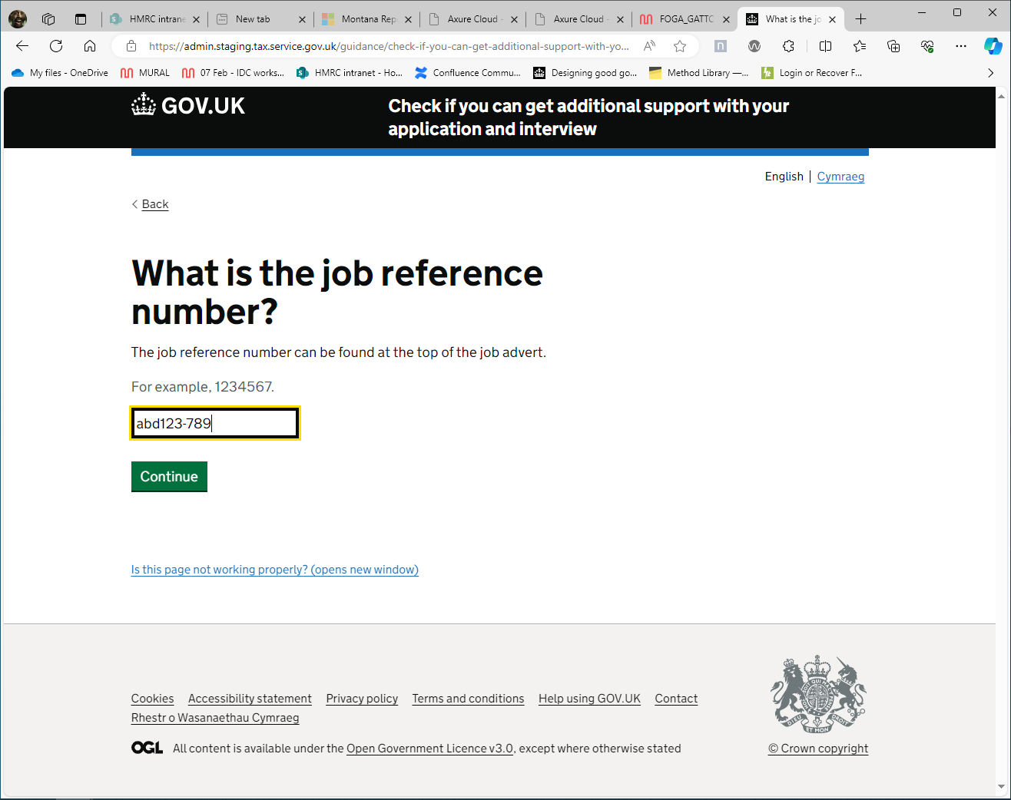
Screenshots of the tool 2
Notes:
Read through

Slide 45
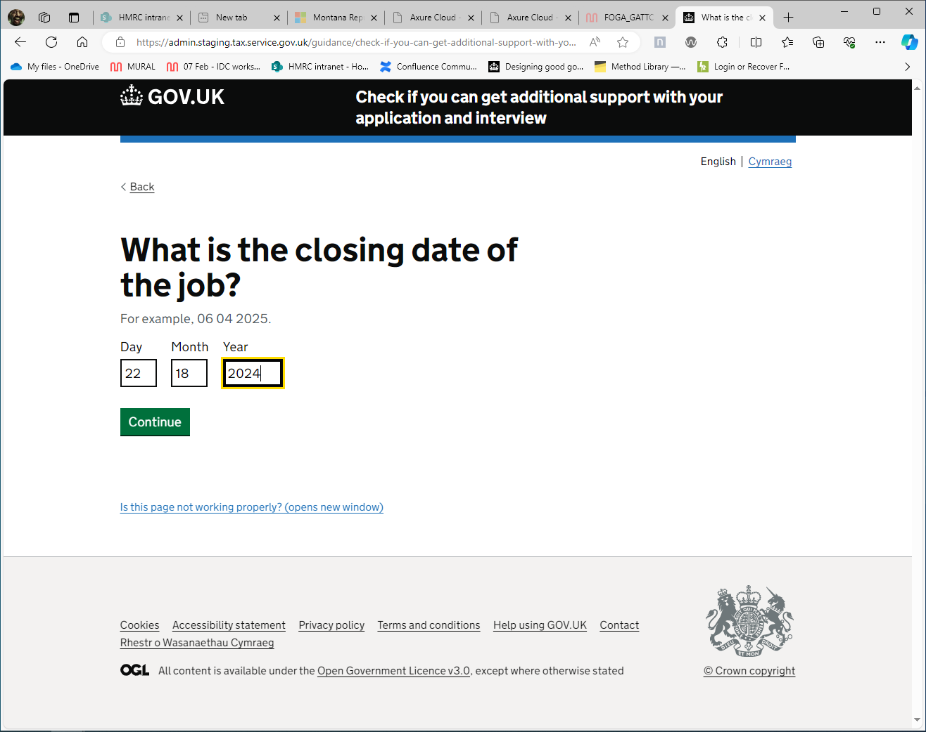
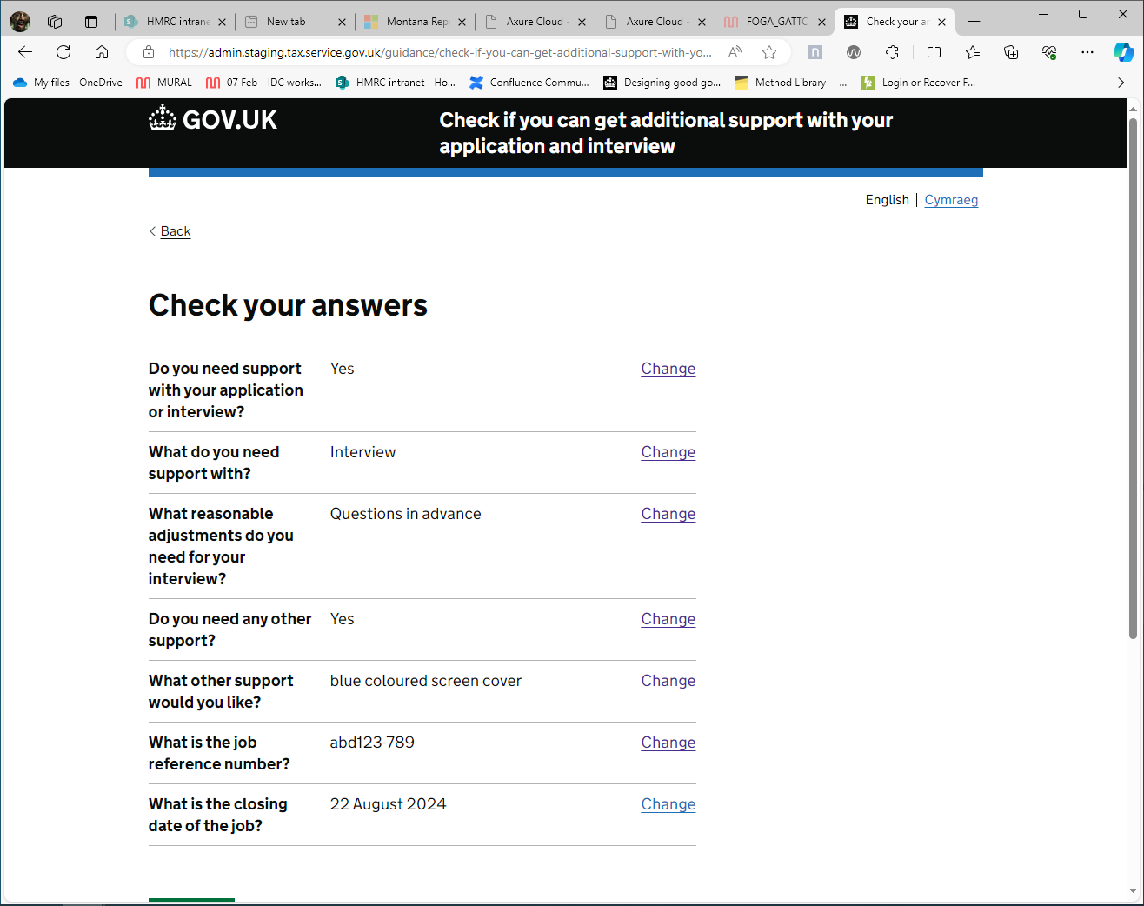
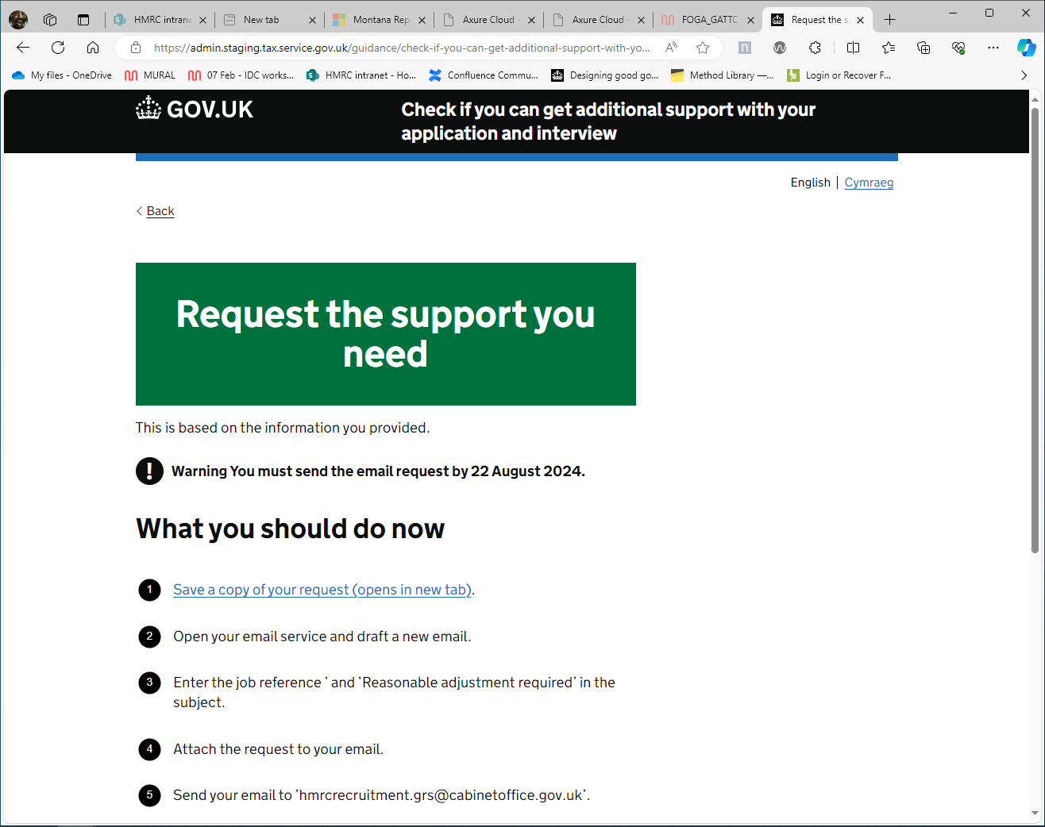
Screenshots of the tool 3
Notes:
Read through

Slide 46
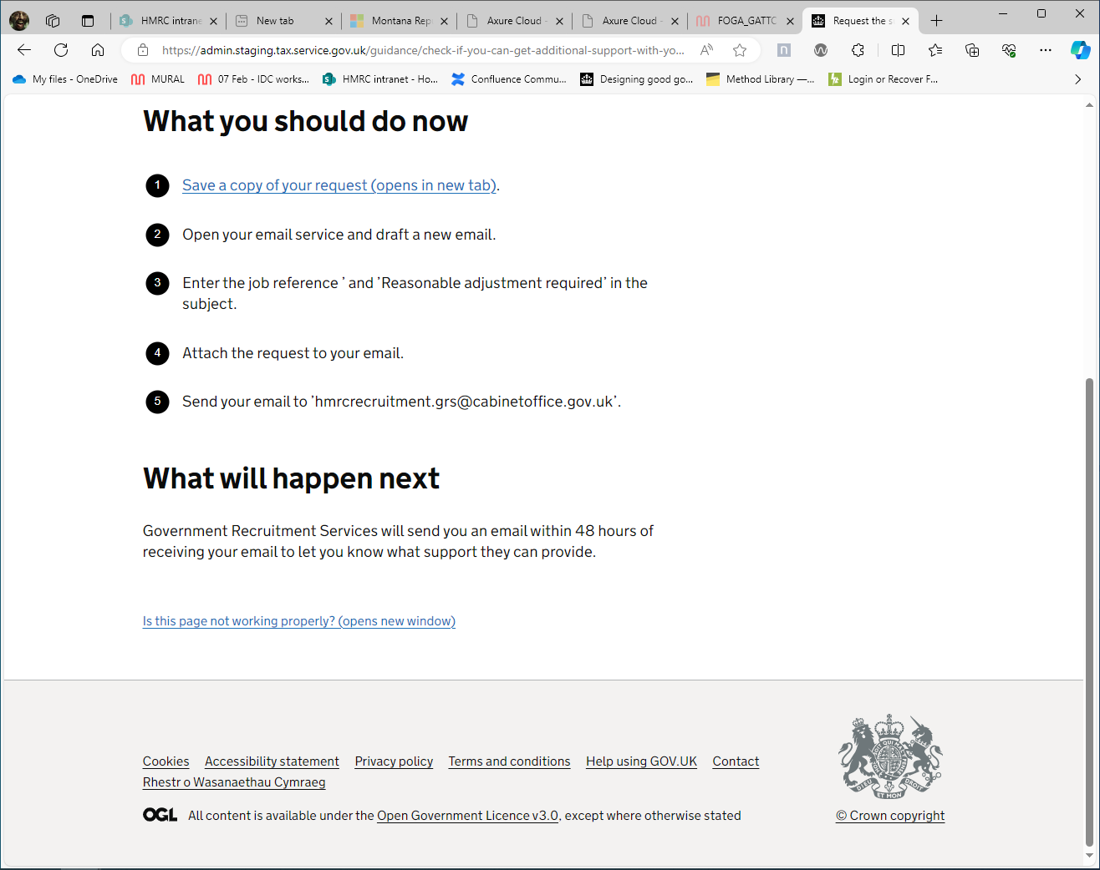



Intended process
Applicant
Vacancy holder
HR
Measurable feedback on reasonable adjustment process
Notes:
So one of the main concepts behind the prototype looks like this
The applicant selects/outlines the adjustments they feel they need, they will then get an email stating their request will be met. about their adjustment. The vacancy holder will also receive an email detailing how it is there legal obligation to provide the requested adjustments. Hr get this email too, the applicant is asked feedback on process at this time initially (so we can iterate and measure)

Slide 47
How it addresses the problem statement addressed
The tool helps build neurodivergent people's understanding of reasonable adjustments, confidence in requesting them, and makes the process clearer and simpler.
Notes:
Soooo how does this address our problem statement…
Read slide
Just to say we did design this from a ND POV, it has always been our intention that the final output will be disability based but we as subject matter experts in one field,
developing this further is what we have always said needs to happen, just we don’t have the experience or expertise to do this, so who ever is taking the lead on this needs to do this

Slide 48
Problem statement addressed
The tools help build vacancy holder and interview panel understanding of neurodivergent applicant’s needs,
how to meet them, when and why.

Slide 49
How we got stuck
Notes:
We used neurodivergent design thinking to create an inclusive recruitment tool. Right everything is grand but….

Slide 50
Words did not match action
… delayed by working out how to get senior buy-in, and that resulting in supporting us – with a project manager…
Notes:
To be honest lots of Senior leadership saw its value, and we could shout out lots of SLT but once you have their blessing and contacts to help we find most didn’t have the capacity, to take on new work or were restricted by recruitment processes. But at the same time we did get prototypes made and plent of help across GOV
Every SLT loved it,
We present it at DG level, it just doidnt come to anything it the bridge between DG level and ours

Slide 51
Intended process (reminder)
Applicant
Vacancy holder
HR
Measurable feedback on reasonable adjustment process
Notes:
So this is integral to what we needed…. but

Slide 52
Current process
HR
Notes:
This is what was offered.
First off, we don’t want to sound hyper focused, but with the prototypes that were being developed, had one issue that we were disappointed with. We wanted a hands off approach but got stuck in position of , this needs to be re thought…its taking a good idea but not understanding the user cantered design approach on which we built this. And if one gov department is struggling to understand UCD, then is there another that’s willing to develop this approach?

Slide 53
Stuck
Frustratingly…
tool to test,
but nowhere to test it!
Notes:
We had some buy in from a departmental HR but it failed us
Built it using CS colleague guidance system,
which is web-based and can be used by any government org
Confusion around ownership and implementation.
*Hardest part*
Not considered needing to sell a great idea
But a group of hyper-focused people can persistent…

Slide 54
Systematic barriers
What is the purpose of HR and recruitment?
Notes:
From a user-centred point of view, the purpose of having HR is to support and empower employees throughout their journey in an organisation. HR exists not just to enforce policies, but to create a positive, productive, and for this talk most importantly a fair work environment, and fair and equitable way to join and be promoted in that enviornment
.
If we take a user Centred Design approach to the typical process and approach to service delivery around fair and equitable interview process, Then the hr we have delt with is missing its goal, which is to generate solutions that are user focused instead of HR focused.

Slide 55
Removing barriers
Understand: gap that needs filling
Understand: equality law + what’s reasonable
Motivated to: include ND and disabled people by removing barriers
Notes:
David to fil in

Slide 56
Examples of how current system does not work
(this year’s examples)
In the last 3 years we learned about the rights we all have and applied for jobs requesting adjustments.
Notes:
Like all CS we applied for jobs promotoions , and in our small group theses are some of the responses we got

Slide 57
Example 2
day of interview…sorry we forgot to send those, here they are….” (requested 3 days in advance)

Slide 58
Example 3
Do you really need the questions 3 days in advance? hows I send Sunday, for your Monday interview?
Notes:
=

Slide 59
Example 4
SLT: Hay you know about this RA stuff, do we really need to offer them if people request them?……
US: YEAA you absolutely do,
SLT: YEAAAA.. but its for SENIOR management this time?

Slide 60
Example 5
Interview Pannel member (to all interview members, and applicant on day of interview): “Sorry I really think its unfair that the applicant has been given the question 3 day in advance of this interview, its unfair on other interviewees…..
(this in an interview for a HR position. even before any questions)
Notes:
(this in an interview for a HR position. With HR people on th pannel In the fucking interview in front of other panel members and the applicant, even before any questions) and was a DCS application request for questions 3 day in advance

Slide 61
Example 6
It does show why people fear requesting DCS or reasonable adjustments
and
Why we need a system that supports the needs and rights of neurodivergent applicants.

Slide 62
Where is the tool now?

Slide 63

Image representing boxes hidden in warehouse of boxes
Notes:
So this is the best analogy of where the tool is now , we managed to get it into a departmental hr, the problems we showed you where highlighted to them and and the tool that was in development was stalled, it was kicked back to the front door,
Since then our champion in HR but left, to another department and we believe the situation looks like this, but as I said before a group of neurodivergent can be very persistent
we are motivitated to keep this ideas alive and see them developed but need expertise we don have

Slide 64
What we need from you: if you’re willing…

Slide 65
What we need
Okay… so we assume this is a room full of mostly Service designers, But….from all multiple departments
Notes:
Unless its just hmrc policy lab and DWP digitl peeps here,

Slide 66
Back to original project:
strengths and struggles identifier

Slide 67
Help with the next project – developing this into a strengths and struggles identifier…
We need your support if you’re a:
user researcher
content designer
service designer
interaction designer
developer
Notes:
Also trying to move the dial on this , working on tolls that support each other als looking for

Slide 68
Strengths and struggles identifier: progress so far
Categorised neurodivergent traits
Content design: prototyping
Aim: establish what’s a strength or struggle
Next steps
Test and learn
Iterate and improve
Build (repeat)
Notes:
What is the point of this problem statement?

Slide 69
An invitation to help
What we need

Slide 70
Back to the reasonable
adjustment tool

Slide 71
What we need 2
Ultimately, for the reasonable adjustment tool we need people to trial the tool, to show it works and measure the responses.

Slide 72
What we need 3
We need influencers and decision makers to sponsor and champion this project.
This will help accelerate roll out.
Notes:
We need people who will say hay there is this geat idea we can implement in nour department,

Slide 73
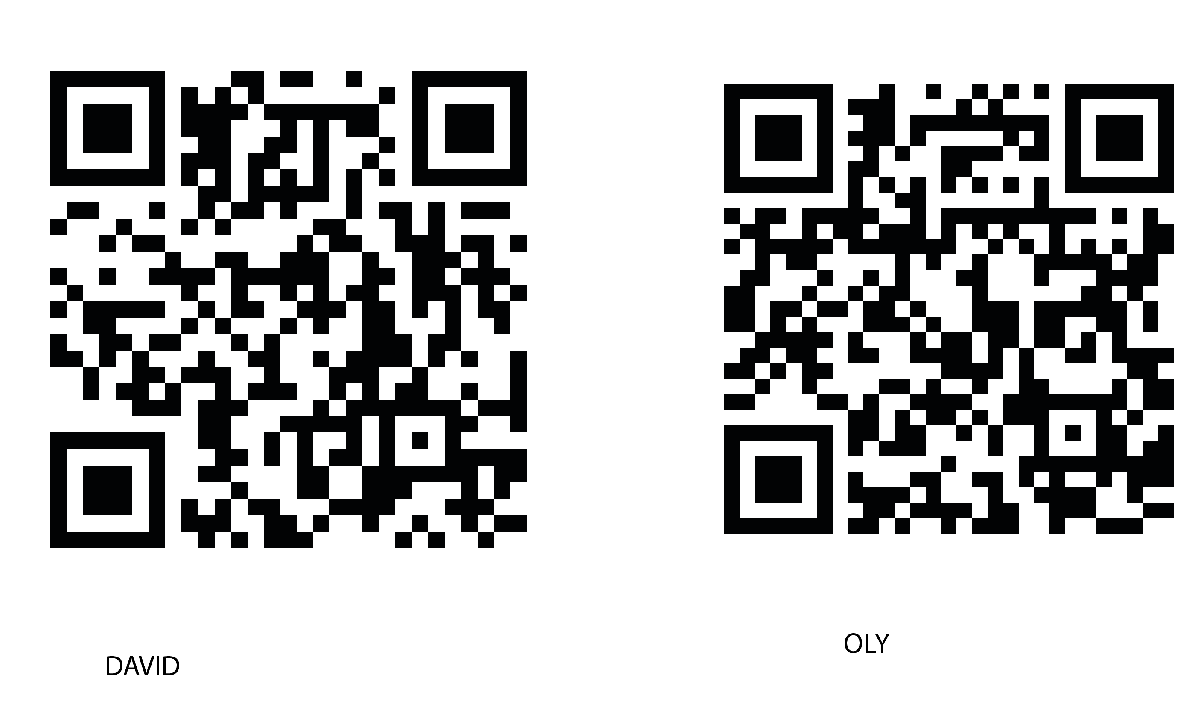
How to contact us
Ollie Sweetman
Oliver.weetman@hmrc.gov.uk
David Hopkins
David.Hopkins1@dwp.gov.uk
Notes:
We have cards with our email addresss es too

Slide 74
questions
?
Notes:
We have cards with our email addresss es too

Slide 75
Appendix: user research findings and recommendations
Alpha, Nov-Dec 2022
Jim Gould, HMRC Interactive Guidance Team

Slide 76
Evidenced pain points and user needs
Pain point 1
People are not aware of the full range of support available, making them less likely to ask for help
Pain point 2
People were uncomfortable revealing specifics of the challenges they face to a prospective employer.
Also they did not neatly fit in to categories
Pain point 3
People were put off by potential time-delay for a response
Pain point 4
Based on the links in the job ads, people were unsure who the support was available for
Pain point 4
People thought about support as one thing for the whole process rather than individual sections of the journey, such as application, interview, job role and so on.
User Need 1
As a neurodivergent job applicant…
I need clear access to timely and beneficial additional support…
So that I am able to confidently apply for a new job without having to reveal the specifics of my neurodiverse challenges or incur time disadvantages
User Need 2
As a neurodivergent job applicant…
I need my additional support at the right time…
So that I am able to confidently; apply for, be interviewed for and carry out a new job

Slide 77

Evidenced pain points and user needs 2
Pain point 1
People are not aware of the full range of support available, making them less likely to ask for help
Pain point 2
People were uncomfortable revealing specifics of the challenges they face to a prospective employer.
Also they did not neatly fit in to categories
Pain point 3
People were put off by potential time-delay for a response
Pain point 4
Based on the links in the job ads, people were unsure who the support was available for
Pain point 4
People thought about support as one thing for the whole process rather than individual sections of the journey, such as application, interview, job role and so on
User Need 1
As a neurodivergent job applicant…
I need clear access to timely and beneficial additional support…
So that I am able to confidently apply for a new job without having to reveal the specifics of my neurodiverse challenges or incur time disadvantages
User Need 2
As a neurodivergent job applicant…
I need my additional support at the right time…
So that I am able to confidently; apply for, be interviewed for and carry out a new job
User need 3?
Tell us once about reasonable adjustments and neurodiversity challenges

Slide 78
Recommendations - Moderate issue
Links to support in the job ad need to be; in context, easy to spot and explicit about what is / is not covered
Friendly, consistent design and content is vital
People need reassurance that a diagnosis is not required before requesting support
Large text boxes to encourage people to give enough detail
This is personal and sensitive. People need clear acknowledgement of receipt and response timelines

Slide 79
Recommendations - Major issue
HMRC job ads now contain a support link with similar content to the new IG tool – this needs collaboration
People should be able to “tell us once” about RAs and their challenges. Some were unaware that this tool is just for the application
“None of the above” needs to be redesigned to remove the risk of people dropping off
More detail on the range of support available would encourage people to apply and ask for support
People were still put off by potential time-delay for a response - this must be explicit and manage expectation

Slide 80
Links
Blog in apolitical: Making recruitment in government more neuroinclusive
User research round 1: Sept 2022
User research round 2: Dec 2022

