Slide 1



Sprinting towards better consent processes
Thomas Sweetland-Michie
Mansoor Mir
Claire Craig
Notes:
Welcome etc

Slide 2
Brought to you by…
James Green, Hannah Chan, Natasha Peters, Homera Khan, Alice Wilson, Lauren Shiel, Alison Hay, Matthew Langland, Rowan Pierce, Shivani Sharma, Natasha Den Dekker, May Jorge, Dani Spinage, Solene Heinzl, Helen Wall, Carly Clarke, Kate Miller Sparkes, Hayley Burrows, Andy, Vicky Shirt, Poppy Collier, Nicola Reekie, Fran Biscotti, Elena Gorman, Sarah Derrick, Barry Tatham, Lara Roth, 9 anonymous research participants and more…
Notes:
The first thing to say is that this work does not belong to the three people on stage. This was a truly collaborative bit of work and it belongs equally to everyone on this slide. We had huge involvement from all kinds of people – my colleagues at Essex, Researchers, service designers, content designers, SEND practitioners, subject matter experts, people with lived experience, parents of people with lived experience. This work simply wouldn’t be here without every single one of these people and I’m so grateful to all of them for thinking that this idea was worth exploring, and giving up so much of their time to do that.

Slide 3
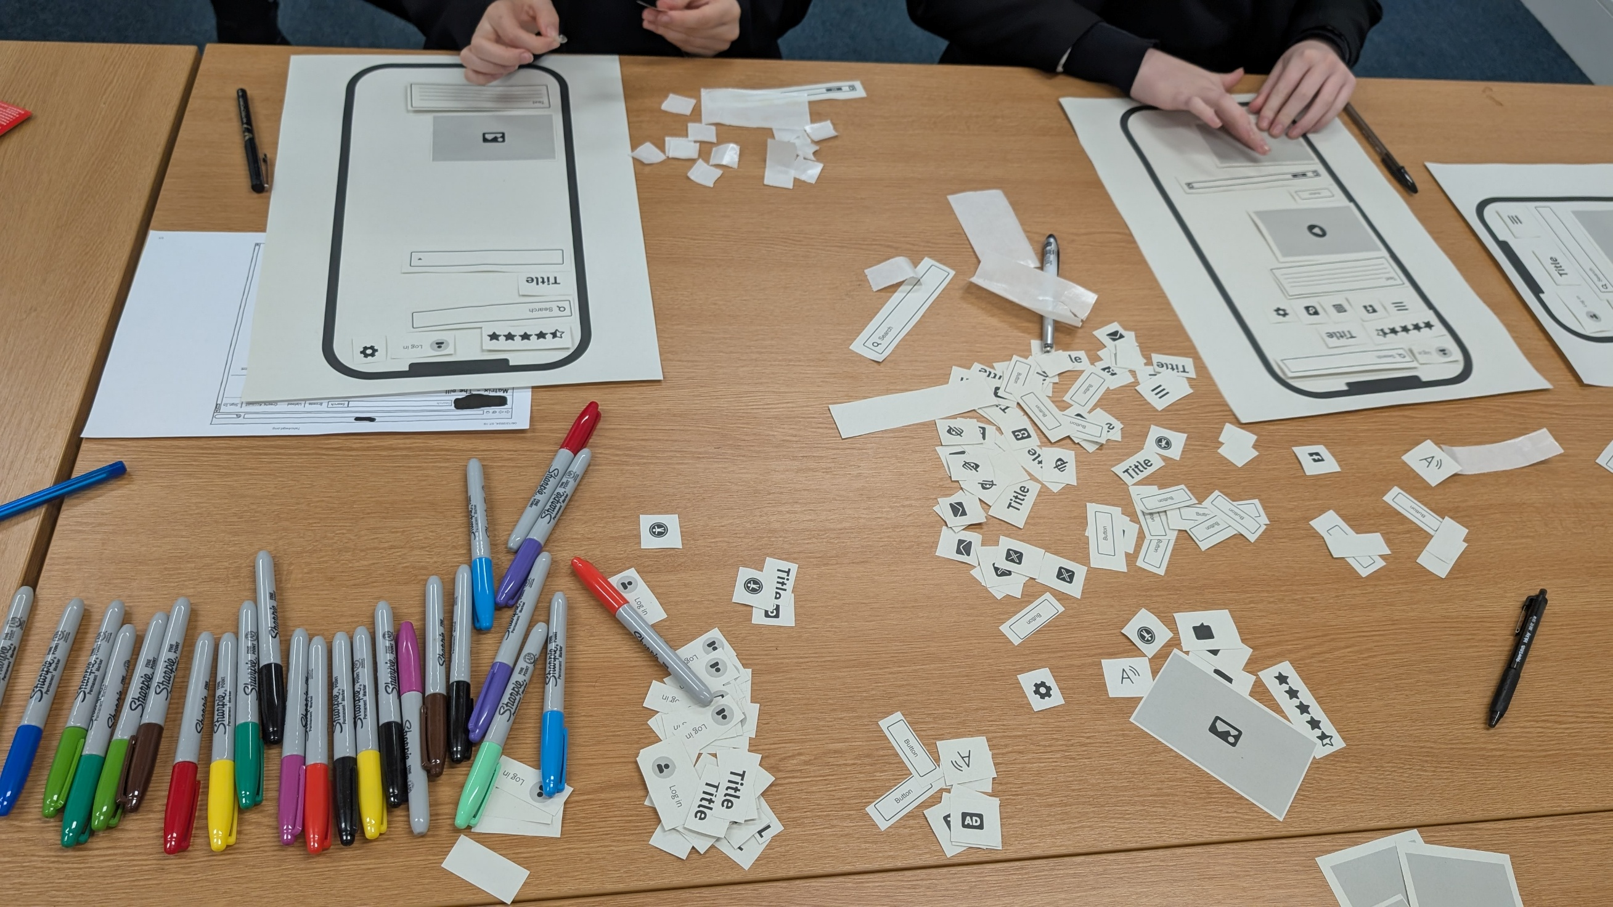
Notes:
I want to start by telling a story… A lad comes into a research session full of energy and enthusiasm. He's interested about what's on the table and what's about to happen.

Slide 4
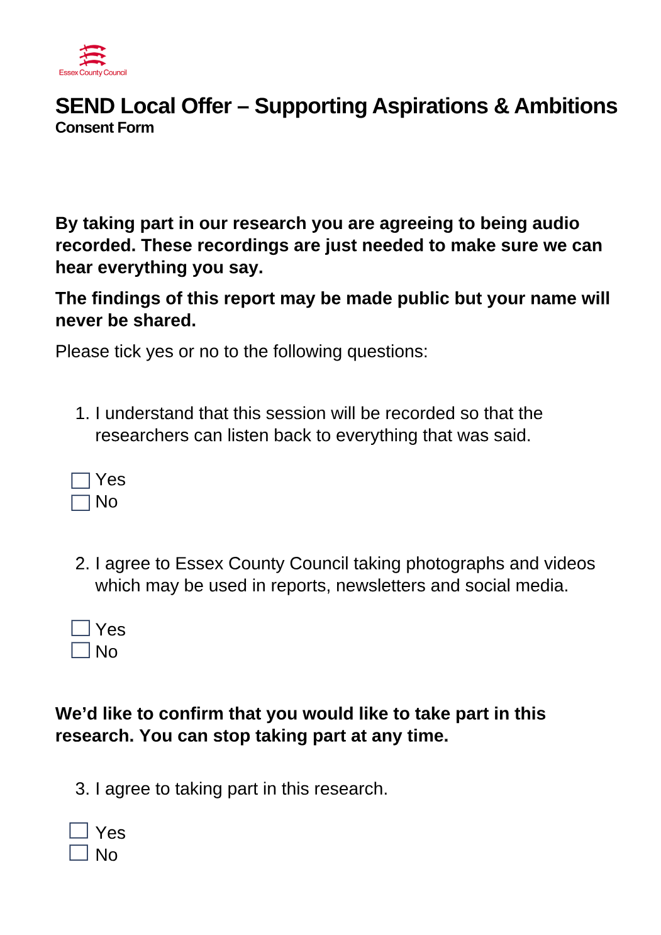
Notes:
I hand him a consent form, and immediately I've lost him. His energy changes. He politely completes the consent form, and he leaves - preferring to go back to his maths class.

Slide 5
What happened?!
Notes:
What happened?
You could say the consent form did exactly what they're supposed to do. They exist to give people a choice. But I couldn't help but feel there was something else going on here. So I have no idea what was going on for that young man, but it reminded me of a friend’s son who has autism with a PDA profile and it was no more than that sudden realisation – what if? What happens when someone with demand avoidance meets a consent form? So…

Slide 6
… a cross-organisational design sprint to explore a question:
Do consent forms create barriers to participating in research for people with demand avoidance and/or high levels of anxiety?
Notes:
REMEMBER TO CLICK IN THE RIGHT PLACES
What we'll be talking about over the next 45 minutes or so is how this ended up in a cross-organisational design sprint CLICK
exploring the question: Do consent forms create barriers to participating in research for people with demand avoidance and/or high levels of anxiety?

Slide 7
… a cross-organisational design sprint to explore a question:
Do consent forms create barriers to participating in research for people with demand avoidance and/or high levels of anxiety?

Slide 8
… a cross-organisational design sprint to explore a question:
Do consent forms create barriers to participating in research for people with demand avoidance and/or high levels of anxiety?

Slide 9
… a cross-organisational design sprint to explore a question:
Do consent forms create barriers to participating in research for people with demand avoidance and/or high levels of anxiety?

Slide 10



A structured way of looking at a particular problem over 5 days, gifted to us by Google/Google Ventures.
All research activities start with obtaining consent which should enable a participant to understand what they’re signing up for.
Varying levels of discomfort a person might feel, resulting from demands being made of them.

Slide 11

Notes:
I had some low level experience of demand avoidance, which also can be known in some circumstances as pathological demand avoidance, or persistent demand for autonomy.
Everybody experiences some kind of reaction to demands being made of them - I use an example of being asked to mow a stranger's lawn. All sorts of mental arithmetic is done, very quickly, and usually at a fairly subconscious level - what's in it for me? What's actually being asked of me? Can I do it?
People with demand avoidance, or PDA, can find this mental juggling happens at a much lower threshold - these are some of the kinds of things that can elicit the same kind of thinking: following recipes, implied or explicit instructions and expectations, social rules and laws, and bodily functions. There are significant crossovers here for somebody with generalised anxiety disorder, or high functioning anxiety, who may struggle under the pressure of people's expectations of them, or their own expectations of themselves.

Slide 12
Notes:
So when someone with demand avoidance is presented with a consent process, what happens? Could it provoke a response like I saw in the school in Essex? But moreover - why have consent forms always been a thorn in my side as a researcher? This was the third iteration of consent forms for this project.
The first had been too long, and had taken too much out of each session. The second had been too tiny, and participants hadn't read it. We thought we might have nailed it for the third - we went for simplicity, just this side of ethical acceptability. But it still didn’t feel right.
So I started thinking, and talking to people.

Slide 13

Notes:
I reached out to a participant from previous research, and I knew her three kids all had a diagnosis of autism with a PDA profile. This is what she said to say when I asked her if she had experienced any difficulties around consent with her kids.

Slide 14

Takeaway
Demand avoidance or anxiety may stop people taking part in design research.
That’s not because they feel they don’t want to, but because they feel they can’t.
Notes:
A quick takeaway then…

Slide 15

Design sprint: Go!
Notes:
I talked to my line manager, and proposed setting some time aside to look at this. She was keen to support it. I reached out to a colleague, James, who is a passionate advocate of inclusive design of public services, and told him my thoughts. He was excited. I was happy - I had three people who thought this was worth looking at. I didn't expect what happened next...

Slide 16
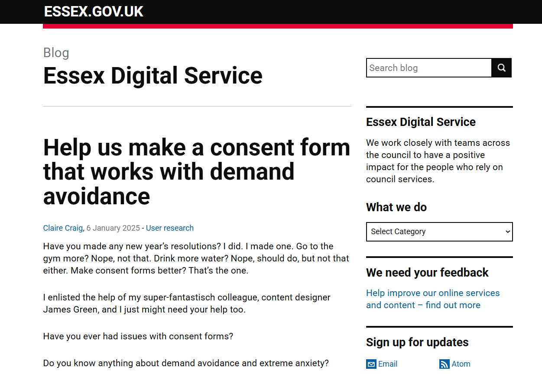

Slide 17
Assemble the sprinters
Notes:
We wrote a blog post and thanks to James' curation and cultivation of his professional network, it got some traction. The response was fantastic - the amount of people who got in touch saying they'd like to be involved in some way was so validating. It meant that inclusive design was important to people, it meant that accessible research was important to people, and sorting out the bugbear of consent processes was important to people.
We then thought about the logistics of what we were about to do. We had had interest from lots of people who identified as having PDA, demand avoidance or high levels of anxiety, and we needed to make sure the design sprint would be a comfortable and safe space for them to contribute.

Slide 18
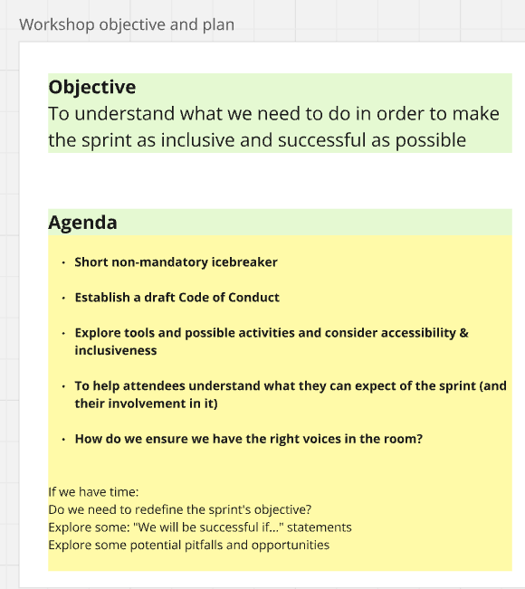

Slide 19
Make the space safe
Notes:
We decided to run a pre-sprint workshop to look at how we could do this and an invite went out to everyone who had expressed interest in the sprint. During that workshop, we looked at whether a code of conduct would be helpful and what it could look like, we looked at a set of core principles for the design sprint, and we looked at the accessibility of tools and activities that we might use.
Doing this meant we could align people's expectations as to what taking part in the sprint might feel like, and what expectations they can have of other participants, and what would be expected of them. < Super useful and widely applicable learning for successful collaborative activities (ie research).

Slide 20
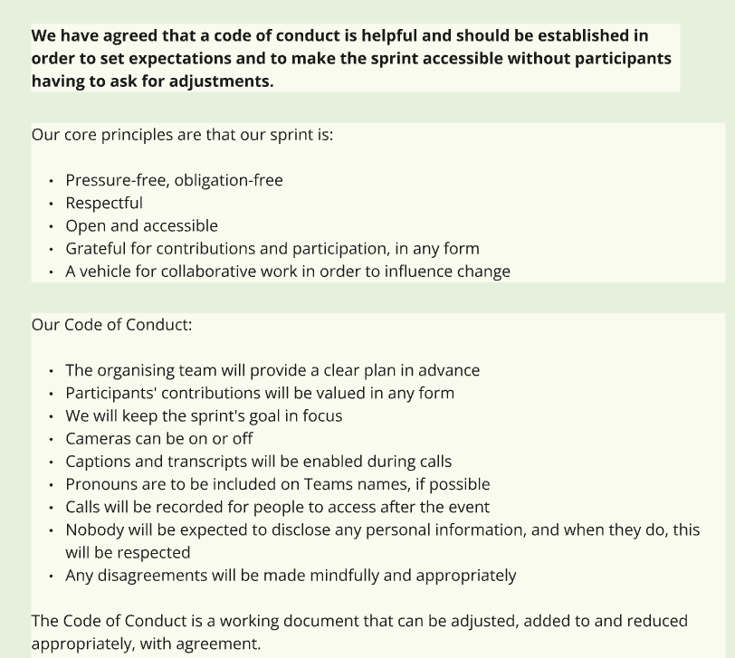

Slide 22
Our core principles are that our sprint is:
Pressure-free, obligation-free
Respectful
Open and accessible
Grateful for contributions and participation, in any form
A vehicle for collaborative work in order to influence change
Notes:
This was where we landed with our core principles, and we drafted a fairly comprehensive code of conduct, which we kept open as a working document throughout the sprint, so it could be adjusted if anything came up and we felt the need.
This whole process was a really useful tool and contributed to the sprint’s overall success – especially for the people with lived experience. For example, one of the challenges that came up very early on in the planning of this was that an internal team at Essex who deal with SEND support and training had an interest in what we were doing but wanted us to be very clear about terminology used as it had the potential to cause significant complications for them. However, we knew this was in opposition to terminology that some people who were attending the sprint wanted to use in reference to themselves – so this needed a bit of negotiating. Setting up these principles and a code of conduct allowed us to do that – and we got through the sprint without any issue.

Slide 23

Plan for the needs of your user group
Notes:
The other key thing to pull out about the planning for the design sprint is recruiting research participants for day 5. During a conventional design sprint, research will take place on day 5, and this is normally testing out ideas or a prototype with some participants - you may do some guerrilla testing round the office, or recruit some participants earlier in the week. This was going to require a bit of thinking - we wanted to test our new ideas with people with PDA, demand avoidance or high levels of anxiety. We knew we wanted young people to take part, and that their involvement would have to be worked in around school commitments. And we needed to get them on board... Thankfully we had a huge pool of participants from our SEND project, and had fostered some good relationships so when we explained what we were doing, parents and young people were interested in helping out.
The meta knots I got tangled in were extreme – this is a visual representation of my brain when I was thinking about recruiting for and planning the research exercise… How do you do research on consent forms with a target group of people for whom consent forms might pose a real challenge, when that will involve obtaining their consent before they take part – using an existing consent process which we’ve already identified might be causing them difficulties…? I’ll let Tom go into more detail about the research, but at this stage I knew I needed to begin the recruitment part of the research early. I reached out to parents early with as much detail and as many firm arrangements as possible – time required, rough requirements – probably just doing a small solo activity online – and a promise that they weren’t tied into anything and we’d keep them in the loop as much as possible.
Finally, there were some people with lived experience who wanted to contribute but didn't want to take part in the sprint - we did this in a couple of ways. A few were interviewed beforehand, so we could collect and include their thoughts on PDA and consent forms, others sent some written thoughts for us to consider and others felt that they just wanted to be kept informed and able to dip in and out.

Slide 24
Takeaway
Reach out beyond your usual team to solve tough problems.
Plan ahead to make the space safe and productive.
Notes:
I don’t know why we don’t do this more often. Sure – conferences, UK Gov camps, cross-gov slack channels etc go some way and with that alone I’ve never worked in a more open, sharing and collaborative professional landscape. Our experience at Essex with Local Gov Drupal is also a really good example of collaborative problem-solving. But when I raised my head above the parapet and said ‘guys, I think this is a problem,’ the response was overwhelming. It made me wonder what other problems we can work on in this way.
Really laying the foundations well for a bit of work really pays off – this wouldn’t have been practical or viable without it. But maybe we should make a habit of thinking a bit more deeply about the needs of our colleagues and team members as well as our participants and users before we go into a project. For team members, can we make a habit of asking: What will make this project work for you? What do you need to be successful?
For participants and user groups – we’re extremely good at identifying user needs after the research is done, and we are getting very good at thinking about accessibility and inclusion. But what more can we do in advance to identify needs around participation? And are we good enough at the moment at tailoring inclusivity to our target group of participants for each individual project?
So – after the planning --- we were ready to go. Tom’s going to tell you about the design sprint itself.

Slide 25
The sprint week

Slide 26
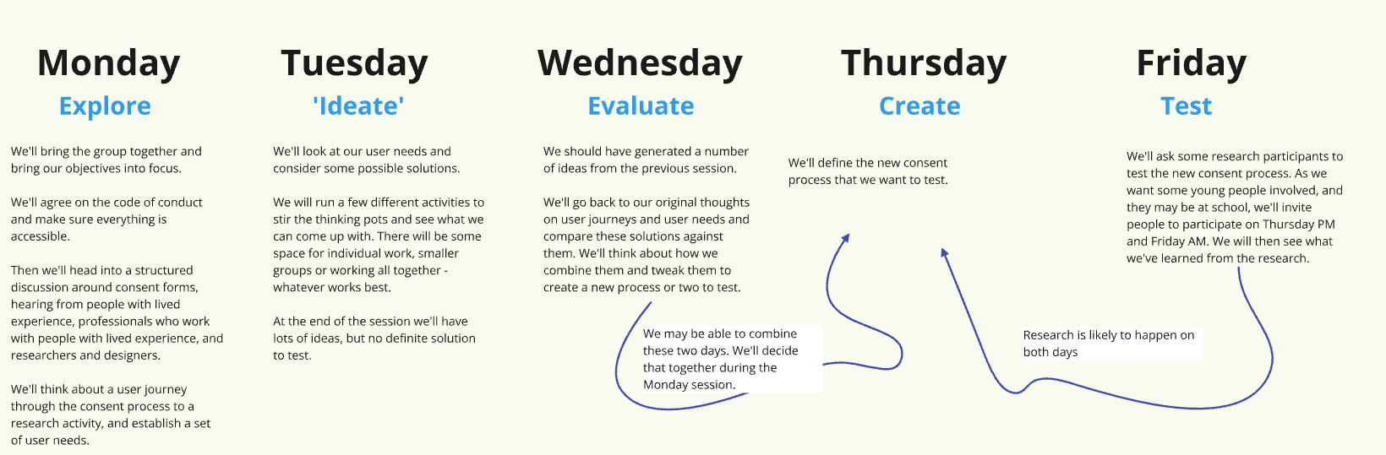
Notes:
I'll start by giving you a quick overview of our week – which followed a pretty classic design sprint structure:
We spent the first half of the week exploring the problem space and playing with ways we could improve the consent process. Towards the middle and end of the week, we spent some time revisiting and reaffirming our findings from previous days, created some prototyped consent forms based on our findings, and ultimately designed a round of research to test our prototypes.
In the slides behind me I’ll share some screenshots like this one from our Miro board, hopefully that gives you a bit of an insight into what the work looked like across the week.

Slide 27
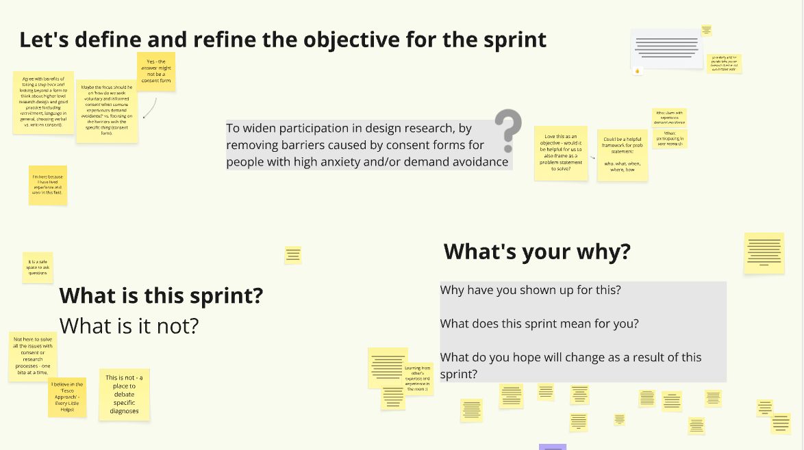
Notes:
Design sprints are a great way to carve out time to explore and address a specific problem, but as you'll see, that exploration can grow arms and legs and get a bit unwieldy, so the first thing we did was to set our scope and the sprint objective.
Claire and James set a prompt objective and we spent some time discussing and responding to it - we felt it focused too strongly on the 'consent form' part of the process when, considering the problem as a whole, what we really wanted to do was to support people who experience anxiety and/or demand avoidance to take part in research, if they wanted to, in an empowering way, not just widen participation for the sake of it.
We also discussed what this sprint was not - again so that we could keep our focus clear, and we recognised that this sprint was not a panacea for all consent or research operations. So immediately there was a bit of tension with the scope to do with looking at the problem widely enough so that we weren't focusing on just one part of a wider process (the consent form) but not zooming out too much that we lose our focus.

Slide 28
Takeaway
Define your scope, but balance focus with flexibility
Notes:
Define your scope, but balance focus with flexibility. It was important for the group to explore the problems in depth, and allowing for flexibility and pivoting was crucial to allow the key issues to kind of bubble to the top. This meant that the sessions felt a bit messy at time, so combining that flexibility with a focus you can refer back to is really important to keep moving in the right direction.

Slide 29
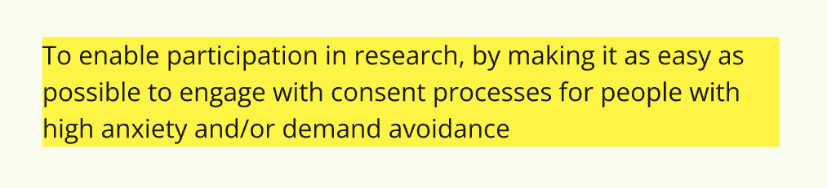
Notes:
With that said, we agreed our initial sprint objective: To enable participation in research, by making it as easy as possible to engage with consent processes for people with high anxiety and/or demand avoidance.

Slide 30
Exploring the problem
Notes:
As in any design process, the first thing we did was explore the problem. In this case, this was actually about exploring and understanding two problem spaces: demand avoidance on the one hand, and consent processes on the other.

Slide 31
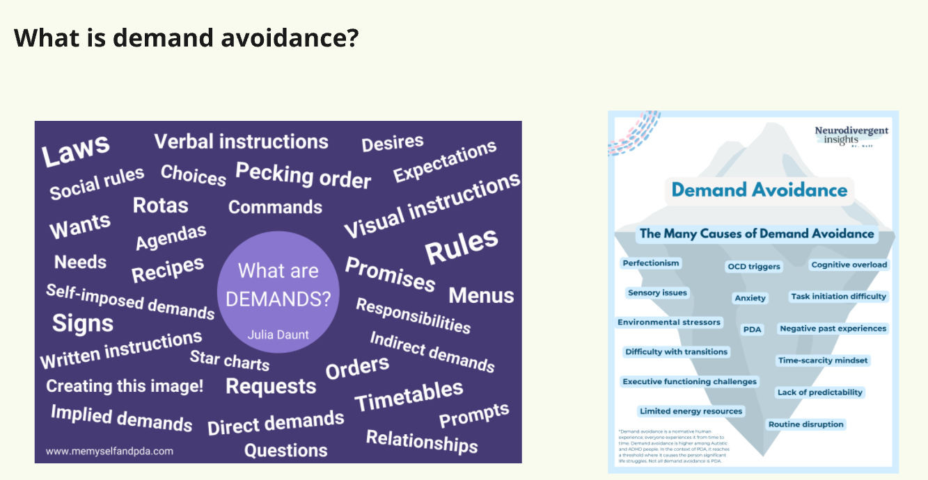
Notes:
I’ll begin with Demand avoidance.
We started quite broad in this exploration and had an open discussion using some infographics as prompts about what demand avoidance feels like or how it might present itself in this context, and captured key points.

Slide 32
Demand avoidance…
…is complex
…is a ‘cannot’, not a ‘will not’
…can be unpredictable
…affects understanding as well as action
…is triggered by all sorts of stimuli
Notes:
What we found was that:
Demand avoidance is extremely complex! There was huge variation in how participants described their experiences, and it can be a complicated thing to live with. Different situations can affect an individual differently, depending on the day.
Demand avoidance is a "can't not a won't" - one participant described the feeling as a "chafing against expectations" - a real barrier and not about just avoiding things you don't want to do - "even things you want to do can be a demand."
Demand avoidance can be unpredictable - it varies day by day, and minute by minute in response to factors like energy levels, other stressors, what the physical space is like, and this makes it quite difficult to manage.
Demand avoidance affects understanding as well as decision making - it's not always about the moment where the individual has to do something or make a decision, that anticipation affects their ability to understand the process or task in the first place.
Finally, demand avoidance can be triggered by language, such as "you can do 'the thing'" or "do you want to 'do the thing', or negative language like "no", “can’t”, or “won’t” it could also be a response to a sense of lost autonomy or assumptions being made, or it could be that the individual is anxious about the outcome of the choice they’re making.

Slide 33
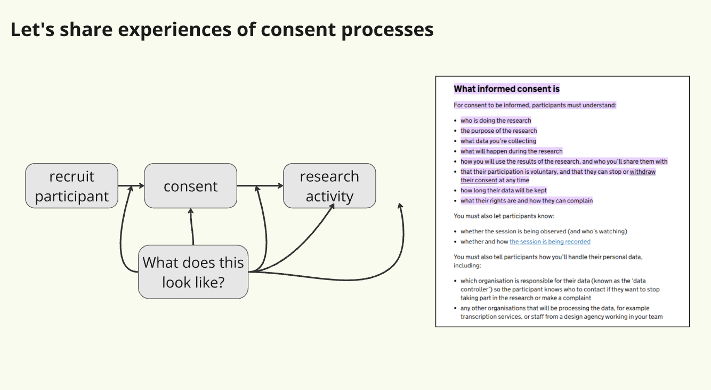
Notes:
We also explored consent forms together to understand what they feel like and what barriers they might present for someone who has these experiences.
Like with demand avoidance, we began with an open conversation about what we know and how we've experienced consent forms in the past.

Slide 34
Consent forms …
…feel difficult for everyone!
…can feel like they’re for the organisation
…can make a chat feel stiff and formal
…can feel like a ‘one off’ event
…shouldn’t be one-size-fits-all
Notes:
What we found was that:
Consent forms feel difficult for everyone! They're too long, they're too wordy, they're not (always) written in a way that helps people understand what they're agreeing to.
Because of that, consent forms often feel like they're for the benefit of the organisation and not the participant.
They can make what originally felt like a fun and informal chat about your experiences feel like something stiff and formal.
Consent forms feel like they're 'done' once they're signed, whereas really there just one part of an ongoing process of making sure people are happy to take part
AND Consent forms shouldn't be one-size-fits-all - they can and should be person centred and support the individual to feel empowered, not intimidated.

Slide 35
Provocation statements
Notes:
A really useful exercise to explore our experiences and perceptions of consent was to use provocation statements - this was a really useful activity to do early on to get the visceral reactions, especially from our lived experience experts who don't necessarily think about consent forms as much as we do, but were also a useful vehicle for us as practitioners to unpack our established ways of thinking about things.

Slide 36
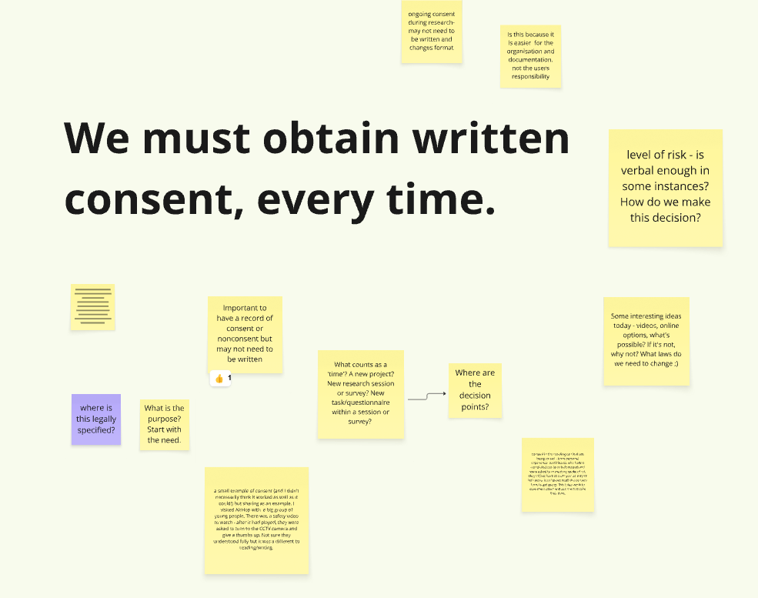
Notes:
I'll give you an example: "We must obtain written consent, every time". Why does consent need to be written? In the public sector, we rely a lot of the time on paper forms and other written documentation but there are examples out there of audio or video recorded consent being effective, or online versions being used that can be more easily adapted to individuals’ needs.
One participant shared an experience of being with a group of young people who consented to an activity after a safety briefing by giving a 'thumbs up' to a camera – their reflection was that they weren't sure exactly how well the young people understood what they were doing, but it was a very different feeling to a six-page consent form.
This activity was a great way to let the group unpack the idea of consent and consent forms from different angles.

Slide 37
Takeaway
Consider how different participants might respond to the same activity
Notes:
Think about how different participants will respond to one activity: design sprints are about bringing together different minds and experiences to tackle a problem, so I think when you're designing your activities it's important to think about how those different individuals will approach, contribute, and take away from the experience.

Slide 38
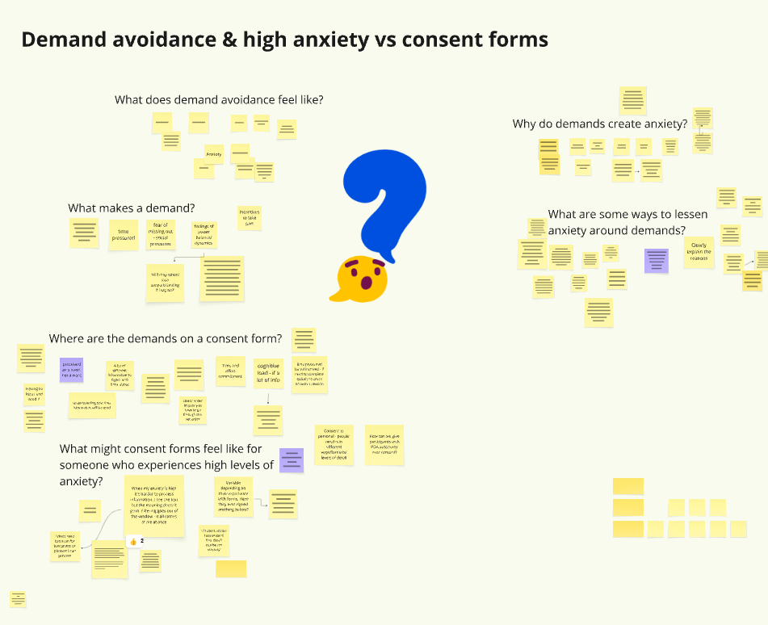
Notes:
Finally, after exploring demand avoidance and consent forms separately. we brought those two areas together to start talking about how demand avoidance affects the way consent is experienced, and by the end of day one we had summarised our collective understanding of the problem:

Slide 39
Consent forms present several demands.
Demands cause anxiety for several reasons.
There are several things we can do to mitigate this.
Notes:
Demand avoidance feels like anxiety, and a sense of overwhelm. It can feel like a resistance, and an instinctive response.
Consent forms comprise several different demands:
time
information processing
learning
evaluating risk
expectations
recordings
Those demands create anxiety because of:
a loss of autonomy
worry about consequences
worry about perfectionism
worry about expectations
We might mitigate that anxiety by:
giving people time
giving them a motivation
giving them a reason
giving them options/alternatives
in general being open, honest and human as a researcher and enable the participant to do the same

Slide 40
Ideating about solutions
Notes:
In a design sprint, Tuesday is usually about ideating, or coming up with possible ways to address problems identified and explored on the Monday.

Slide 41
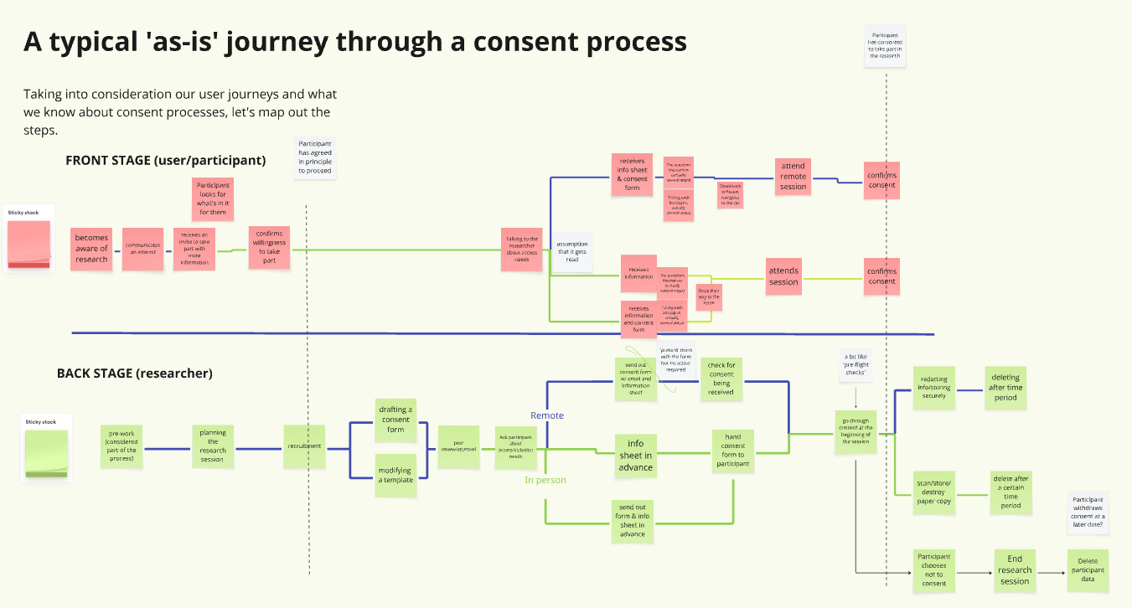
Notes:
We dug a bit deeper into consent procedures by constructing an as-is process map together of all the things that happen from when the participant becomes aware of the research right through to when they take part in the research, and the 'gates’ they go through to get there, for example the point at which they've agreed in principle as part of the recruitment process and when they could be considered to have fully consented to take part.

Slide 42
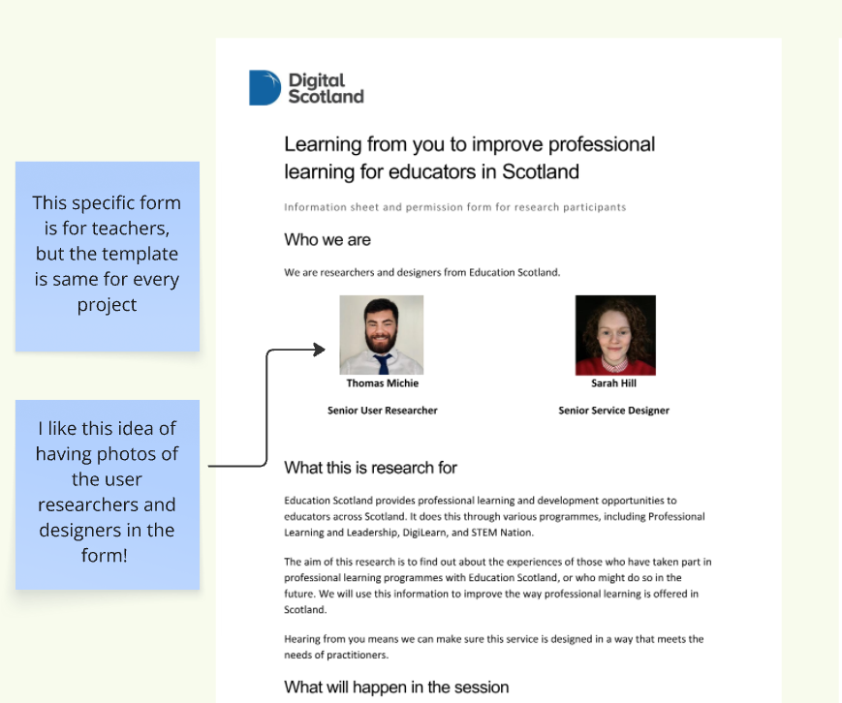
Notes:
We also reviewed some existing consent forms to see what we could learn from what's already being done. I shared our Scottish Government template example which already incorporates some of what we'd discussed – for example, sharing a picture of who’d be at the research session and being up front and detailed about what we’d be asking about in the session, and also the fact that we called it an information and permissions form, which reminded us of discussions we’d had about language and whether consent was the right word to be using in the first place.

Slide 43
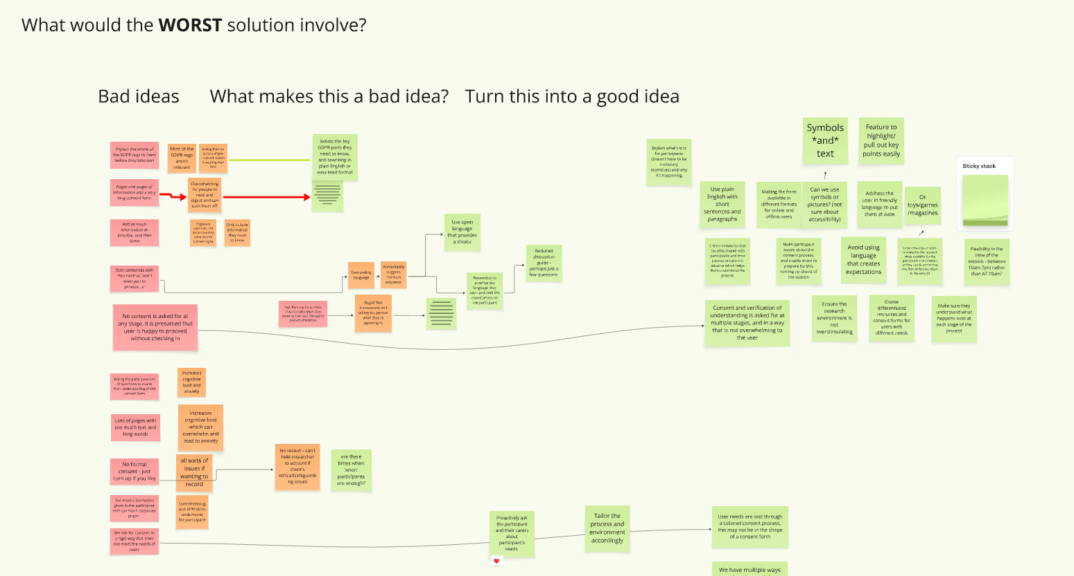
Notes:
Once we felt like we'd pulled together our collective thoughts, we started playing around with solutions using a variety of techniques, including 'worst first'. For anyone not familiar, worst first is a technique for coming up with creative solutions by starting, as the name suggests, with the worst ideas imaginable first. Some of our terrible ideas were:

Slide 44
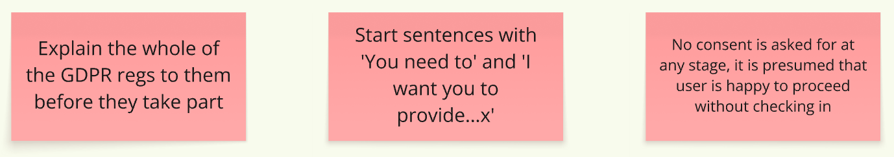
Notes:
Explain the whole of the GDPR regulations to them before they can take part
All sentences start with "You need to " or
No consent is asked for at any stage, we assume the participant is happy to take part
The next step for these awful ideas is to ask ourselves, "why is that a bad idea?", and then, "how can we turn this into a good idea?".

Slide 45
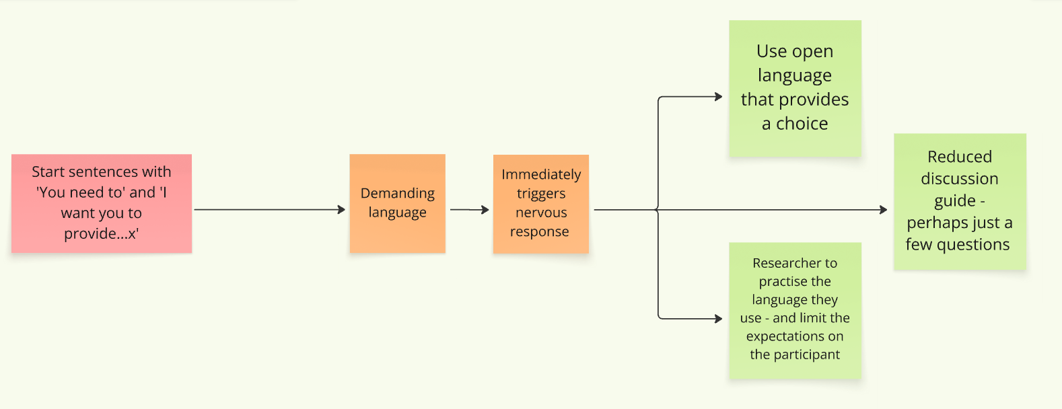
Notes:
For example: we know from what we found out on Monday that 'You must' is demanding language that can trigger a nervous system response for someone who is anxious or experiences demand avoidance, so we can make that a good idea by
using more open language that provides a choice,
or by the researcher practicing and being deliberate about the language they use

Slide 46
Worst idea themes
Low detail about what will happen
Too much about things that feel unimportant
Rigid expectations on the participant
Lack of thought and consideration
Notes:
After going through this process with a few of our bad ideas, we started to identify some themes. Common themes from our worst ideas were
Not enough detail about what's going to happen leading to participants feeling anxious and ill informed
Too much detail about things that don’t feel important, like aspects of data protection or corporate jargon, leading to the participants feeling overwhelmed
Rigid expectations of the participant, which causes them to feel stressed and uncomfortable
A general lack of thought around the consent process, which causes participants to feel like they haven't been thought about

Slide 47
Best idea themes
Conscious decisions about language
Clear expectations
A clearly communicated exit strategy
Making the need to know easy to find
Being person-centred, not process-centred
Notes:
Comparatively, our best ideas commonly included
Making conscious decisions around language and written communication
Being clear about what the participant can expect, and what’s expected of them
Ensuring there’s a clearly-communicated exit strategy
Making the 'need to know' easy to find AND
Being person-centred, not process-centred
So, by the end of Tuesday, we had started to formulate what a better process might look like…

Slide 48
Revisiting and refining
Notes:
Day three of a design sprint is about refining and deciding on a solution to develop. We used it as a day to take stock of what we’d one, so our aim on Tuesday was to refocus and refine our objective in light of what we'd discovered on Monday and Tuesday. I’ll fast forward a bit through Wednesday and Thursday so we can get to the research on Friday.

Slide 49
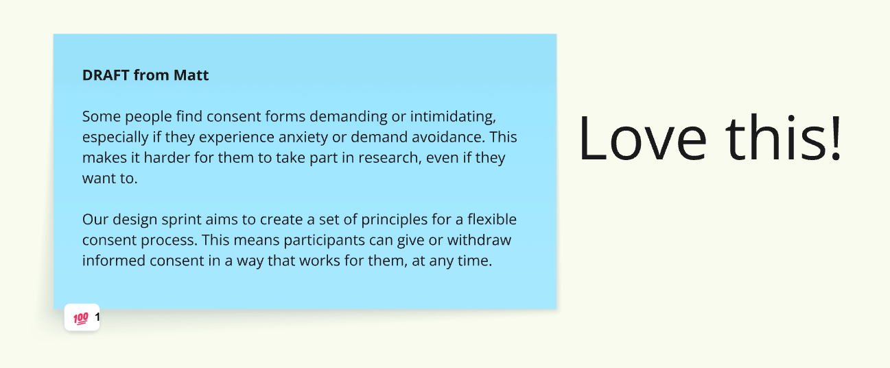
Notes:
So, we revisited our problem statement, to expand and unpack what we'd originally started with, and then used dot voting to bring it back together into a refocused and refined problem statement:
Some people find consent forms demanding or intimidating, especially if they experience anxiety or demand avoidance. This makes it harder for them to take part in research, even if they want to.
Our design sprint aims to create a set of principles for a flexible consent process. This means consent participants can give or withdraw informed consent in a way that works for them, at any time.

Slide 50
Takeaway
Keep referring to the problem you’re trying to solve.
Notes:
Keep referring back to and refining the parameters of the problem you're trying to solve. When navigating a complex space like this. It's easy to get waylaid, side-tracked, and maybe a bit lost so it's helpful to refer to your initial scope regularly and adjust or refine it where it's helpful.

Slide 51
Let’s make something
Notes:
After refining our problem statement and summarising what we'd learned together on Wednesday, on Thursday we started drafting something we could test.

Slide 52
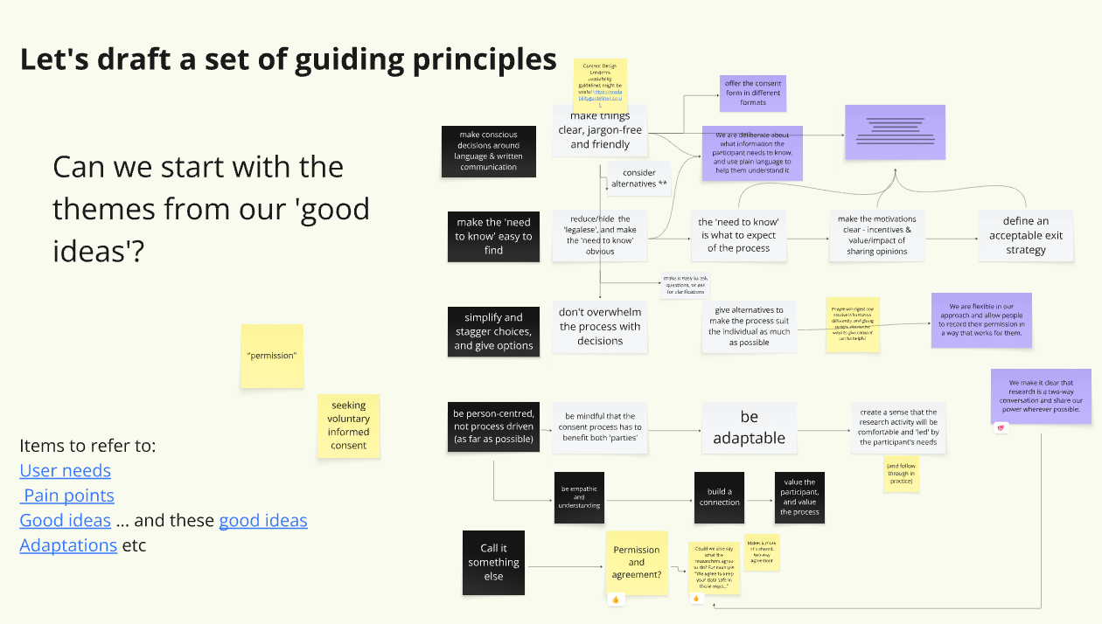
Notes:
We began by drafting a set of guiding principles for researchers and organisations to follow when thinking about consent. There were two reasons we approached it like that:
We'd highlighted that the consent form was only part of a wider consent process, and any part of that process could cause someone who experiences anxiety or strain, so these principles would hopefully allow people to think about their process more holistically
We also recognised that, while we want this process to be as person-centred as possible, there are still organisational requirements around consent, and just designing a new super inclusive consent process wouldn't necessarily be widely applicable to different organisations and contexts.
We then broke into four groups and, again recognising that consent is a journey, each took a step in the process to apply our new principles to - before, during and after the research, plus one group for how we might record consent - fleshing out what a process adhering to our new principles might look like.

Slide 53
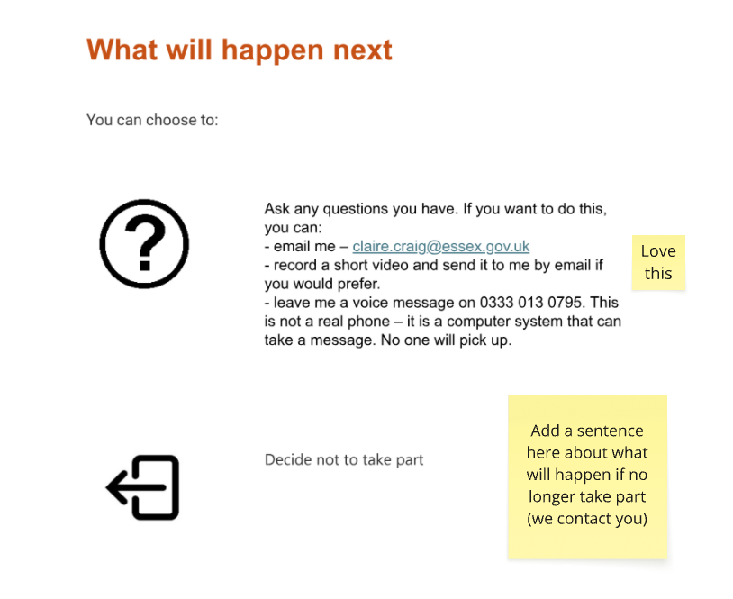
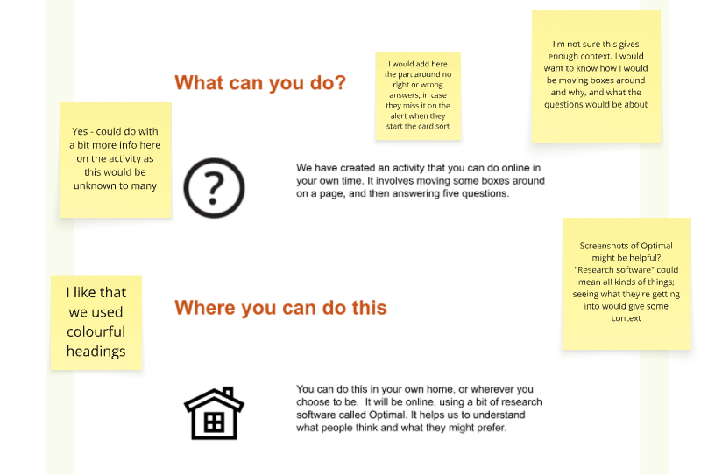

Slide 54
Research with
users
Notes:
The sprint culminated in a piece of research with a number of young people who had experience with demand avoidance or high anxiety, to test the process we'd constructed based on our draft principles. As Claire mentioned, doing user research about how to do user research had a few tricky challenges to contend with, and things got a bit meta...

Slide 55
How do you test an improved consent process without using a consent process you know might be bad?
Notes:
How do you test a to-be consent process, without it being preceded by an as-is consent process (which feels a bit unethical given all the challenges we'd identified for this user group). After a bit of head-scratching and conversations we decided we could employ the 'new' consent process, as long as we make it clear this is part of the testing, invite feedback on it in a variety of ways, set up a 'standard' research activity for participants to complete.

Slide 56
How do you design an appropriate research activity for people who experience demand avoidance?
Notes:
How do you design an appropriate research activity for people who experience demand avoidance? We came up with a few ideas to reduce the demands on the participant: we kept the activity short, we made it something that might feel familiar or engaging, and we heard from parents that the young people would be less likely to engage with a researcher directly, so we made the activity an individual, online activity.

Slide 57
Takeaway
Plan your research (roughly) in advance
Notes:
Plan your research in advance. Although ideally, you’d want to stay really open about what you’re researching or testing in the design sprint so that you can do that authentic exploration and ideation, then plan the research to fit. In reality, planning research and recruiting participants takes time, and I don’t know if we’d have managed to do the research activity we did if Claire hadn’t done that up front work weeks ahead of the sprint to at least identify interested participants and tee them up to take part.

Slide 58
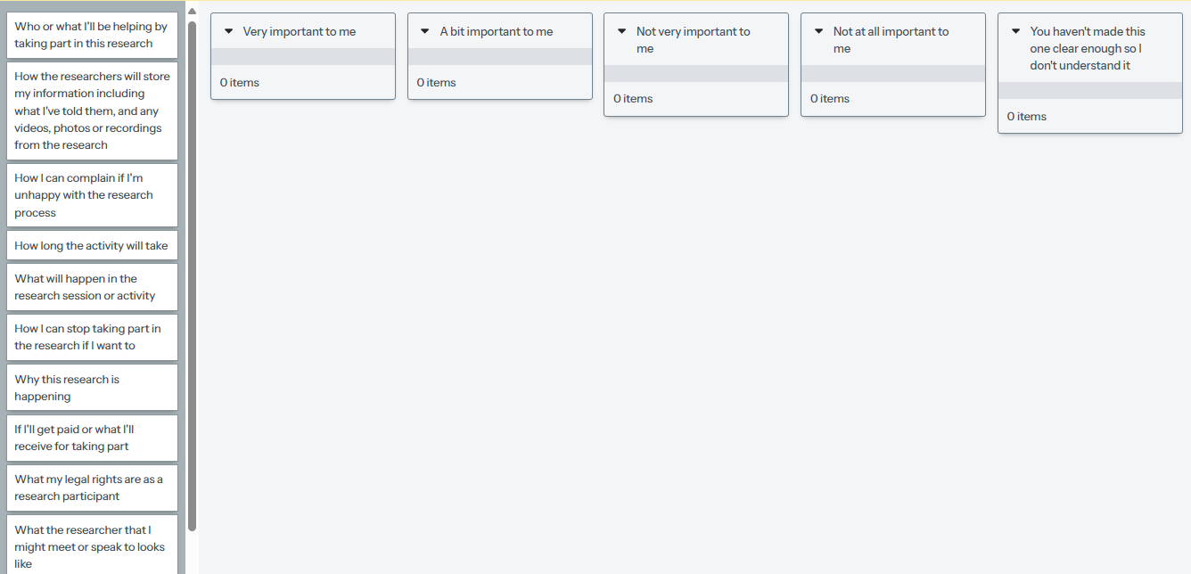
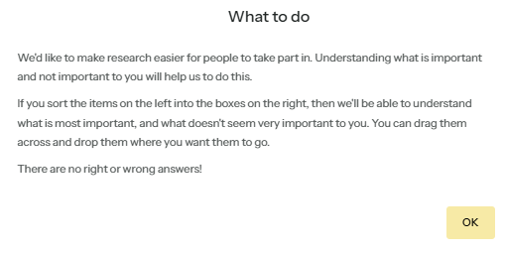
Notes:
In the end, the research activity consisted of the participants going through the 'to-be' consent process, taking part in an unmoderated card sort which asked them to rank the components of a consent form in order of personal importance, and finally a short series of questions asking for feedback on the consent process they’d been through.

Slide 59
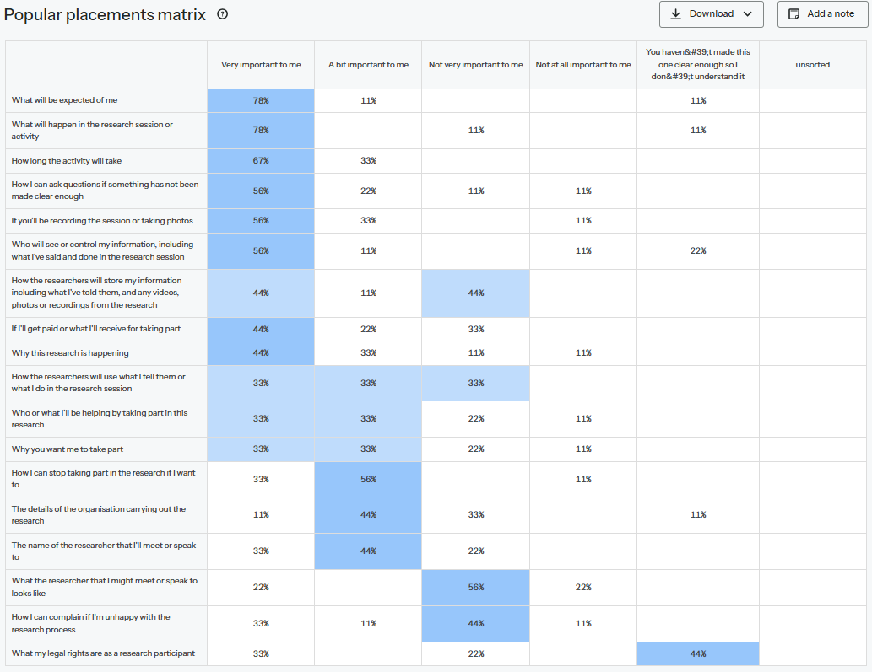
What is going to happen
What is expected of me
How long it will take
Who will see my information and what I say
Legal rights
How to make a complaint
What the researcher looks like
Notes:
So how did the research go? In the end, 9/10 of our participants took part, and the card sort activity itself validated what we'd identified in the sprint as important information for participants who experience demand avoidance: what's going to happen, and what's expected of me? Other important components were how long the activity will take, and who will see my information and what I say.
The parts which were less important for the most participants were things like legal rights (which half of the participants said were not at all important to them), how to make a complaint, and what the researcher looks like (though it's worth considering if that last one is because this was an online unmoderated study).
In terms of the new consent process, we got some really valuable feedback.

Slide 60
“I liked the way it was laid out in small sections of text which were spaced out and had pictures, as this made it quicker and easier to read and understand and it wasn't too wordy.”
“I found it very clear and easy to understand - which was comforting and made me feel confident to begin the tasks and that I wouldn't be confused.”
Notes:
In general, providing the information in the way we did was received positively. Participants were likely to say that either it was helpful, it was clear, and/or it made them more comfortable about taking part in the research.

Slide 61
“I also didn’t really focus on it (it was kind of boring, sorry). It was a bit overwhelming, too”
“It was too all over the place, so I didn't really take it in.”
Notes:
However, two people still found it overwhelming, and there was some sense that the information was "all over the place", so we need to investigate ways to reduce that feeling where possible.

Slide 62
“My mum read out the bits, but I didn't really get it.”
“My mum read it, not me.”
Notes:
For some young people experiencing demand avoidance, the parents were key in making them more comfortable to take part, and may have played a role in reducing the overwhelm, so that channel or conduit should also be considered.

Slide 63
“Completely understanding what I should expect and what is expected of me is very important for me and how I am able to complete tasks and take part in things.”
Notes:
Overall, being well-informed and a sense of autonomy was really key for people who experience demand avoidance. We should reduce the cognitive load of processing this information as much as possible by giving easy access to the bits that are most important to individuals.
I’m going to hand over to Mansoor to talk a bit about how we can apply this work more widely, and the impact it’s had at the Home Office.

Slide 64
What might a new consent form look like?

Slide 65
What might a new consent form look like?

Slide 66
What might a new agreement and permissions process look like?

Slide 67

Before research
Consider language
Tailor the process
Share information in advance
Ask if they’d like to continue
Notes:
Making conscious decisions, be concise and engaging
...to the project, participants, context
That could be an info sheet, and / or other formats, such as video
In a way that minimises (subtle) pressures to say yes

Slide 68

During research
Have a clear clarification, pause, and exit strategy

Slide 69
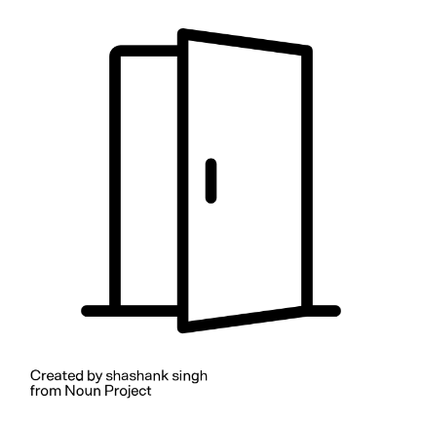
After research
Ask for agreement to use their information
Refer them back to previous information
Keep them updated

Slide 70

Takeaways
People with demand avoidance need: Autonomy – being able to ask questions and to say ‘no’
Clear expectations – authentic informed consent
Clarity – reduce overwhelm
Notes:
Give options, use the right language, change terms to reduce power imbalances, shift the responsibility of understanding
What does a participant needs to know? What do they want to know?
Remove jargon and legalese, allow participants to pick what they’re interested in

Slide 71
Case study: Working with specialist recruitment companies

Slide 72
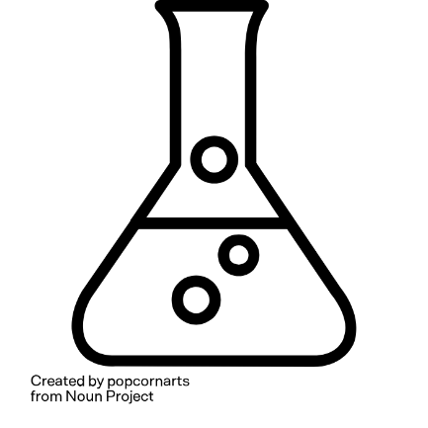
How universal are these needs?
Can we test these principles in other contexts and with other user groups?
What happens when there are extra variables or barriers to consider?
Notes:
Hypothesis – as with the wider approach to accessibility, making things accessible for one group of people will often many other groups (or the whole population). Can we test the approach with a very different context / user group?

Slide 73
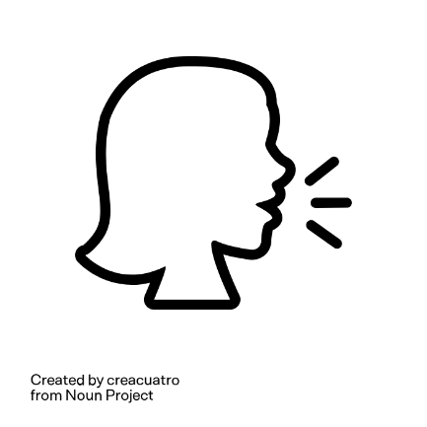
The context
Home Office DDaT works with specialist community organisations to recruit seldom heard (hard to reach) research participants
Recruitment and screening is handled by community engagement leads in the partner organisation. They manage the crucial early stages of getting consent
Notes:
We’ll use these organisations to recruit participants who might be digitally excluded, have access needs, and/or be part of communities and groups where there are mixed levels of trust in the Home Office.
This can also mean heightened concerns about data sharing. An org we have worked with over the last few years does lots of work to build trust with potential participants, invite them to research on our behalf, and limit the amount of information that is shared with HO URs.

Slide 74
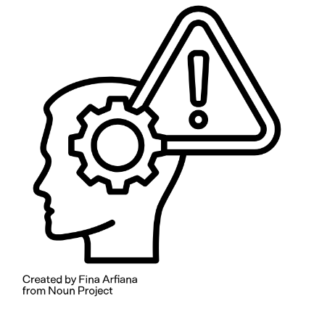
The problem
Standard consent templates led to:
Overwhelm for participants (and translators)
Not reflecting unusual data handling processes

Slide 75

Solution 1
A simplified version of the consent form drafted by the external community engagement lead
Notes:
Really good for conciseness and ease of use – good for URs, good for community contacts and translators, and *maybe* good for participants to avoid overwhelm (but some hidden costs here that might impact on how informed they were)
But not as much focus on legal duties to be transparent about processing activities, data subject rights etc.

Slide 76
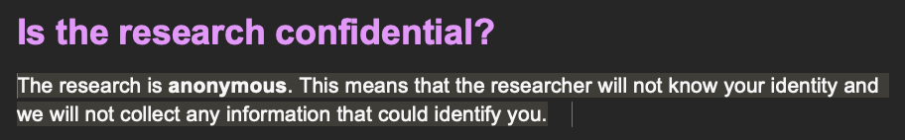
Solution 2
A version developed internally that aimed to reassure participants that no personal data would be shared with the Home Office
Notes:
But this led to new confusion as we then focused on Home Office contacts when telling people how they could exercise their data rights

Slide 77
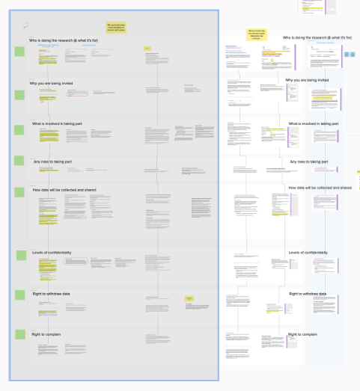
Solution 3
Collating all the examples of variant consent forms that we could find to construct an ‘ultimate’ version
Notes:
Lots of effort – and based on the false assumption that there is a platonic ideal of a perfect info sheet / consent form that we can produce – but it’s more important to focus on the wider process, what you say around the consent form, tone etc.
Consent documents are not the consent process

Slide 78
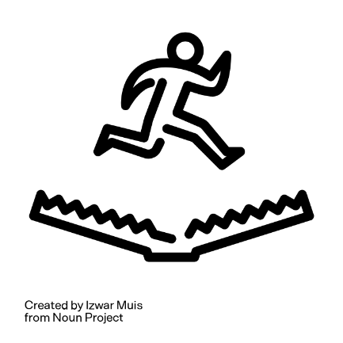
The ‘template trap’
Templates solve a problem – but can create new ones!
Researchers don’t always know what they can edit
https://www.nngroup.com/articles/template-trap/
https://youtu.be/sSZEVLG4Vp0?feature=shared
Notes:
The Home Office ethics board was seeing consent materials that were longer than they need to be, or introduced confusion about data handling
Sometimes this is about time constraints, but often this comes from a place of wanting to do the right thing and being worried about removing something important.
It’s tied to the assumption that it is possible to create a single, perfect template that will apply in multiple contexts with minimal editing.
We don’t need to throw the baby out with the bathwater and get rid of templates altogether – they do have value – but we sometimes need to re-think how we use them.
…and where there were opportunities to further tailor the language, format, or process

Slide 79
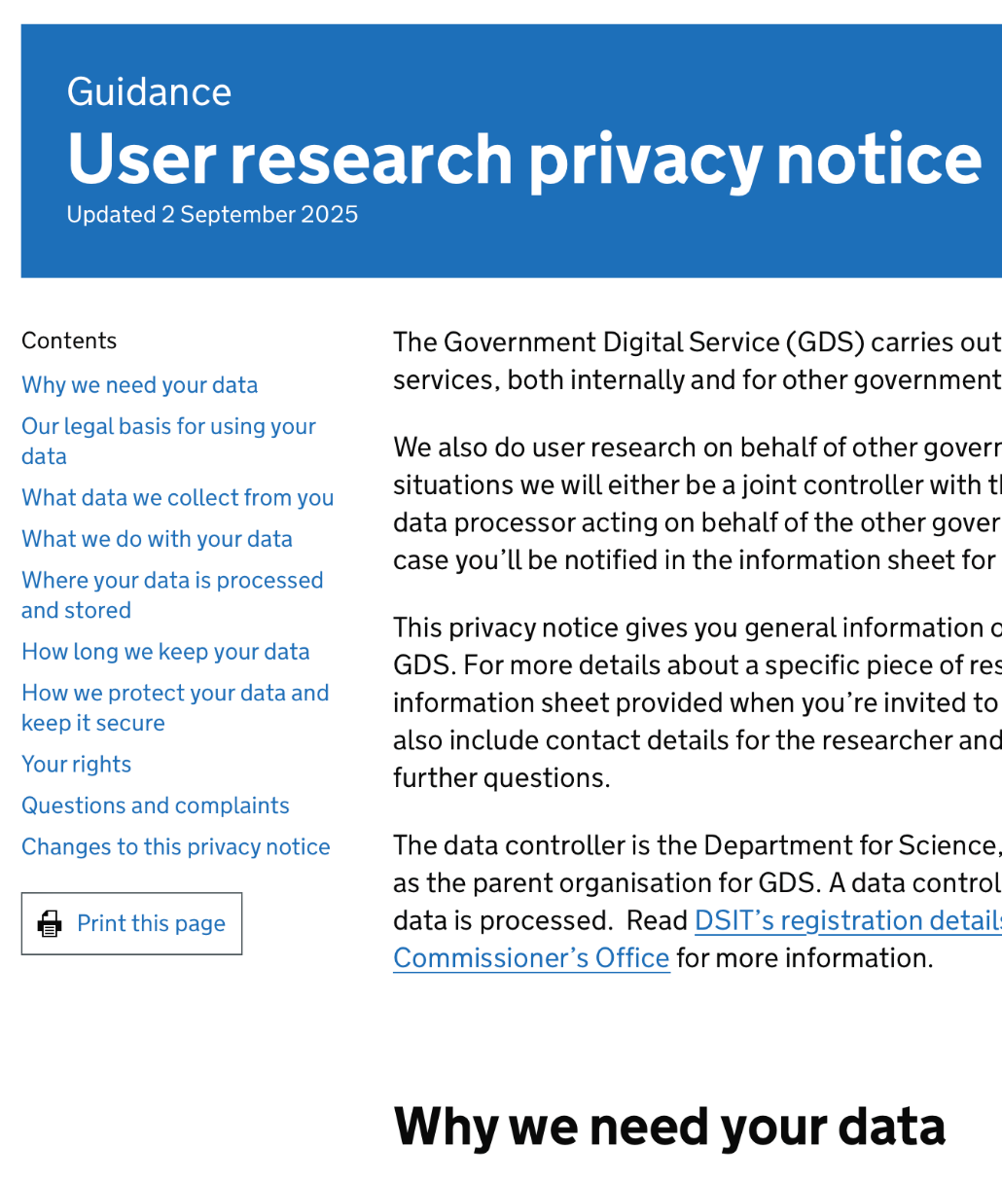
The GDS UR privacy notice
An example of communicating privacy info in a way that aimed to harmonise the needs of participants, researchers, and the organisation (legal duties)
https://www.gov.uk/government/publications/government-digital-service-user-research-privacy-notice/user-research-privacy-notice
Notes:
Again, the theme of collaboration was key here – it was me (a UR), a content designer, and a privacy / legal expert working together to balance all these needs and considerations

Slide 80
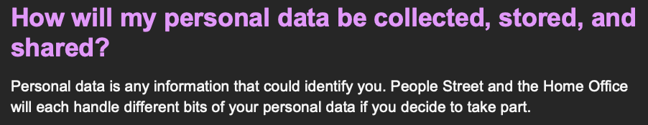
The refined solution
Transparency about what data each organisation will process - plain language (and making translation easier)
Shifting how we use templates – including modular and visual materials, and avoiding the ‘template trap’

Slide 81

The refined solution
Looking beyond templates to consider:
Guidance
Training
Peer review processes

Slide 82
Takeaways
Needs we uncovered during the sprint are relevant to other user groups and other contexts
Focus on the wider process and the outcomes!
Ask the question: “Who are consent processes for?”
Harmonise needs of the org, researcher, and participant
Reassure, but don’t over-promise!
Notes:
– not just on a single ‘perfect’ template (that doesn’t exist)!
- Legal duties (but in some cases there could be other considerations like reputational damage, sharing sensitive info about future potential services etc.

Slide 83
The big ‘why’
- solving complex problems collaboratively and quickly through design sprints
- improving consent processes
- thinking about PDA/extreme anxiety as an emerging area of inclusion and accessibility
Notes:
We came to tell you about three things – solving complex problems collaboratively and quickly through design sprints, improving consent processes and thinking about demand avoidance or PDA as an emerging area of inclusion and accessibility.

Slide 84
The big ‘so what’?
Consent is a two-way dialogue with power shared equally, authentically
Everything we learned about consent and PDA can be applied to consent in design research generally
Consent applies in multiple contexts
Notes:
As a result of our design sprint, we’re thinking about consent processes differently generally – as a two-way dialogue with a real share of power and Mansoor highlighted a case study of how applying that new consent process to a more general audience worked. It’s also important to flip this inside out – how can you consider demand avoidance and anxiety among service users in more general contexts? What struggles might someone with PDA or extreme anxiety have accessing your services?

Slide 85
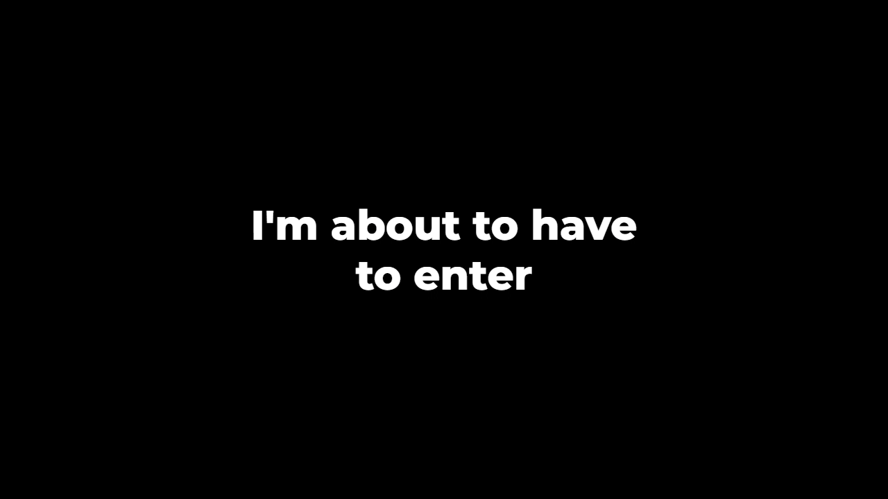
The big ‘so what’?
Notes:
I have another audio clip from the family I spoke to that highlights some of the difficulties with consent in other contexts…

Slide 86

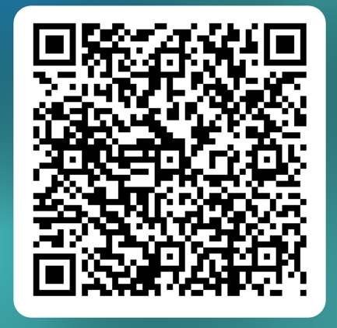
The bigger ‘so what’?
Communicating with people with PDA requires:
- non-demanding language
- maintenance of the other’s autonomy
- consideration of needs
- flexibility
- time
- giving, and gratitude when taking
Stay in touch!
Notes:
We’d like more people to join our work on this – if you’d like to get a copy of our write-up, or our guidance on new agreement and permissions processes, please stay in touch – the QR code will take you to a form where you can send us your email, and we’ll be able to stay in touch. We’d be really interested in hearing from anyone who would like to try this new approach to consent in research, or elsewhere.
Isn’t it always the way that when you think inclusively, you generally just think better?

