Slide 1





Policy Design
at Pace
How service design can help navigate and shape
emerging policy
September 2025
thisisgain.com

Slide 2




Hello!
James Dotti
Senior Service Designer
Astrid van Waveren
Head of Insights & UX
GAIN
Digital Data Technology
thisisgain.com

Slide 3

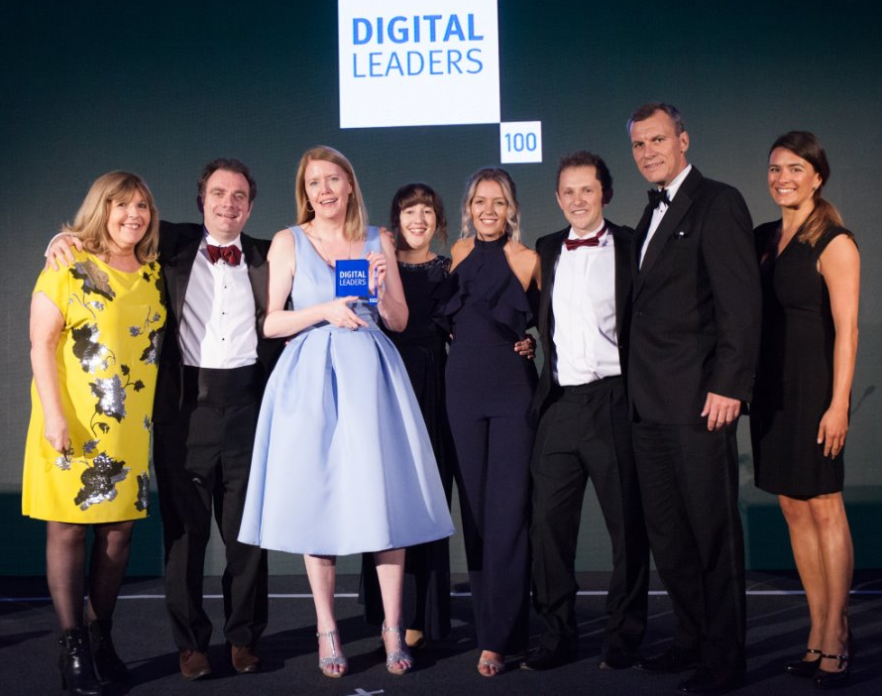
The Apprenticeship Service
250k
New apprenticeships
starting every year
£130m
Levy paid out
every month (approx)
Top 75 Gov Service
Including one of the most
used Government services.
Public sector innovation award - digital leaders 2018
thisisgain.com

Slide 4

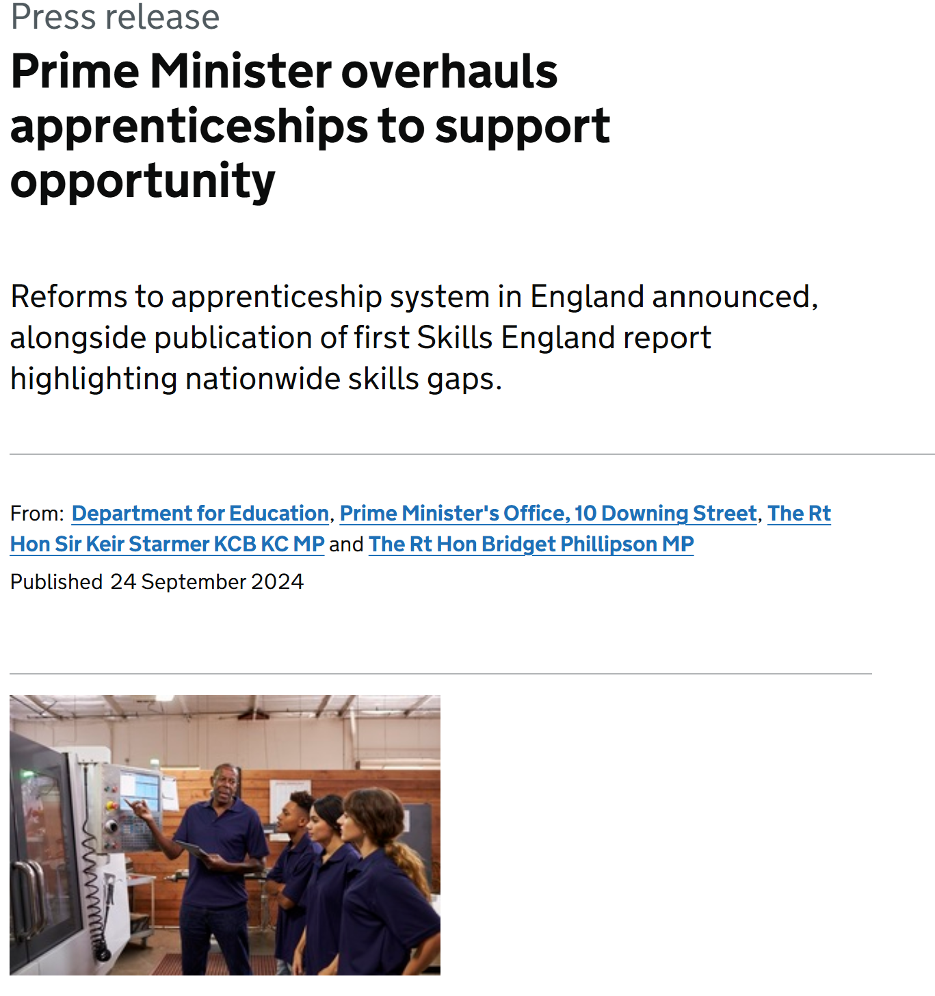
The new 'Growth and Skills' offer
Delivering greater flexibility.
Supporting growth and opportunities for young people.
Encourage greater employer investment in skills shortage areas identified by Skills England.
thisisgain.com

Slide 5


Challenges
The process of policy design wasn't linear - it was organic and incremental.
Timelines were tight and already announced publicly - we had to impact at the same time as shape policy.
Balancing policy ambition with delivery pragmatism.
It's a complex context across a wide stakeholder network, ecosystem, dependencies, 8 delivery teams to coordinate
thisisgain.com]
thisisgain.com

Slide 6
What we did first
1. Intensive cross-team collaboration.
2. Leaning into the complexity.
3. Uncovering the unknown.
4. Asking the difficult questions.
First steps
Phase 1
Phase 2
thisisgain.com

Slide 7

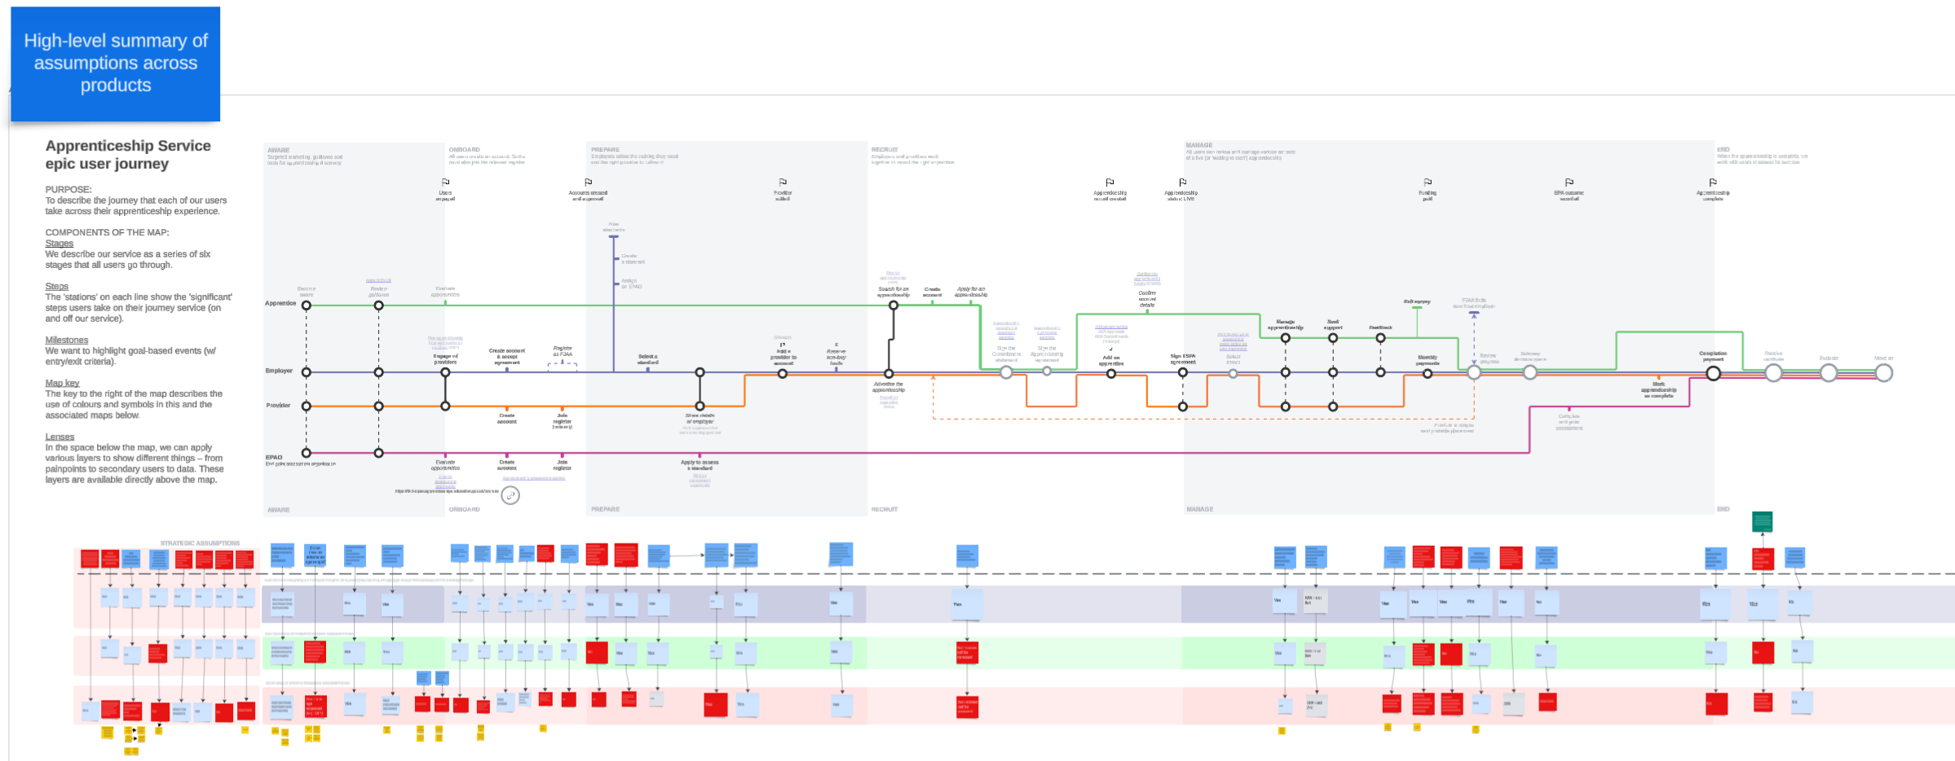
Phase 1
Mapping priority assumptions
and questions
Similarities and differences
Focus on higher levels of certainty
Weekly touchpoints
First steps
Phase 1
Phase 2
thisisgain.com

Slide 8
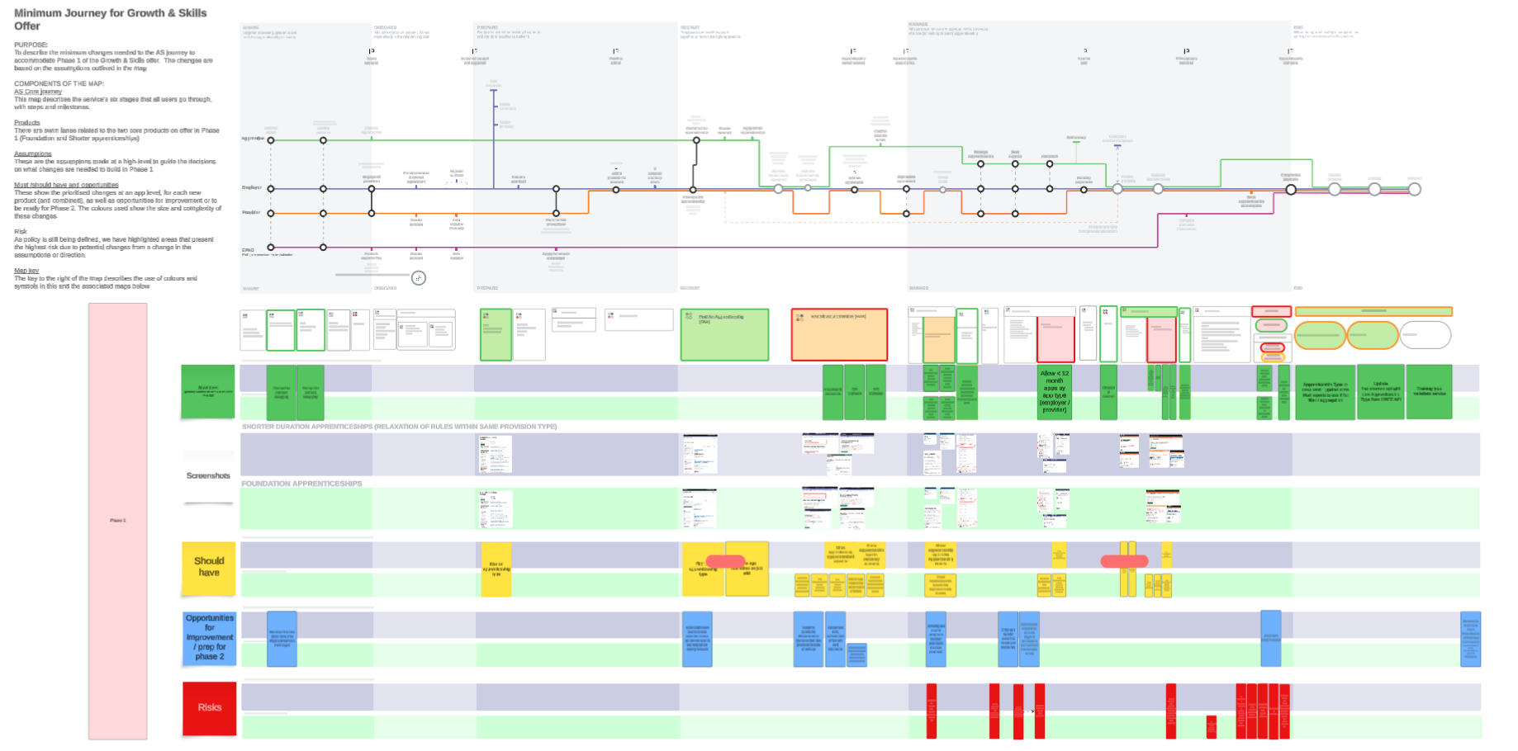
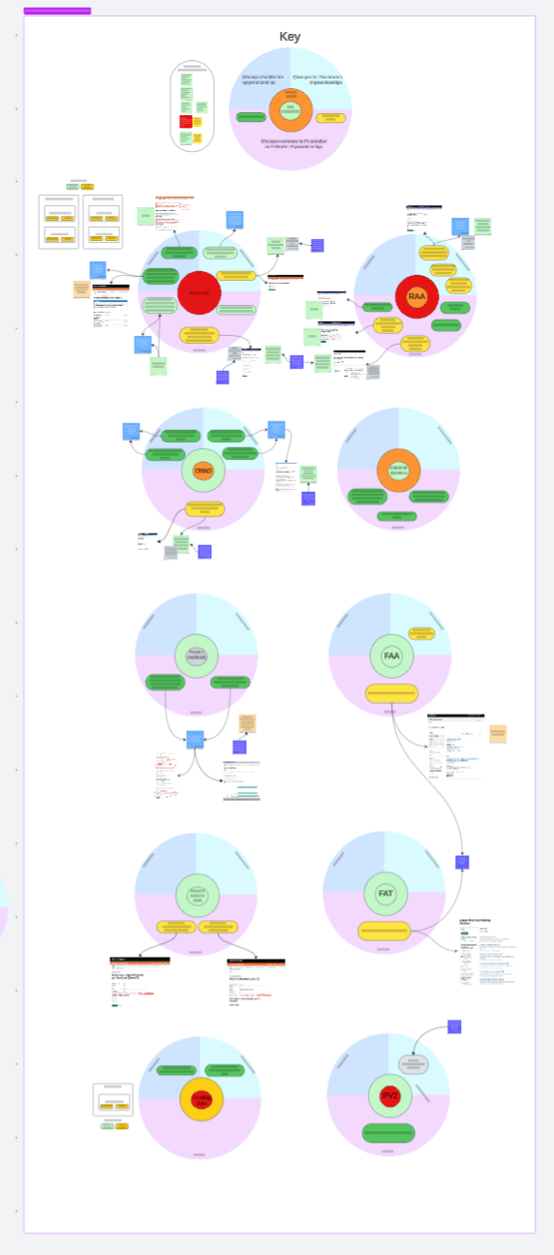
Phase 1
Impacting and prioritisation
Systems and service impacting
Estimation and prioritisation of work
Delivery roadmap
First steps
Phase 1
Phase 2
thisisgain.com

Slide 9
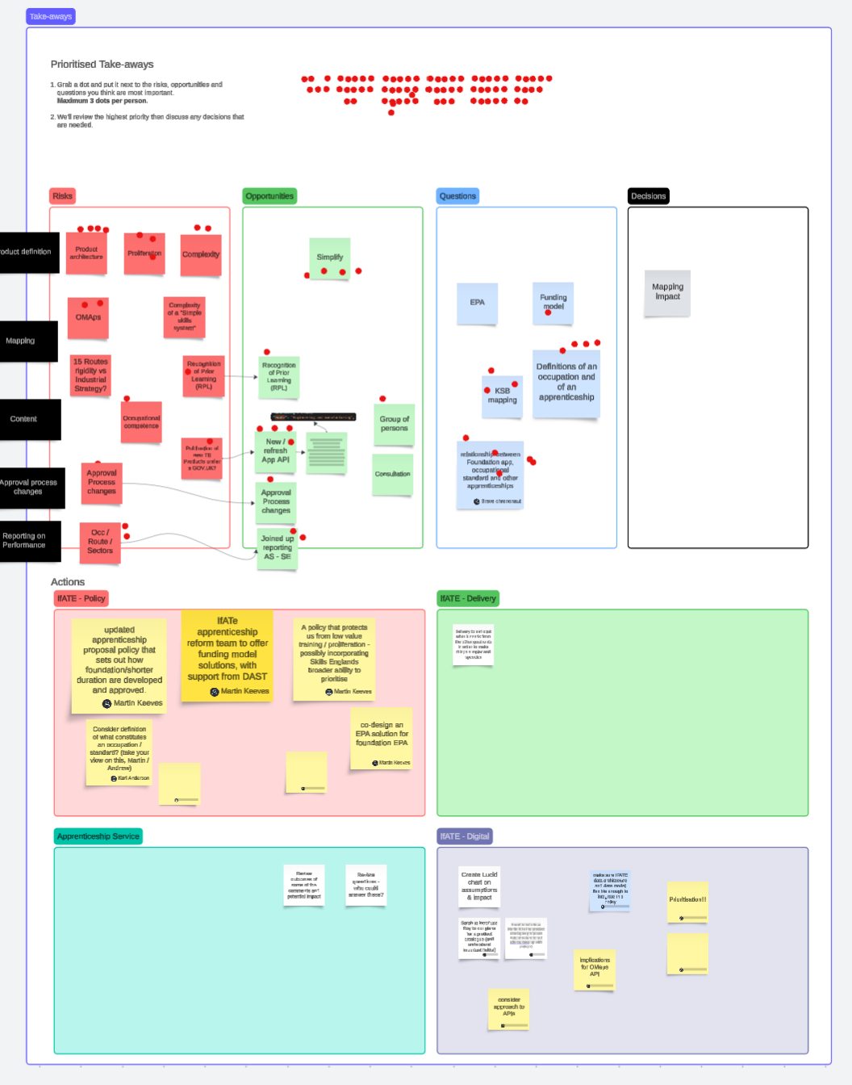
Phase 1
Wider stakeholder engagement
New conversations and dependencies
Workshops with wider stakeholders
Co-ordinated
delivery planning
First steps
Phase 1
Phase 2
thisisgain.com

Slide 10
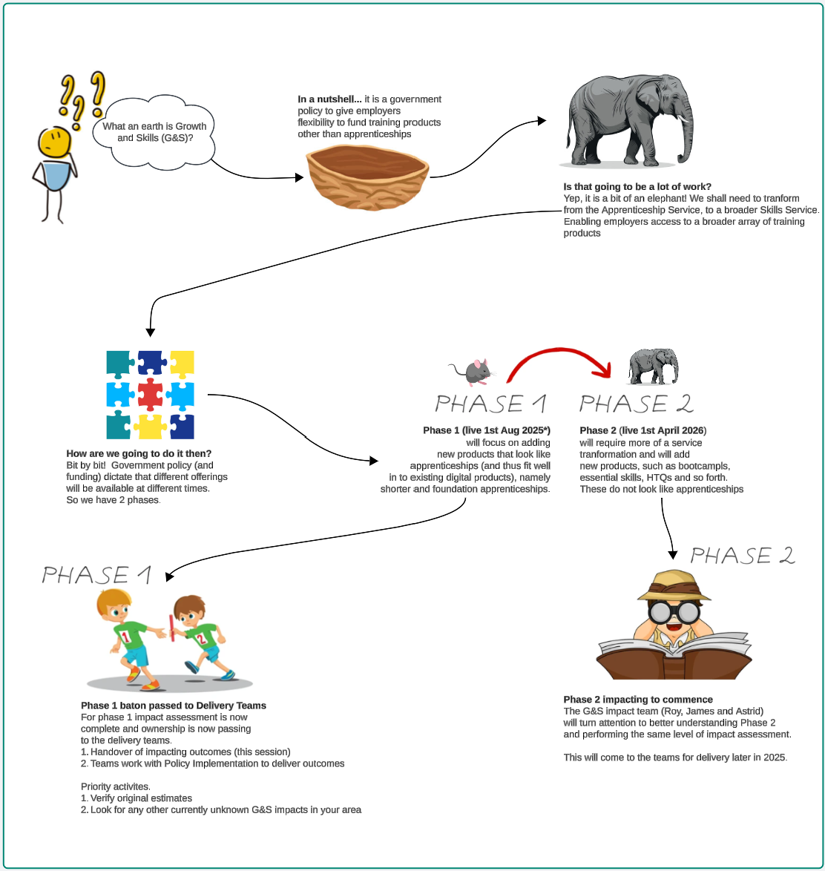
Phase 1
Handover and validation
High-level impact and validation of work required
Documentation of requirements
Handover sessions
with teams
Ongoing support
First steps
Phase 1
Phase 2
thisisgain.com

Slide 11

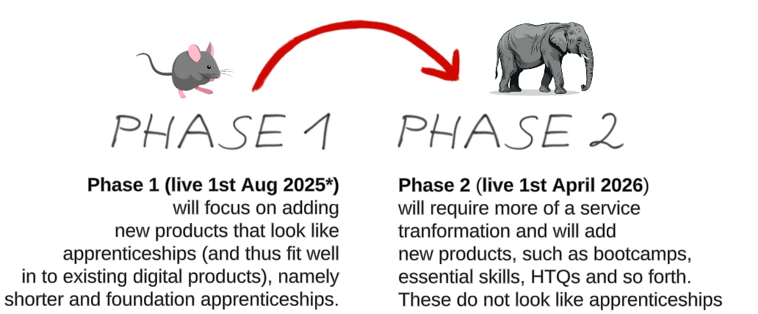
thisisgain.com

Slide 12
Phase 2
Additional complexity
Spend review
Multiple changes in policy direction
Launch of Skills England
Wider DfE dependencies
First steps
Phase 1
Phase 2
thisisgain.com

Slide 13
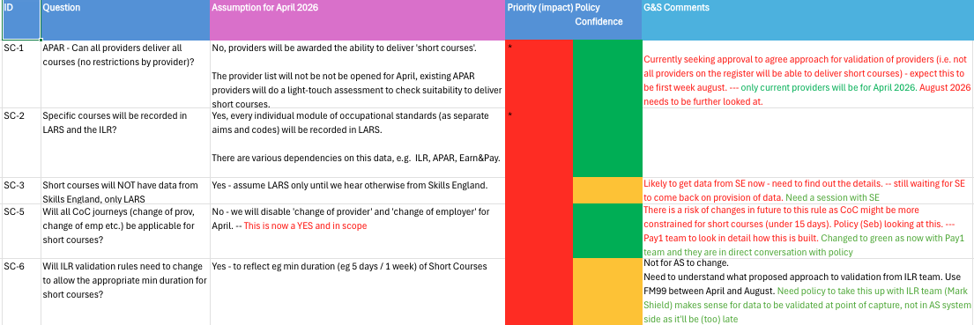
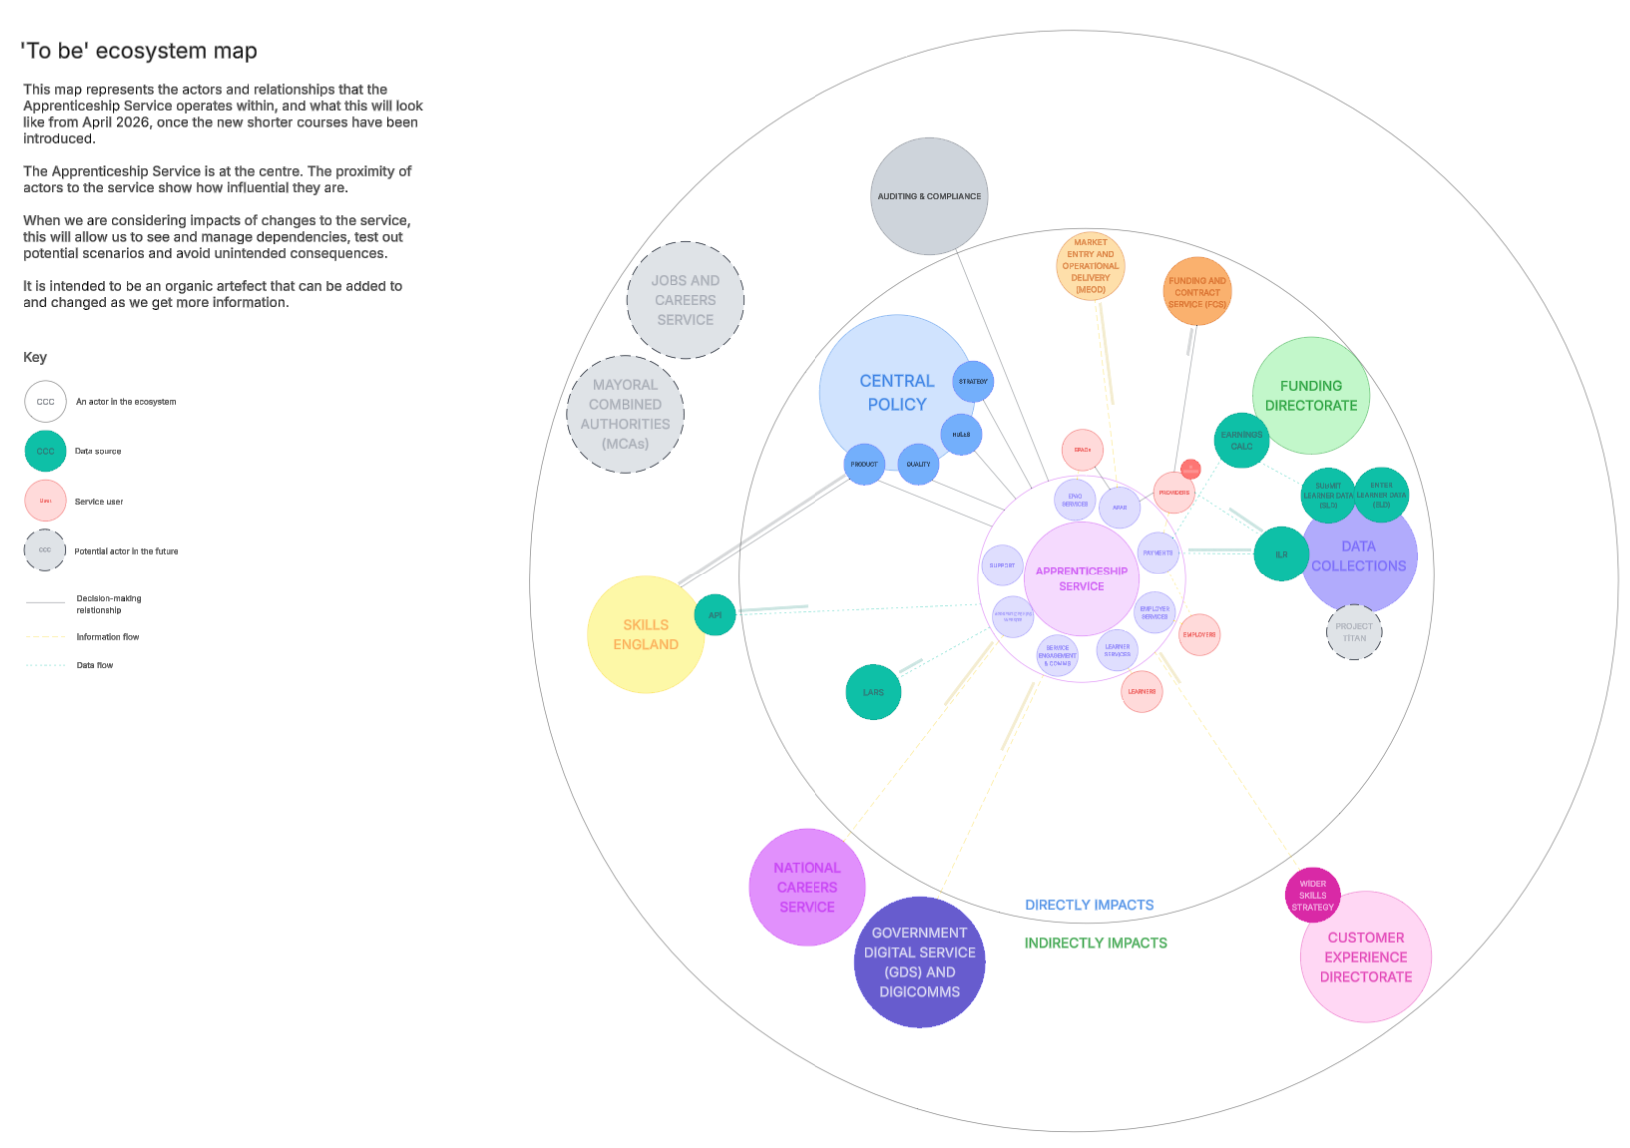
Phase 2
Evolving approach
Assumption mapping
Stakeholder goals
Ecosystem mapping
First steps
Phase 1
Phase 2
thisisgain.com

Slide 14
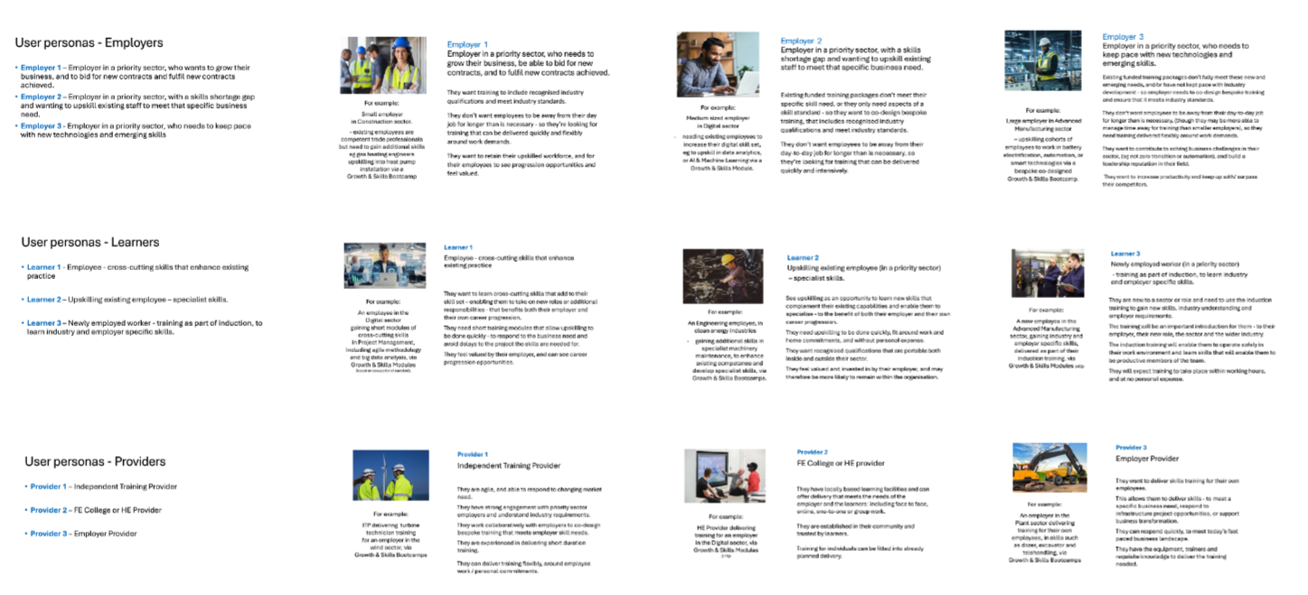
Phase 2
User perspectives
Understanding 'as is' user profiles, pain points and needs
Comparing to AS
Identifying questions for UR
First steps
Phase 1
Phase 2
thisisgain.com

Slide 15
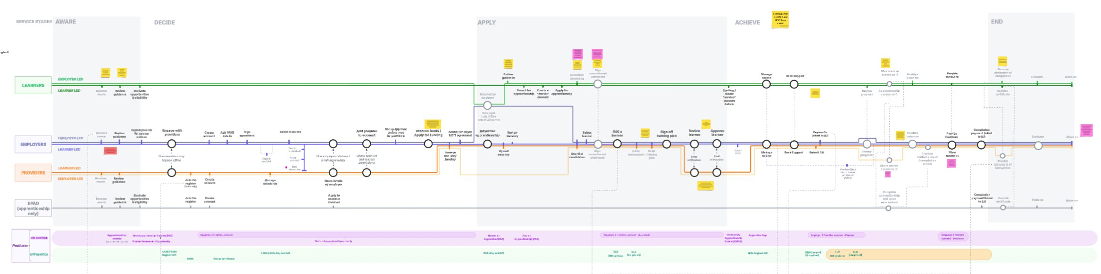
Phase 2
Policy collaboration and co-creation
First steps
Phase 1
Phase 2
thisisgain.com

Slide 16

Service Evolution
thisisgain.com

Slide 17
Results
Phase 1 successfully delivered.
Phase 2 work has started.
Strong stakeholder relationships.
Policy teams better understand the service and users.
Better prepared and more successful co-ordination.
thisisgain.com

Slide 18
What’s next
Finalising policy decisions.
Handover to teams.
Starting to plan for future phases - roadmap.
thisisgain.com

Slide 19
What we've learned
Co-design can be quick, but decision-making can be slow.
Lean teams require more adaptability.
Scope of responsibility is essential.
Look wider than your immediate stakeholders/ dependencies.
Pick your battles.
thisisgain.com

Slide 20


Slide 21
Q&A

Slide 22
Thank you

