Slide 1
The human alternative
And how design can help

Slide 2
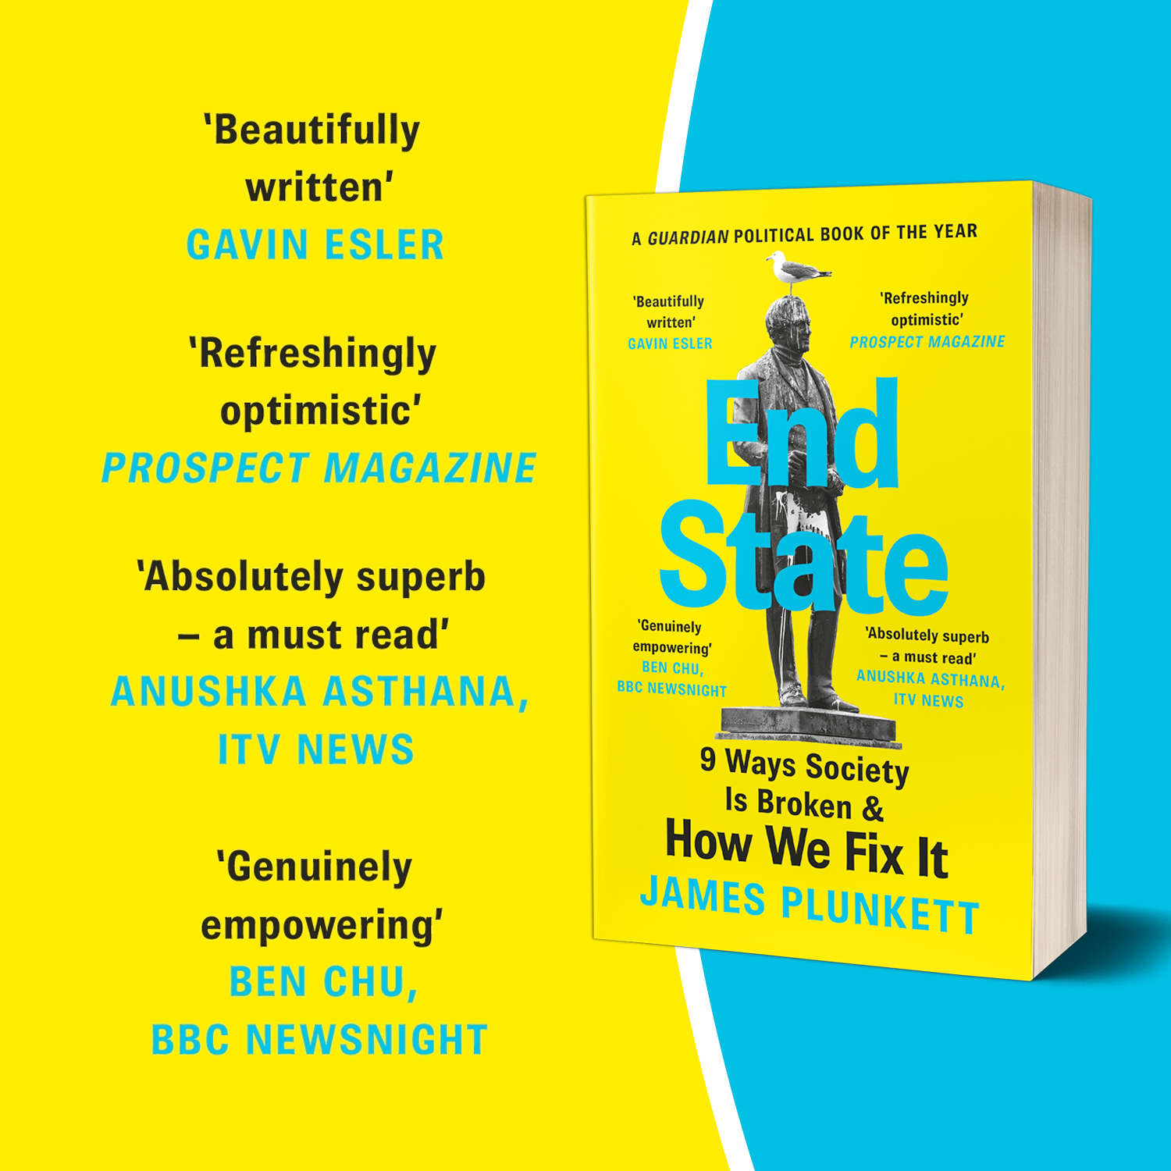
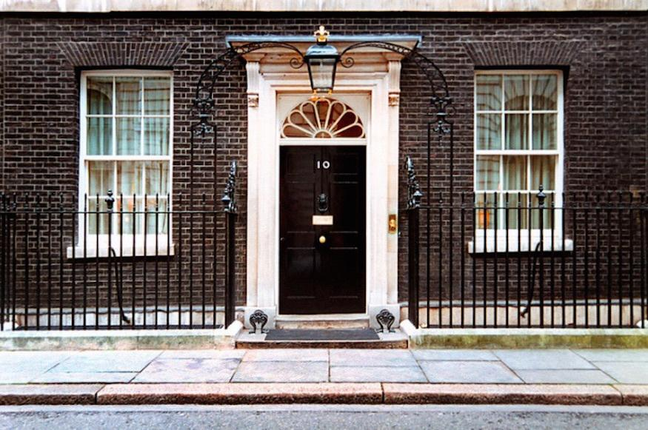



Why did I write it?
Notes:
It all started here…
I was working in Number 10 in the late 2000s…
The key moment which planted the seed for the book was a meeting of Gordon Brown and Tim Berners Lee
Brown sitting there talking about big govt policy levers
Berners Lee talking in the logic of the internet - networks, nodes, platforms, openness, sharing
And it’s become over the years a metaphor for the mismatch between a twentieth century government and a twenty-first century economy

Slide 3

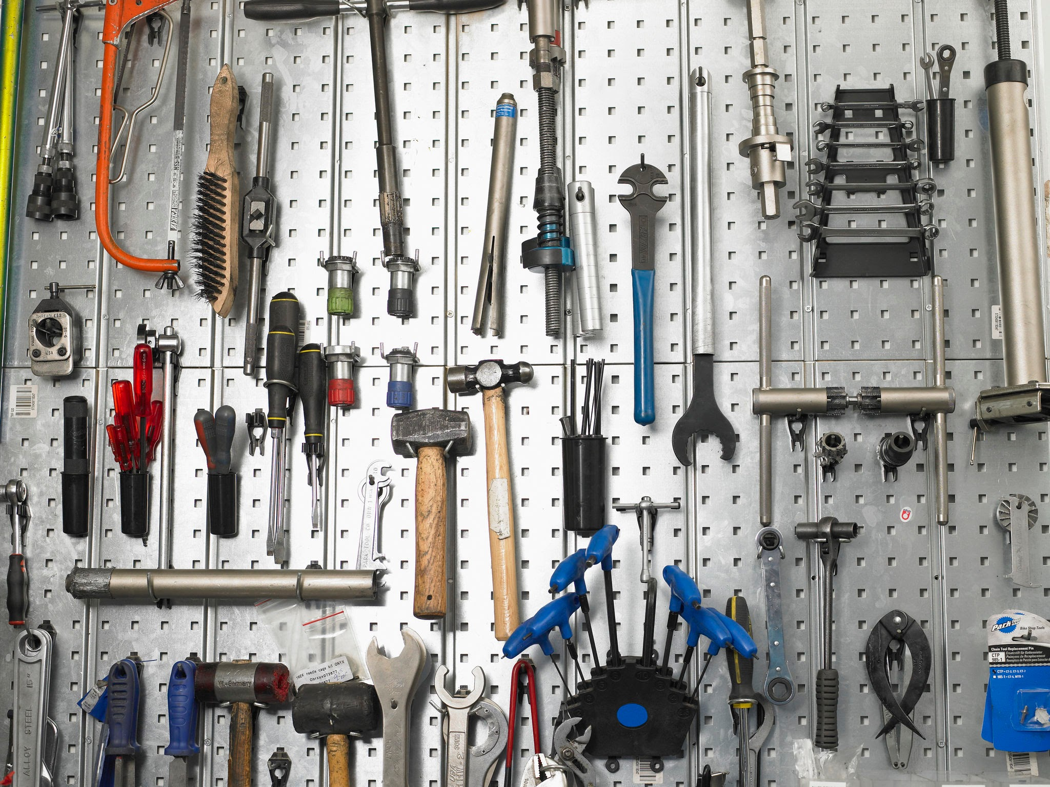

Slide 4


Slide 5
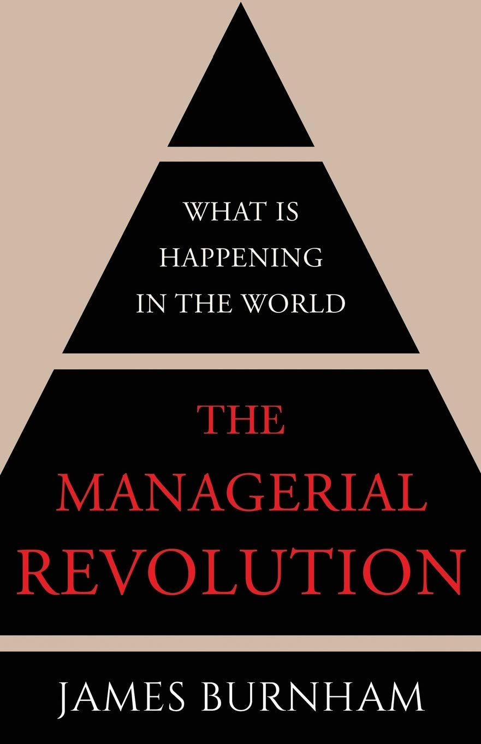

Slide 6
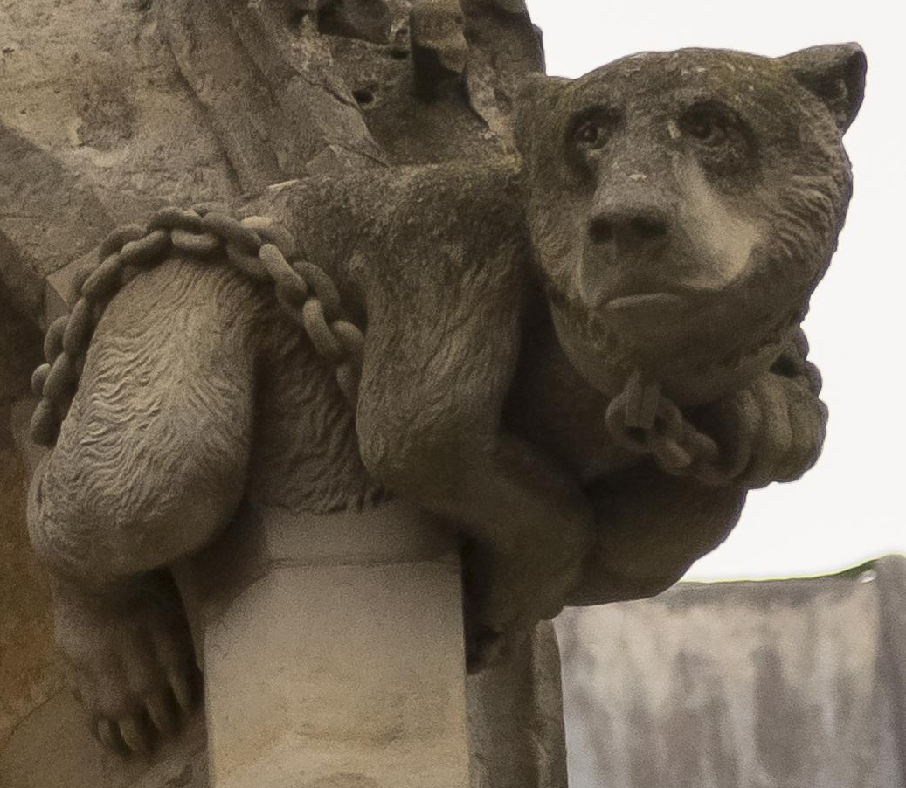

Slide 7
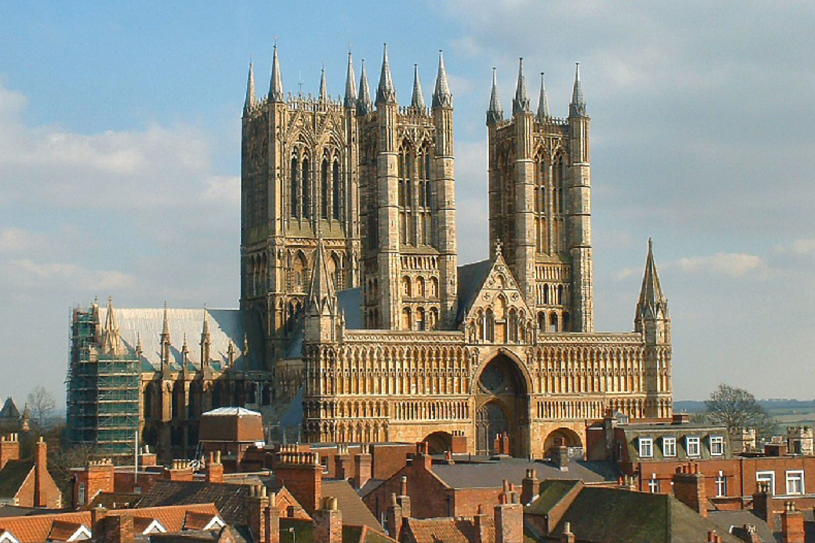

Slide 8
The demise of bureaucracy as a mode of procedure. And the rise of a human alternative

Slide 9
Chapter 1
Rise of the
machine(ry of government)

Slide 10
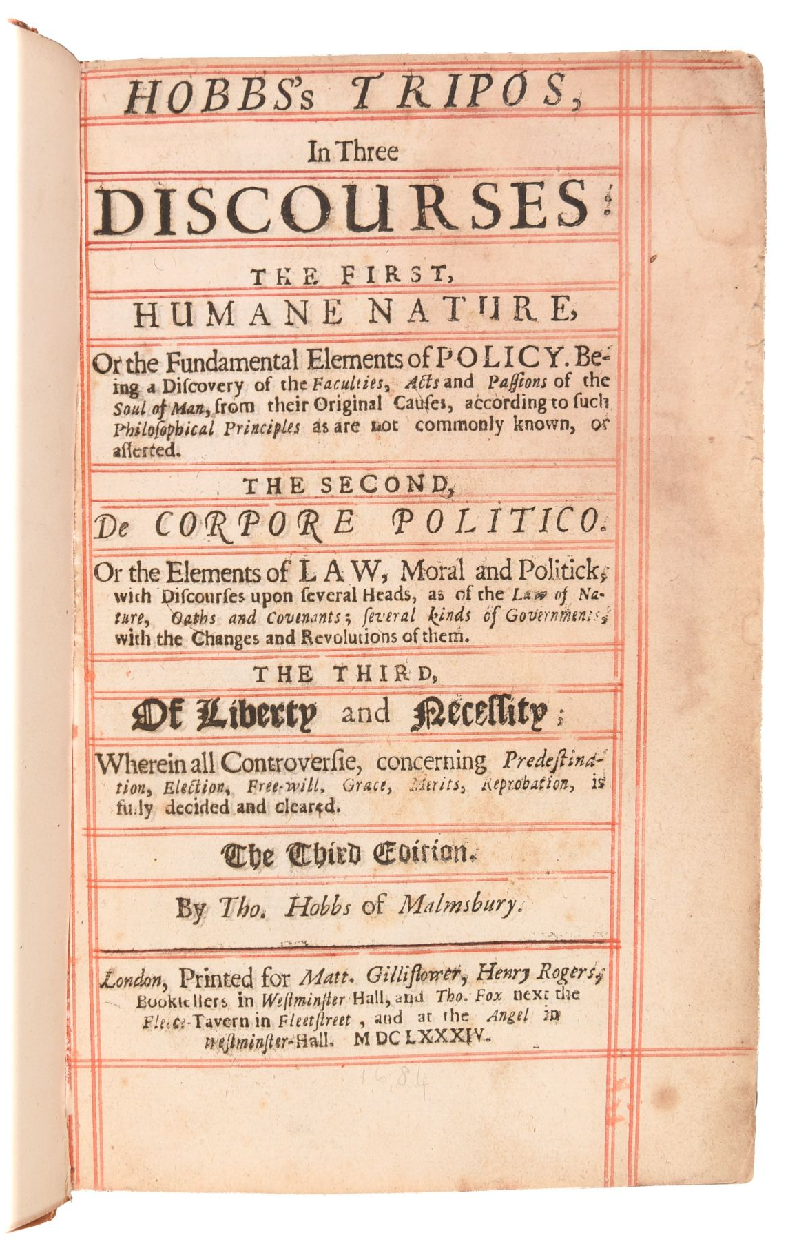
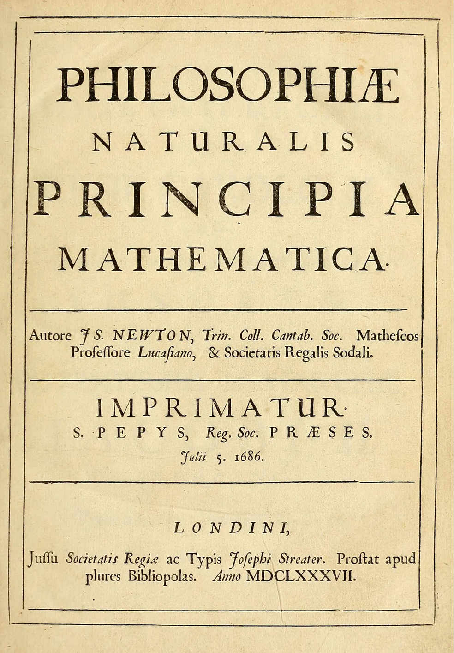
Notes:
Two examples:
Public sewers etc

Slide 11
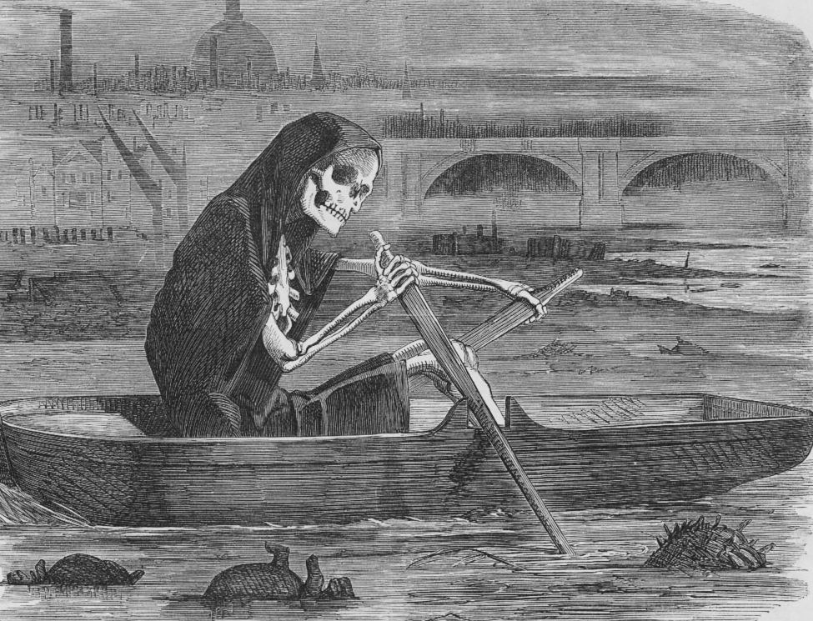
Notes:
Two examples:
Public sewers etc

Slide 12
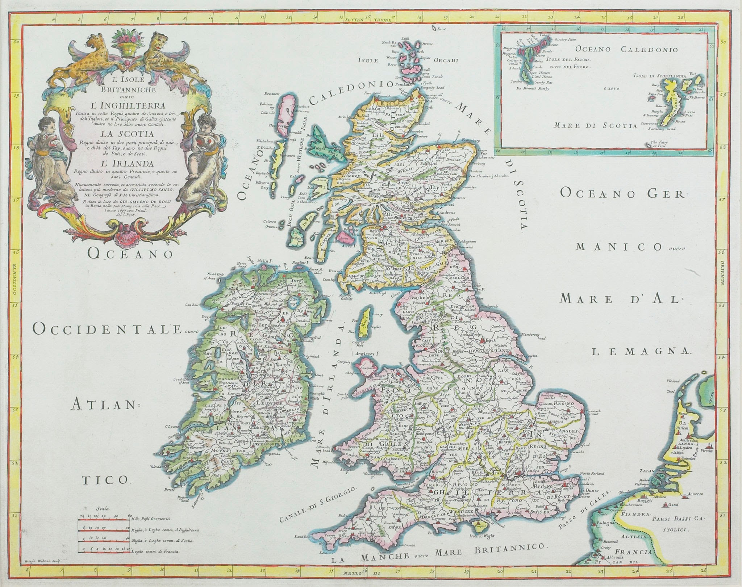
Notes:
Two examples:
Public sewers etc

Slide 13
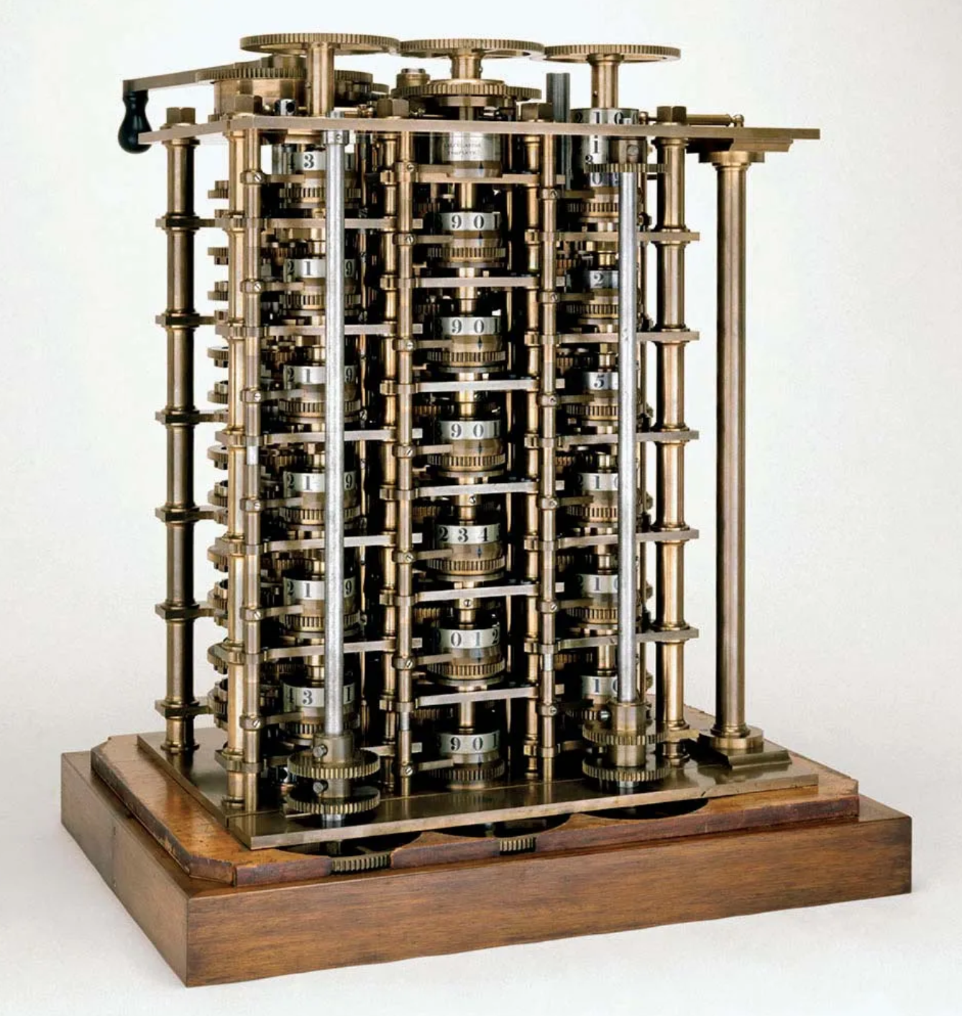

Slide 14
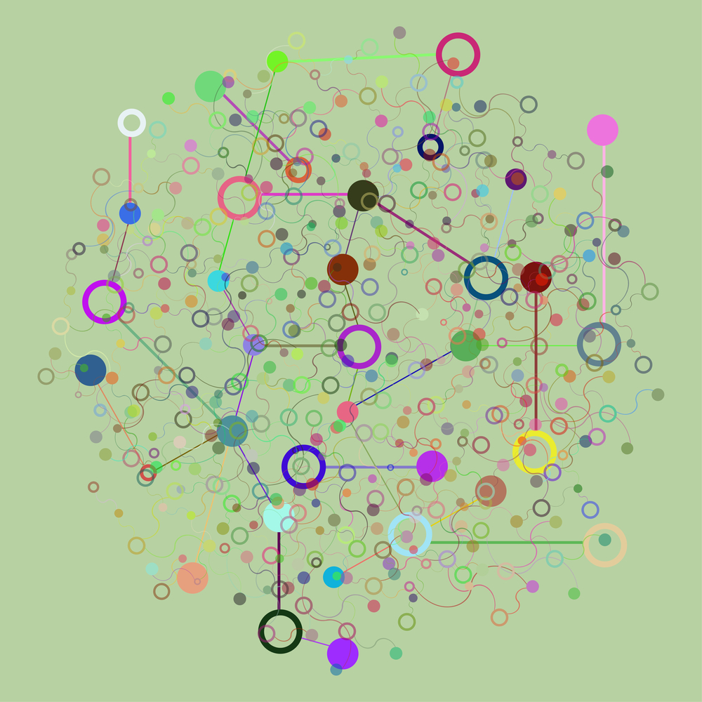

Slide 15
“Nowhere is the deep, almost exclusive faith we have in Mechanism more visible than in the Politics of this time. Considered merely as a metaphor, all this is well enough; but here, as in so many other cases, the 'foam hardens itself into a shell,' and the shadow we have wantonly evoked stands terrible before us and will not depart at our bidding.”
Thomas Carlyse, Signs of the Times (1829)

Slide 16
Chapter 2
Progress, hubris, collapse

Slide 17
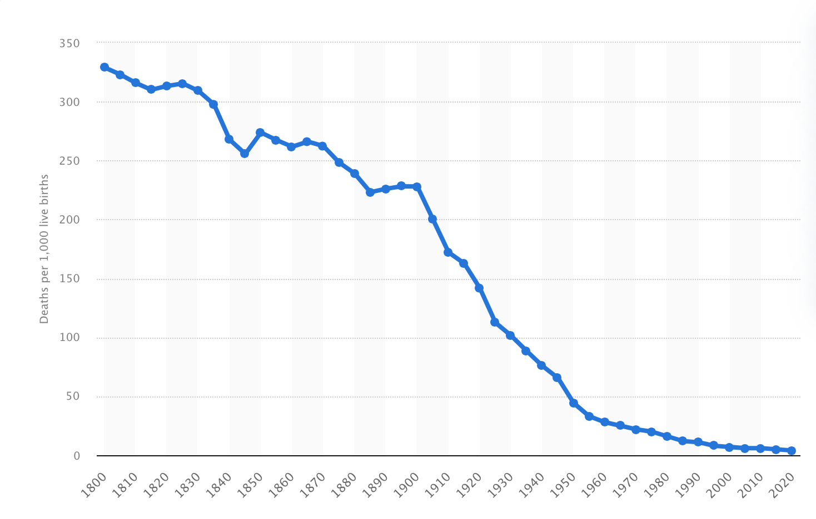
Child mortality, UK, 1800-2020
Deaths by age five per 1,000 live births
Notes:
Two examples:
Public sewers etc

Slide 18
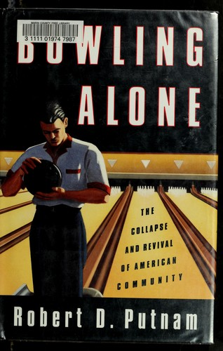
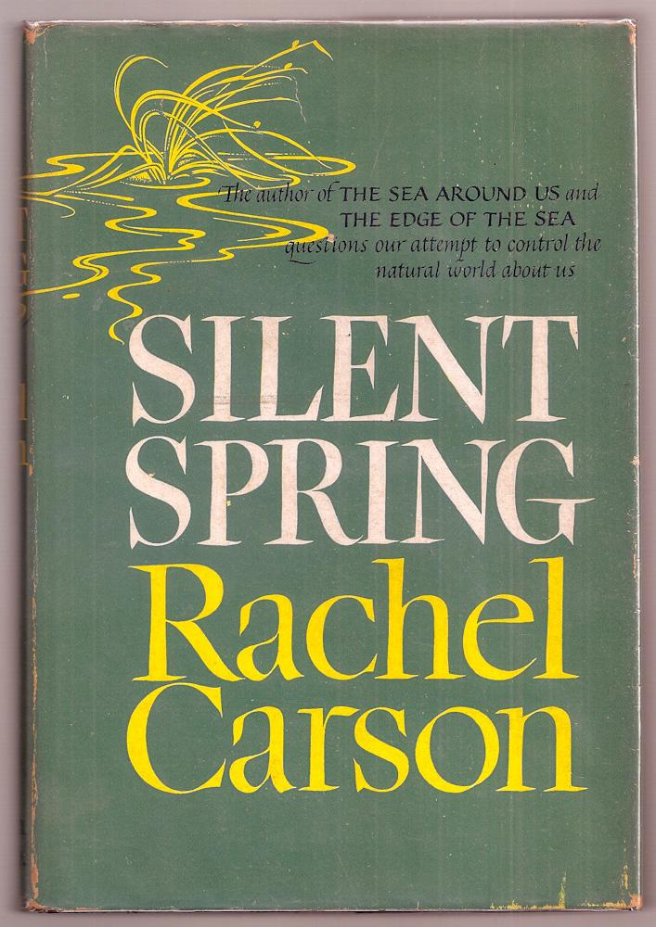

Slide 19
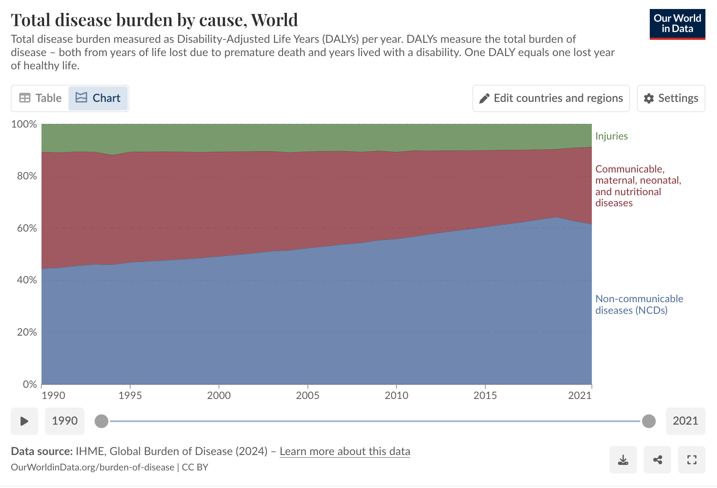

Slide 20


Slide 21
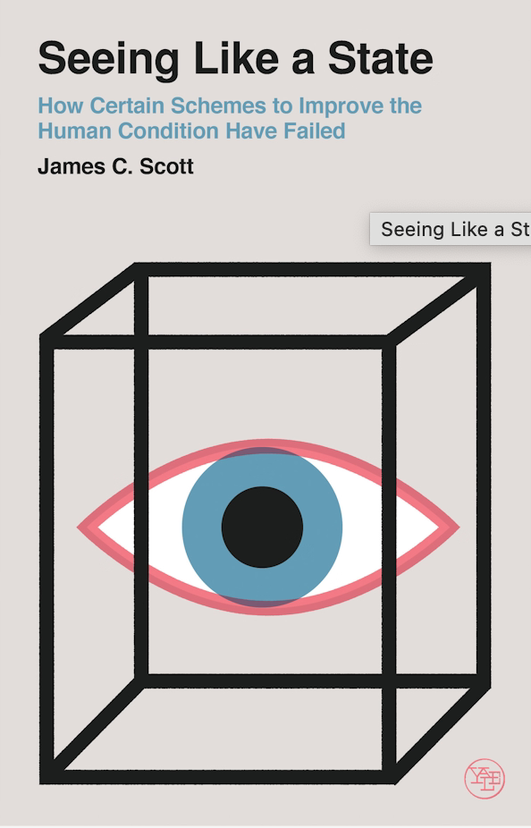

Slide 22
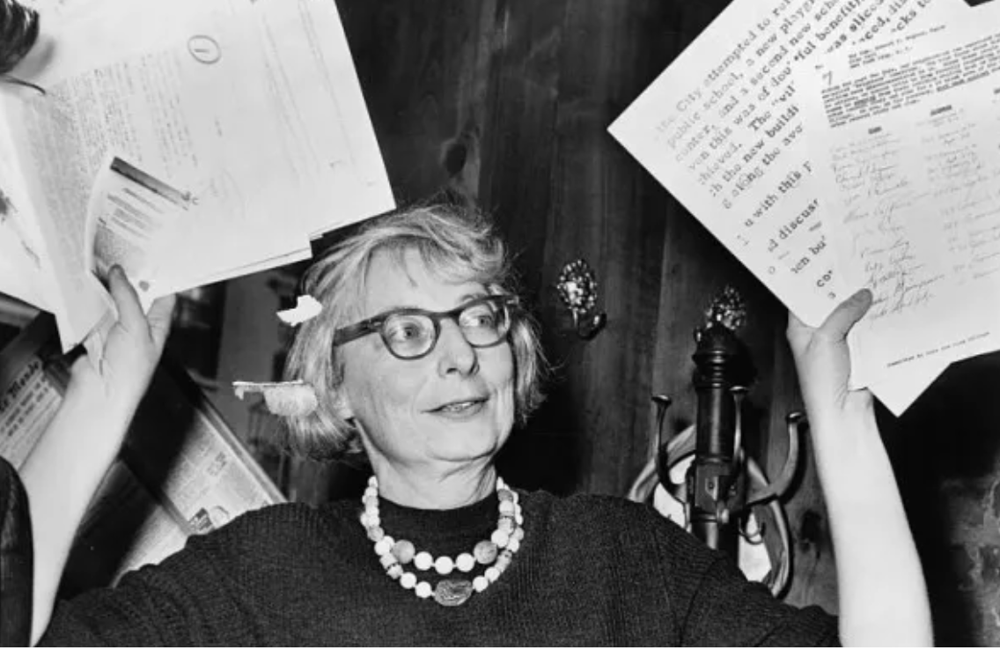

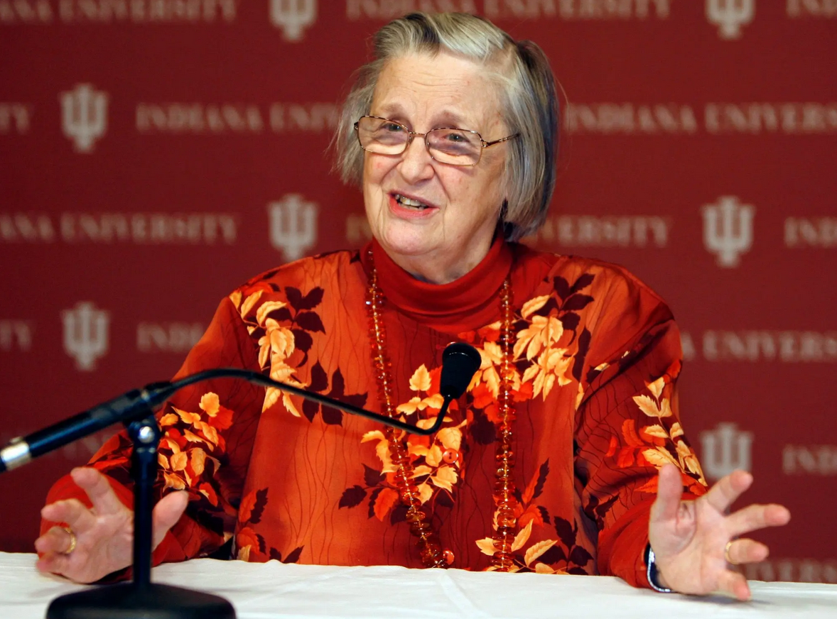

Slide 23
Chapter 3
The human alternative

Slide 24


Slide 25


Slide 26
Technocratic/transactional → Relational
Generic → Local / contextual
Standardised/impersonal → Personal
Efficient (but not really) → Purposeful

Slide 27
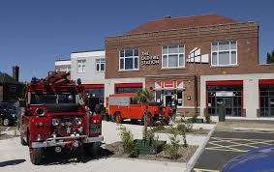

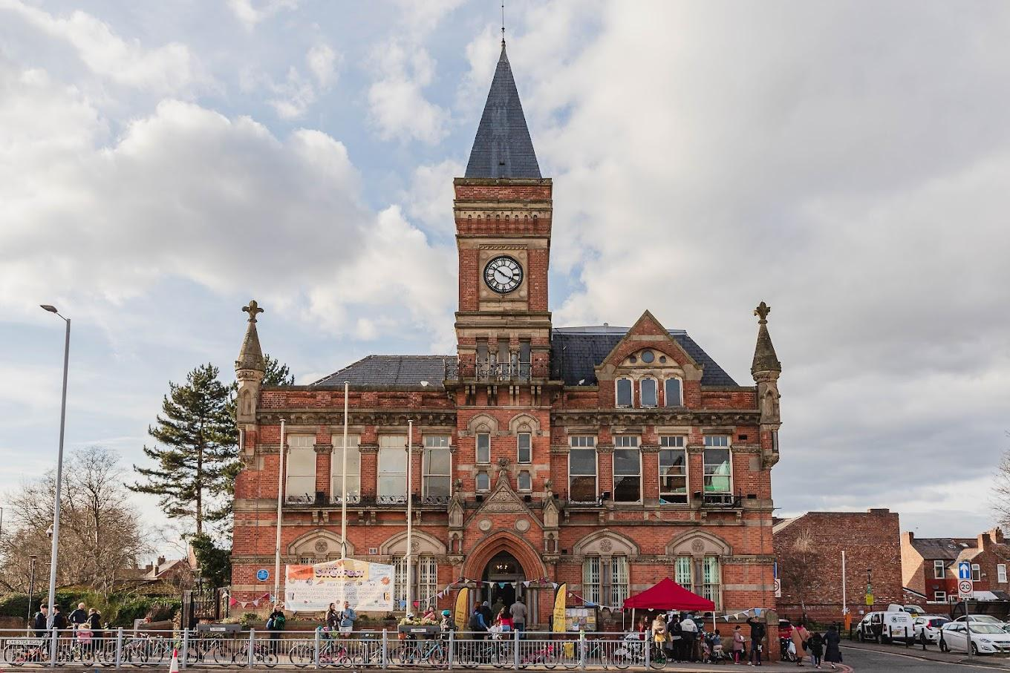


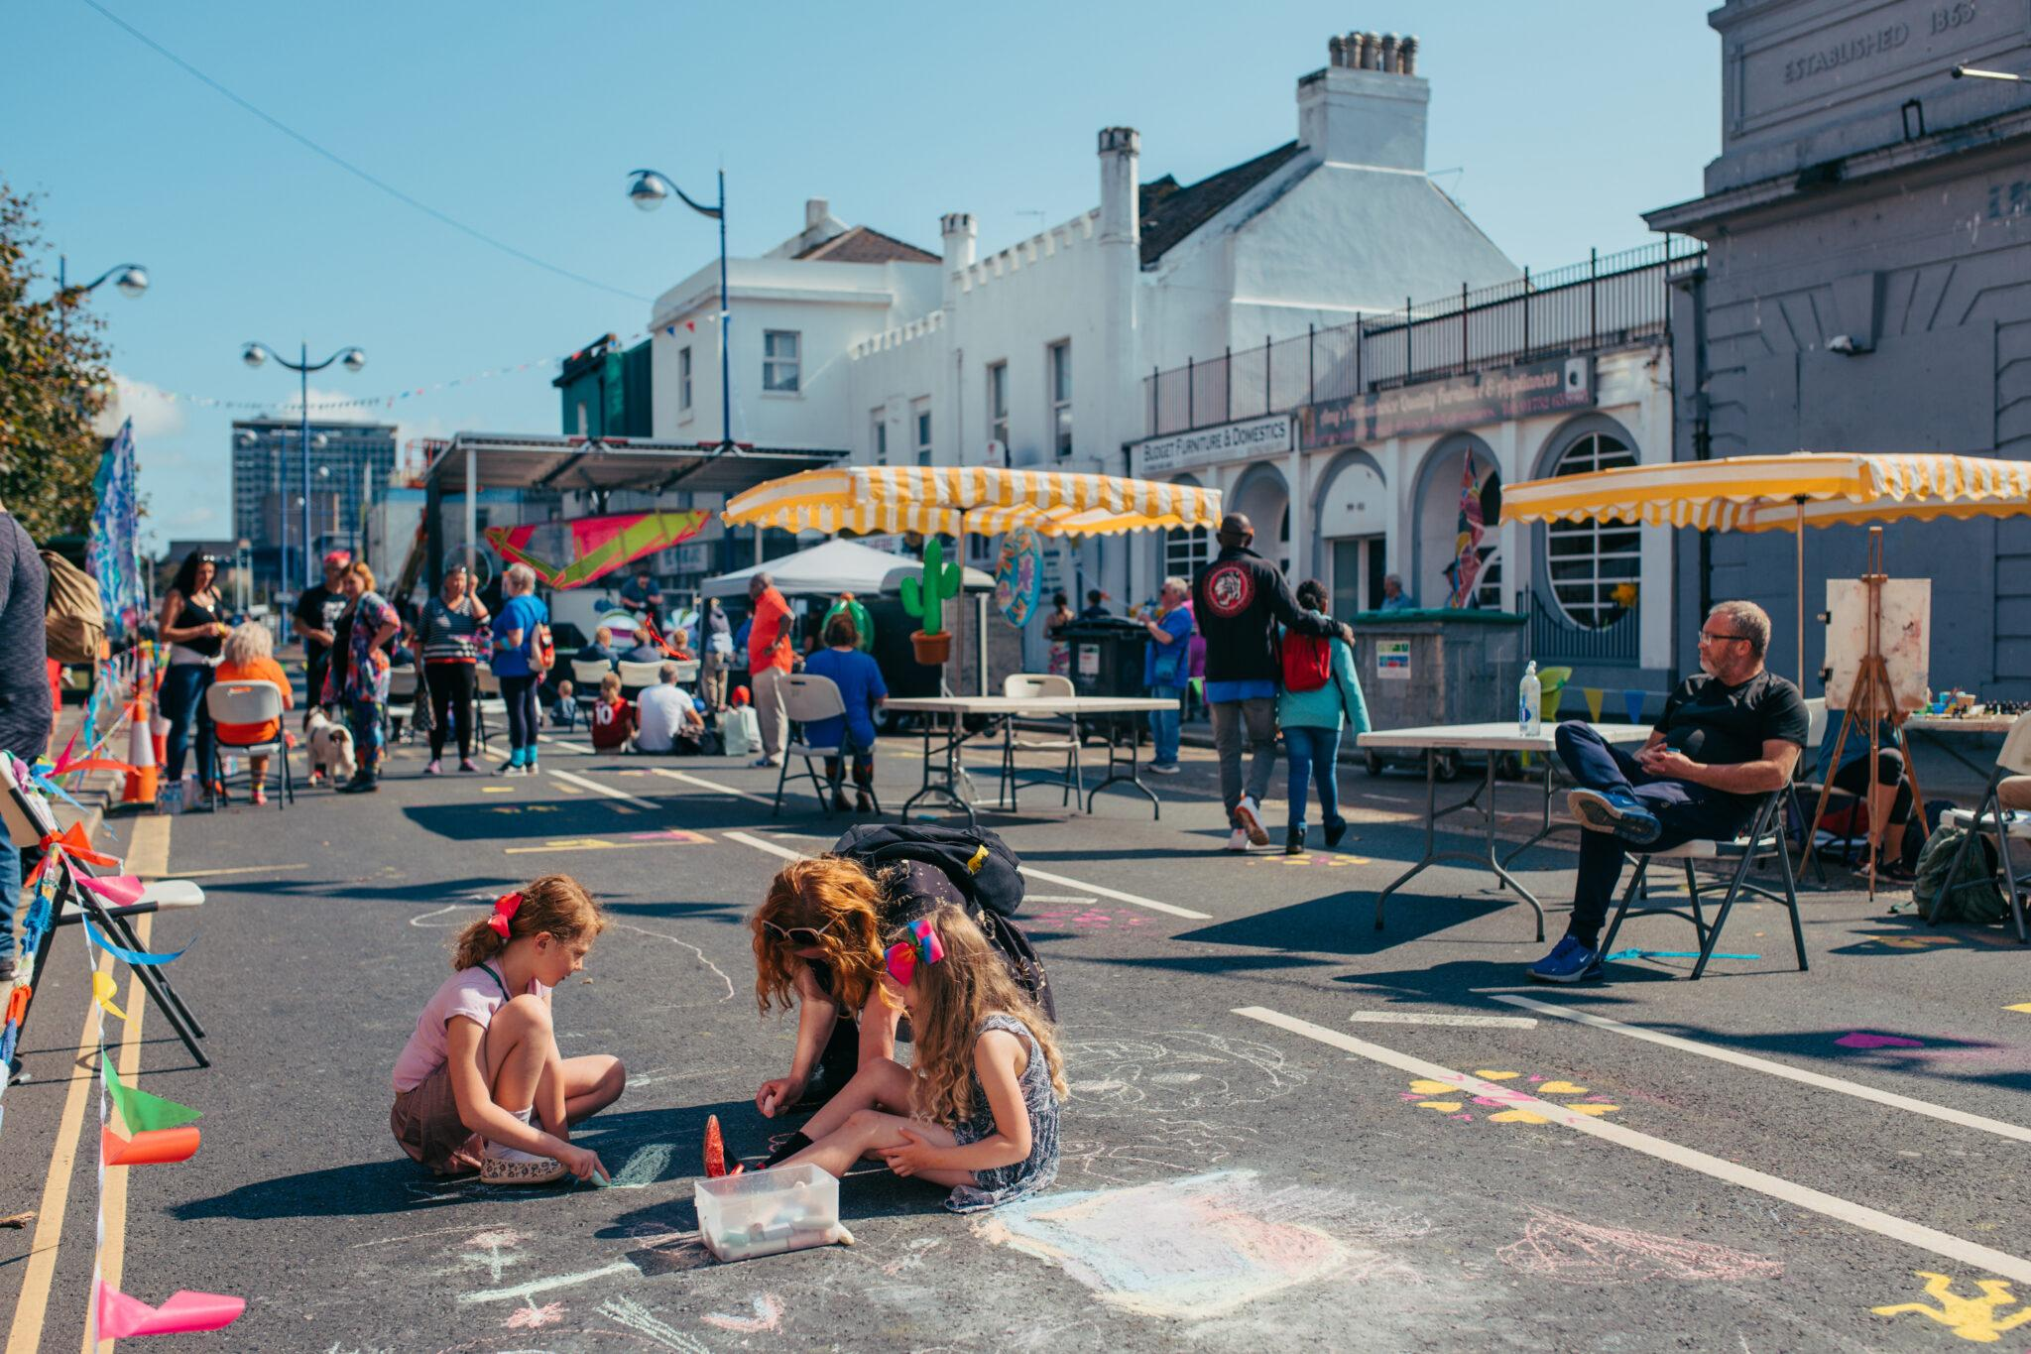
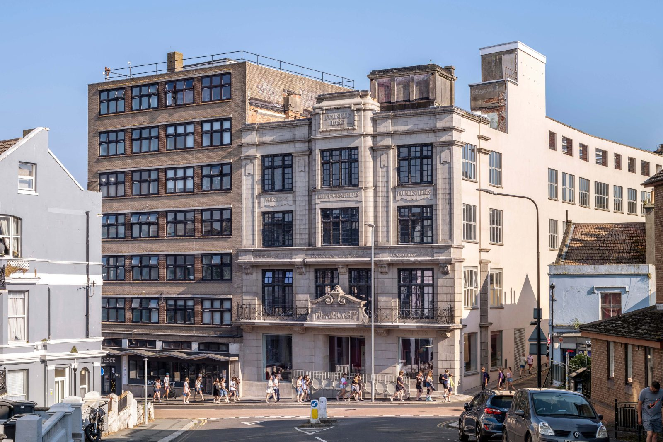





Slide 28
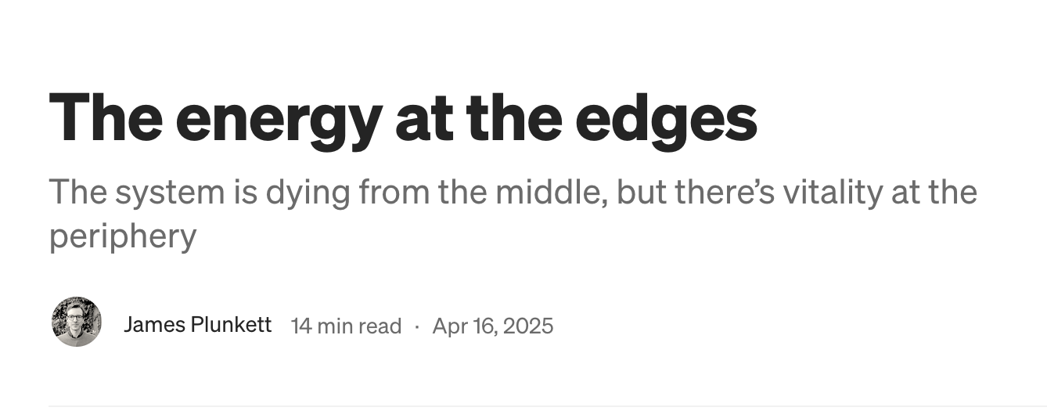

Slide 29
Conclusion
What is the work?

Slide 31
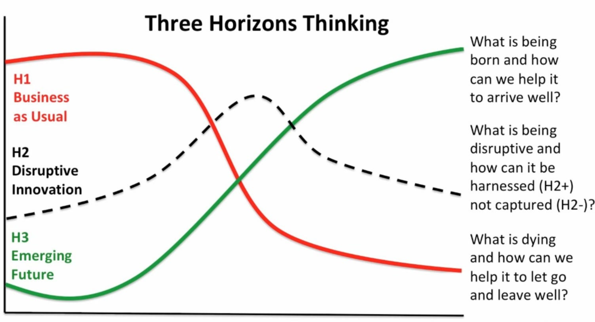

Slide 35
Technocratic/transactional → Relational
Generic → Local / contextual
Standardised/impersonal → Personal
Efficient (but not really) → Purposeful

Slide 36
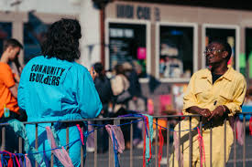

Slide 37


